Slide 1

NIMAS File Creation:
Metadata Best Practices
Nicole Gaines, NIMAC Project Director
ngaines@aph.org
Liz Schaller, NIMAC Director
eschaller@aph.org
August 2026

Slide 2
Today’s Presentation
Creating NIMAS: Key Resources
NIMAS Metadata: PDF and OPF
Supplying NIMAS Metadata
Metadata Best Practices
Final Hints and Additional Resources

Slide 3
Learning Objectives
Understand the key resources to consult in the creation of complete and accurate NIMAS metadata
Understand how to use the Excel to OPF tool
Reinforce NIMAS metadata best practices

Slide 4
Mark your calendar!
How to Assist Your Customers Looking for Accessible Formats (Webinar 4)
  For guidance on how to assist customers in locating accessible formats, please join us:
    Wednesday, August 12, at 2pm ET

Slide 5
Preparing NIMAS Files:
Key Resources

Slide 6
Resources for Producing NIMAS
The three essential resources for preparing NIMAS are:
  The NIMAS 1.1 Specification
  The DAISY Structure Guidelines (DSG)
  NIMAC Metadata Guidelines

Slide 7
NIMAC Metadata Guidelines
These guidelines were developed by the NIMAC, based on the requirements of the NIMAS technical specification and best practices for materials cataloging and discoverability.
The Guidelines document begins with a metadata overview, including a sample OPF, followed by detailed entries with examples for each metadata field.
The guidelines also include the complete NIMAC Subject list.
In addition to being available as a downloadable resource, the Guidelines can also be accessed directly on the NIMAC website.

Slide 8
NIMAS Metadata:
OPF and PDF

Slide 9
The PDF
The PDF included in the NIMAS file set is for file review and cataloging purposes only.
The PDF always includes the title page and copyright page – and should also include the covers, when needed.
Information that must be present in the NIMAS PDF includes:
  complete title
  ISBN(s)
  publisher imprint
  copyright statement
The PDF is considered to be the authoritative source for the bibliographic metadata supplied with a NIMAS file.
If you are submitting NIMAS for digital material that does not have title or copyright pages, you will need to create a PDF for the NIMAS file set. Please refer to this Guidance Document for more information.

Slide 10
The OPF File
All NIMAS file sets must also include an OPF that includes required <metadata>, a <manifest> of all files in the file set, and a <spine> referencing the .xml file.
The OPF contains three types of metadata:
  Required metadata supplied by the publisher
  Required metadata that is standard across all files
  Optional metadata
The bibliographic metadata supplied in the OPF should match what is shown on the PDF for the file set.

Slide 11
Required Metadata - Supplied by Publisher
Complete Title
Author(s)/editor(s)/illustrator(s) – required only if present on the book
Publisher
Identifier (ISBN used as unique identifier for file set + the letters NIMAS)
Language
ISBN(s)
Subject
Publication Year
Copyright Year
Numerical edition – required only if present on the book
Grade level(s) (see pick list)
State or National edition (see pick list)
Content Type (see pick list)
Series – only if applicable to the book

Slide 12
Required Metadata – Default or Supplied by Vendor
Format (will always be NIMAS 1.1)
NIMAS File Creation Date (supplied by vendor)
Rights (default statement provided below)
  <dc:Rights>The only legal and authorized use of these files is for the production of alternate media materials for blind, visually impaired, or print disabled students as specified in the NIMAC limitation of use agreement. The copyright for these files is the sole property of the original owner. </dc:Rights>

Slide 13
Optional Metadata
Source book pagination
Publisher Note (see detailed section in guidelines for further explanation)

Slide 14
Supplying NIMAS Metadata

Slide 15
NIMAC Search
The NIMAC system extracts the OPF metadata submitted with the file set to create the searchable records that are available to users.
While the NIMAC online search interface is flexible, reliable, and speedy, it is not a Google search that will retrieve similar records if there is no match.
Metadata accuracy and completeness are essential for ensuring that your materials can be found by users when braille or another format needs to be produced for a student.

Slide 16
OPF Metadata and File Submission
Not including required metadata can cause file validation or the metadata extraction to fail and prevent the upload of the file.
This is the case whether you manually upload the file or deliver it by FTP.
Checking to ensure that all required metadata are present and correct will help ensure your upload is successful.
However, successful upload does not necessarily mean all metadata is complete or correct – files undergo a metadata review as a part of the file certification process.

Slide 17
NIMAC Metadata Review
When reviewing the file metadata, the NIMAC checks the OPF metadata against the cover, title page and copyright page PDF that was supplied in the NIMAS file set.
Using established practices for professional library cataloging, we check to ensure the metadata supplied matches the book—and that the XML file also reflects this same information.
Even if a publisher uses different metadata internally to track items (such as an abbreviated title), the printed book is the authoritative source for NIMAS metadata.

Slide 18
Metadata Corrections
NIMAC staff routinely make minor metadata corrections at the point of file review so files can be certified.
These corrections are automatically saved to the OPF file as well as to the system record.
However, we may require that metadata be corrected by the vendor if multiple errors are present or an error is present across a large number of files.

Slide 19
Metadata Queries
We welcome metadata queries and are happy to provide guidance related to individual titles or programs.
Just email us at nimac@aph.org.
We can review your cover/title page/copyright page PDF against the OPF and let you know if there are any issues or questions.
This process can be especially useful for creating an OPF template for different components of a new program to ensure that metadata is handled consistently across all files.

Slide 20
Excel to OPF Tool
As mentioned in the first session of this two-part series, the NIMAC offers a free tool within the system for generating correctly tagged and formatted OPF metadata.
We encourage you to explore this option, especially if you are preparing a very large program for delivery.

Slide 21
Using the Excel to OPF Tool
To use this tool:
  Download the metadata template from the Resources tab of your NIMAC account.
  Fill in one line of the sheet for each OPF you need.
  Upload it using the “Transform Excel to OPF” menu option.
The system will immediately email you a zip file that includes a “starter” OPF for every item included in the Excel sheet.
Note: The metadata template was updated in 2024. Please be sure to download (and use) the newest version.

Slide 22
Completing the OPF
The “starter” OPF will contain all the correctly tagged and formatted metadata, but it will not yet be complete.
You will need to add the <manifest> and <spine> portions of the OPF.
Then your file will be ready to use in the NIMAS file set!

Slide 23
Metadata Best Practices

Slide 24
Content Type
There are five terms used to describe the content supplied to the NIMAC.
Choose the option that best describes the content of the book:
  Textbook – Used for student books that provide core instructional content.
  Consumable – Used for workbooks, lab manuals, and practice books that are intended to be used only once and then discarded.
  Supplementary reading material – Used for stand-alone “storybooks.”
  Digital instructional material – Used for material that is distributed to students in a digital format rather than print.
  Other – Used for materials that do not fit into another category (for example, blackline masters). Always use “Other” for file sets that include only the student-facing pages from teacher ancillaries.
Example: <meta name="DCTERMS.description.note" content="Textbook"/>

Slide 25
Copyright Date
This element reflects the copyright date of the print book.
If the copyright statement includes more than one date, use the most recent.
If no copyright date is found on the print book and the publisher has not supplied a date, please use the publication year.
Example:
<meta name="DCTERMS.date.dateCopyrighted" content="2026"/>

Slide 26
Creator
The Creator element is used to capture the authors, editors, or illustrators credited on the title page of the print book – or on the cover, if there is no title page.
Be sure to use the correct role attribute in the OPF (i.e., author, editor, or illustrator).
Enter the name as is appears on the book, but do not include academic titles or credentials – or attribution phrases.
You may include as many creators as are credited on the print book title page, but you must include at least the first three.
If no author, editor, or illustrator appears on the title page, you can leave the element empty. (This is okay!)
Please do not use the Creator element to repeat the publisher metadata.

Slide 27
Creator Examples
Example 1:
  Book shows: By Paul Smith, Ph. D. and Amy Jordan, M.A.
  Edited by Alex Andrews
  OPF:
    <dc:Creator role="author">Paul Smith</dc:Creator>
    <dc:Creator role="author">Amy Jordan</dc:Creator>
    <dc:Creator role="editor">Alex Andrews</dc:Creator>Code language:
Example 2:
  Book shows: Created by the Lawrence University Math Project
  OPF:
    <dc:Creator role="author">Lawrence University Math Project</dc:Creator>

Slide 28
Format
This element must be present in the OPF for all NIMAS file sets.
NIMAS 1.1 is the only format accepted by the NIMAC at this time.
Example:
<dc:Format>NIMAS 1.1</dc:Format>

Slide 29
Grade Level
This element can be repeated up to seven times.
If you are not sure which grade levels apply to the book, please consult with the publisher.
Please choose up to seven grades from the list below:
  Pre-Kindergarten*
  Kindergarten
  Grade 1
  Grade 2
  [ . . . ]
  Grade 12
*The NIMAC does not ordinarily serve PreK students but occasionally receives these materials.
Example:
Grade metadata for a high school Algebra textbook
<meta name="DCTERMS.audience.educationLevel" content="Grade 9" />
<meta name="DCTERMS.audience.educationLevel" content="Grade 10" />
<meta name="DCTERMS.audience.educationLevel" content="Grade 11" />
<meta name="DCTERMS.audience.educationLevel" content="Grade 12" />

Slide 30
Identifier
This element reflects the ISBN found on the print book followed by the letters “NIMAS”.
This element does not repeat.
If more than one ISBN is found on the print book, use the first 13-digit ISBN found.
The Identifier must also be used as the zip file name for NIMAS file sets and as the file name for the XML, PDF, and OPF of the file set.
Example:
<dc:Identifier scheme="NIMAS">9782222156542NIMAS</dc:Identifier>

Slide 31
Language
Use the two-letter language code as found in ISO 639-1:
  http://www.loc.gov/standards/iso639-2/php/code_list.php
Up to two terms may be included.
Please use a separate OPF element for each language.

Slide 32
Language Examples
Examples
1. Allez, viens! Beginning French, Level 1
<dc:Language>fr</dc:Language>
<dc:Language>en</dc:Language>
2. Introduction to World Geography
<dc:Language>en</dc:Language>
3. Matemáticas, Curso 1
<dc:Language>es</dc:Language>

Slide 33
MathML
There is not a NIMAS OPF element for capturing whether the XML file contains MathML tagging.
However, if a file contains MathML, the NIMAC system will detect this upon upload and automatically add this information to the searchable record.
Please do not manually add MathML metadata to the system record.
If the system has not supplied MathML metadata upon upload, this means that MathML was not detected by the system during the file validation process.
Please contact the NIMAC if you have any questions.

Slide 34
NIMAS File Creation Date
Enter the date that the NIMAS file set was prepared by the conversion vendor.
Please use only the format YYYY-MM-DD.
If you create a revised file set to replace a file that has already been certified by the NIMAC, please be sure to update the NIMAS File Creation Date to reflect the date that the revised file set was prepared.
Example:
<dc:Date event="DCTERMS.created">2025-12-15</dc:Date>

Slide 35
Numerical Edition
This element should be used whenever a numerical edition statement is present on the print book.
If no statement is present, please leave the tag empty.
Please use this format: 2nd ed., 3rd ed., 4th ed., etc.
Please do not include “1st ed.” in the metadata unless this designation appears on the print book.
Any additional non-numerical edition information (except for state edition) should be included in the Publisher Note field.

Slide 36
Numerical Edition Examples
Example 1
Title page shows: American History, Third Edition
<meta name="nimas-SourceEdition" content="3rd ed."/>
Example 2
Title page shows: Geography, 4th edition, Fully Revised and Expanded
<meta name="nimas-SourceEdition" content="4th ed."/>
<meta name="DCTERMS.description.note" content="Fully Revised and Expanded."/>

Slide 37
Publisher
Reflects the publisher imprint(s) shown on the title page of the print book.
This field does not repeat.
If two imprints (or publisher logos) are found on the print book, the publisher metadata should capture both, separated by a slash.
To prevent the inadvertent upload of files to the wrong publisher inventory, imprints must be associated with an account for a file to successfully upload.
Please reach out the NIMAC if you need to have an imprint added to a publisher’s account. (Note: if you are manually uploading a file and the imprint you need is not found in the pick list, please reach out.)

Slide 38
Publisher Examples
Example 1 (one imprint)
<dc:Publisher>Houghton Mifflin Harcourt</dc:Publisher>
Example 2 (two imprints)
<dc:Publisher>National Geographic Learning/Cengage Learning</dc:Publisher>

Slide 39
Publisher Notes - Optional
This element is generally optional.
It can be used by the publisher to supply additional information related to the title, such as a short description or a publisher catalog number.
Please do not use this element to repeat metadata that has already been supplied elsewhere in the metadata.
It is fine to leave this element empty if no note is applicable or desired.

Slide 40
Publisher Notes - Required
There are a few situations in which a Publisher Note is required:
When a non-numerical edition statement is found on the title page, it should be captured using this element.
If a new printing or updated file set is submitted after a file has been available in certified inventory for a year or more, a “supersedes” note should be supplied that references the reason for resubmission.
When a file is submitted that includes only the student-facing pages from a teacher ancillary, a note indicating that the file set is partial should be supplied.

Slide 41
Publisher Notes – Required – Partial File Sets
NIMAS files submitted to the NIMAC are required to include the complete contents of the printed book.
The only exception to this rule relates to ancillary materials that are published primarily for the use of the teacher.
The NIMAC can only accept the pages from these ancillaries that are distributed directly to the student.
If you are submitting a NIMAS file for this type of material, a note indicating that it is a partial file set is required.
In addition, the Content Type for these materials should always be captured as “Other.”

Slide 42
Publisher Notes - Examples
Example 1: Non-numerical edition information
<meta name="DCTERMS.description.note" content="Custom Edition for Jefferson County Public Schools."/>
Example 2: Supersedes note
<meta name="DCTERMS.description.note" content="This file supersedes the file set submitted on 2022-01-31. File is resubmitted to reflect an updated printing and include MathML tagging. "/>
Example 3: Partial file set
<meta name="DCTERMS.description.note" content="This file is INCOMPLETE. It contains only the pages distributed directly to
students."/>

Slide 43
Rights
The default Rights statement below must be present in the OPF for all NIMAS files.
This element does not repeat.
Publishers are welcome to append additional rights information after the default Rights statement, but this must appear in the same tags and following the default statement.
Please note that the default statement must appear exactly as it shows below or else the system will identify it as a supplementary Rights statement and supply the default statement to your files (creating a duplicate statement)
<dc:Rights>The only legal and authorized use of these files is for the production of alternate media materials for blind, visually impaired, or print disabled students as specified in the NIMAC limitation of use agreement. The copyright for these files is the sole property of the original owner.</dc:Rights>

Slide 44
Series
This field is used to provide a collective title that applies to a subset – or all – the books published in a program or curriculum.
Up to two Series elements can be used (if two Series apply).
If no series applies, please leave this element out.
Do not use this element to repeat the individual book title.
Example 1
<meta name="DCTERMS.relation.isPartOf" content="Houghton Mifflin Leveled Readers"/>)
Example 2
<meta name="DCTERMS.relation.isPartOf" content="FOSS Full Option Science System, Next Generation"/>

Slide 45
Source Book ISBN(s)
Please include all the ISBNs found on the print book that refer to the edition provided in the NIMAS file set.
This element may be repeated as many times as needed.
Do not include in the metadata ISBNs for editions that are NOT identical to the content of the NIMAS file set, such as the ISBN for the teacher’s edition.
Examples
<dc:Source>9780618224561</dc:Source>
<dc:Source>0618224563</dc:Source>

Slide 46
ISBNs for Identical Content
ISBNs for other print editions that contain the identical content may also be included in the metadata using the Source element, even if these ISBNs do not appear on the print book.
This information can be valuable to NIMAC users.
If you are adding an ISBN to the metadata that does not appear on the book used to produce the NIMAS file set, please include a Publisher Note to explain.
Example
<meta name="DCTERMS.description.note" content=” ISBN 9789232958473 is for the hard cover edition. Content is identical."/>

Slide 47
Source Book Pagination
This element provides the pagination information of the print book.
This element is OPTIONAL.
Enter the last page number for each numbered section of the book, separated by commas, and followed by “p.”
Disregard unnumbered pages.
Please do not provide the total number of physical pages.
Examples
<meta name="DCTERMS.format.extent" content="xvi, 1024 p."/>
<meta name="DCTERMS.format.extent" content="xi, 356, N24, R12 p."/>

Slide 48
State/National Edition
This field reflects whether the book is customized for use by students in one U.S. state only, or the book is distributed nationwide.
State editions generally include the name of the state in the title, an edition statement, and/or a graphic representing the state on the printed book.
If a state edition is not indicated on the print book, please assume it is a National edition and enter “National ed.”
For state editions, please use the US postal code abbreviation (http://www.stateabbreviations.us/) followed by “ed.”
Please reach out to the publisher or the NIMAC if you are unsure how to capture this metadata for a specific book.

Slide 49
State/National Edition - Examples
Examples
Title: myWorld Interactive: Kentucky World History, Growth and Expansion of Civilization
<meta name="DCTERMS.description.version" content=“KY ed."/>
Title: Geography Alive! Regions and People
<meta name="DCTERMS.description.version" content="National ed."/>

Slide 50
Subject
This field reflects the subject area(s) of the textbook.
One subject must be supplied, but up to three may be provided.
Repeat the element in the OPF as needed.
Please use only terms from the NIMAC subject list as these terms are the ones available to NIMAC users for searching.
Note: If a general or more specific term is possible, choose the more specific term. (For example, use “Algebra” rather than “Mathematics” for an algebra textbook.)
Supplementary reading materials should always include “Reading” as a subject.

Slide 51
Subject - Examples
Examples
Title: Prentice Hall Middle School Math
<dc:Subject>Mathematics</dc:Subject>
Title: Discovering Geometry: An Investigative Approach
<dc:Subject>Geometry</dc:Subject>
Title: Badger Learns to Ride a Bike
<dc:Subject>Reading</dc:Subject>

Slide 52
Text Publication Year
This element is used for the year that the specific edition/ISBN was first published.
This date may or may not be the same as the copyright year or the printing date.
If a publication date statement does not appear on the print book, please check with the publisher or the NIMAC for assistance.
Special note: Due to a quirk in the NIMAS specification, publication year must be captured in the OPF twice using both the elements below.
Example:
<meta name="DCTERMS.date.issued" content="2025"/>
<meta name="nimas-SourceDate" content="2025"/>

Slide 53

Title
The title metadata should capture the complete title as found on the title page – or on the covers.
Titles for instructional materials can include many elements.
Don’t hesitate to reach out to the NIMAC for assistance if you are unsure how to best organize and format the title metadata or <doctitle>.
Example:
<dc:Title>Bridges in Mathematics, Grade 5, Home Connections</dc:Title>

Slide 54

Providing the Complete Title
In some cases, a book that contains a title page may still only show the complete title on the cover.
It’s essential that all elements of the title are captured so that NIMAC users download the correct material from a program.
Example:
<dc:Title>California Math Expressions, Common Core, Grade 2, Volume 1, Homework and Remembering</dc:Title>

Slide 55

Title & Grade
If the grade does not appear on the title page, it is generally not included in the title metadata.
However, if the grade level does not show on the print book, but it is needed in the title to distinguish between otherwise identical titles, please include it in brackets.
Example:
<dc:Title>McGraw-Hill Reading Wonders [Grade 4]</dc:Title>

Slide 56

Title Capitalization
Follow English title capitalization rules, regardless of how capitalization appears on the print book.
Example:
<dc:Title>Single Variable Calculus </dc:Title>

Slide 57

Title Capitalization - Spanish
For Spanish titles, follow Spanish capitalization rules.
Generally, this means you will capitalize only the first word in the title and any proper nouns.
Example:
<dc:Title>Ven aquí, gato</dc:Title>

Slide 58
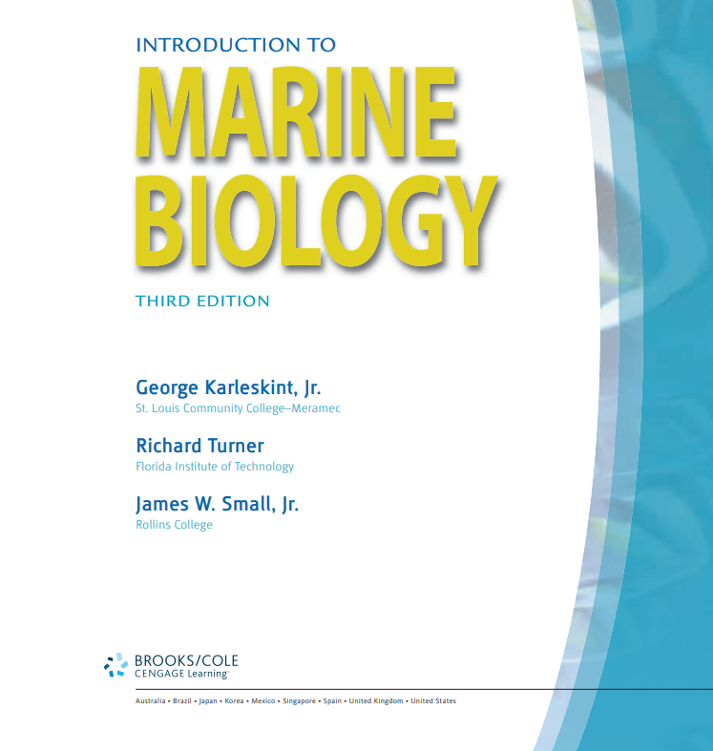
Title and Numerical Edition
Do not include numerical edition information in the title.
Please use the numerical edition element to capture this information.
Example:
<dc:Title>Introduction to Marine Biology </dc:Title>
<meta name="DCTERMS.description.version" content="3rd ed."/>

Slide 59

Title and State Edition
Only include the state name if it appears as a part of the title phrase.
State edition will generally be captured only in the designated element.
Example:
<dc:Title>Global History and Geography II </dc:Title>
<meta name="DCTERMS.description.version" content=“NY ed."/>

Slide 60

Title – State in Title
In cases where the state name is integrated into the title, it should be retained in the title metadata.
State edition will still be captured in the national/state edition element.
Example:
<dc:Title>enVision+ California Mathematics, Grade 5, Volume 2</dc:Title>
<meta name="DCTERMS.description.version" content=“CA ed."/>

Slide 61
NIMAS Metadata:
Final Reminders

Slide 62
<doctitle> and <docauthor>
In addition to the OPF metadata, <doctitle> is required in the XML.
The <doctitle> should match the <dc:Title> metadata found in the OPF.
<docauthor> is not required in the NIMAS 1.1 specification but is strongly recommended.
<docauthor> should capture the first or primary author only – this element does not repeat.
If an edit is made to the title metadata in the NIMAC system, the change will automatically save to <doctitle> in the XML.

Slide 63
Resources from the NIMAC!
The NIMAC has archived videos and downloadable PowerPoint presentations on our website that you are welcome to access at any time.
Links to the resources referenced in this presentation can be found there, as well as additional downloadable resources!
We encourage you to visit the Publishers & Conversion Houses page on our website.

Slide 64
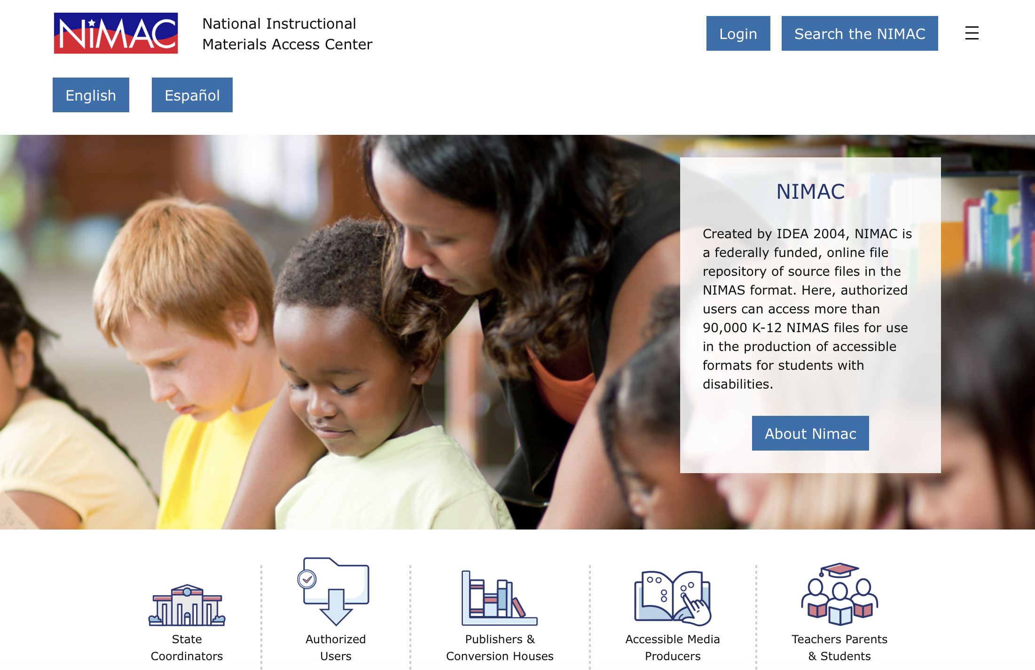
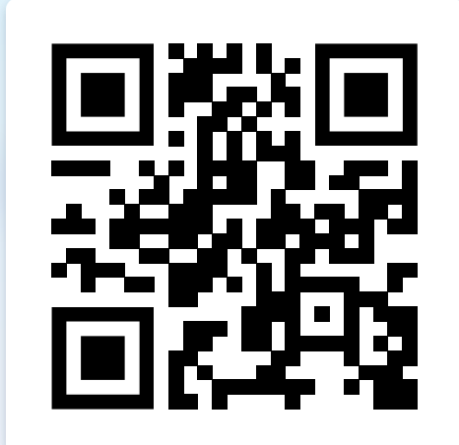
NIMAC Informational Website

Slide 65
Coming up!
How to Assist Your Customers Looking for Accessible Formats (Webinar 4)
  For guidance on how to assist customers in locating accessible formats, please join us:
    Wednesday, August 12, at 2pm ET

Slide 66


Questions?
Don’t hesitate to get in touch with us for assistance:
nimac@aph.org
877-526-4622
The contents of this resource was developed under a grant from the US Department of Education, #H327E210001. However, these contents do not necessarily represent the policy of the US Department of Education, and the reader should not assume endorsement by the Federal Government. Project Officer: Rebecca Sheffield.

Slide 67
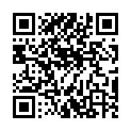
Exit Survey

