Slide 1
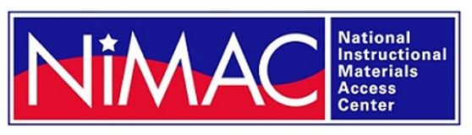
Serving Students with Disabilities: Connecting Customers with
Accessible Formats
Liz Schaller, NIMAC Director
eschaller@aph.org
Jeffrey Witt, READS Director
jwitt@aph.org
August 2026

Slide 2
Today’s Presentation
NIMAC and NIMAS
  NIMAC and NIMAS Basics
Louis
  Louis Basics & Searching
Customer Assistance
Additional Resources
Q&A!

Slide 3
NIMAC and NIMAS

Slide 4
Equal access to the curriculum
The NIMAC and the accessible materials providers we’ll refer to today help ensure that students who require accessible formats such as braille, large print, audio, or accessible digital files, receive the materials they need to participate – and succeed – in the classroom.
The NIMAC has a key role in serving students by making publisher-supplied, high-quality source files available to the individuals, agencies, and organizations that States and districts designate to create the accessible formats required by their students.
Publisher participation in the NIMAC is vital to ensuring the timely delivery of instructional materials to students with disabilities.
We thank you!

Slide 5
NIMAC Case Study on Timely Delivery
In 2025, the NIMAC worked with True North Evaluation on a case study on timely delivery of accessible formats.
The case study included national surveys and focus groups as well as more in-depth data collection from three states: Ohio, Oregon, and Utah.
The case study explored the benefits to timely delivery when files are available in the NIMAC, as well as practices that facilitate timely delivery.
The full report, which you are welcome to share with colleagues, is now available on the NIMAC website: Case Study Report (PDF) and Case Study Report (Accessible Word)

Slide 6
Benefits of Timely Delivery
(n = 312)

Slide 7
NIMAC-Related Practices that Facilitate the Timely Delivery of Accessible Formats

Slide 8
The NIMAC
The National Instructional Materials Access Center (NIMAC) was created by IDEA 2004 to serve as the source file repository for K-12 textbooks and core instructional materials.
States and districts that choose to work with the NIMAC require publishers to send files to the NIMAC as a part of instructional materials procurement (e.g., through adoption contracts).
These files are downloaded by accessible media producers – as designated by the states – to produce braille, large print, digital text, and other accessible formats.
The goal of the NIMAC is to expedite accessible format production by receiving , validating, and making files available in advance of an identified need.

Slide 9
The NIMAC Today
The NIMAC has been in continuous operation since December of 2006.
To date, the repository has received over 91,000 files from more than 200 educational publishers.
NIMAC users have downloaded over 61,000 files to use in the first-time production of accessible formats.
All 50 states – and the eligible territories – have chosen to work with the NIMAC.

Slide 10
What are NIMAS files?
The National Instructional Materials Accessibility Standard (NIMAS) is the source file format that the NIMAC receives from publishers.
This format was created under IDEA 2004 and can be used to produce a range of accessible formats.
These files are not distributed directly to students as they require further conversion before they can be used in the classroom.
As such, the NIMAC does not generally work directly with individual students, teachers, and schools.
The NIMAC generally works with state or district agencies and the organizations they designate to produce accessible formats.

Slide 11
Who is eligible for NIMAS-sourced materials?
IDEA also defines the eligibility for students who can receive accessible materials produced from NIMAS files.
  Students must have both:
    A qualifying disability under the guidelines of the National Library Service for the Blind and Print Disabled (NLS); and
    An Individualized Education Plan (IEP).

Slide 12
Materials Within Scope for NIMAS
NIMAC receives a wide range of student-facing instructional materials, including:
    textbooks,
    workbooks,
    supplementary readers,
    and ancillary materials such as blackline masters.
Exempt materials include:
    teacher’s editions
    pre-2006 titles
    trade books
    college textbooks
    reference books

Slide 13
How do States and Districts work with NIMAC?
IDEA does not require that states work with the NIMAC, but all 50 states, the six eligible territories, and DoDEA have chosen to do so.
States and districts that coordinate are legally obligated to:
  require NIMAS from publishers in their textbook adoption contracts; and
  abide by the eligibility requirements of IDEA and copyright law in the use of NIMAS files.
States are also required to designate and manage a small number of Authorized Users for their state.

Slide 14
How the NIMAC Supports Students
States and districts require NIMAS in textbook contracts
Publishers create NIMAS files and send them to the NIMAC
Registered NIMAC users log in and download files
Downloaded files are used to create braille and other accessible formats
Accessible formats are distributed to qualifying students for use in the classroom

Slide 15
Once braille or another accessible format has been produced from NIMAS, can additional eligible students benefit from that format?
Yes! Once produced, accessible formats can be reproduced for distribution to other qualifying students with disabilities.
The NIMAS file is not downloaded again as a part of this reproduction.
The NIMAC encourages accessible format producers to participate in the Louis Database of Accessible Materials to prevent unnecessary duplication of effort and to allow organizations to optimize limited resources.

Slide 16
Side Note: Requests for hard-copy books
As an XML-based source file format, NIMAS files contain all the information from the book, but not necessarily the precise layout.
To proofread their work, AMPs generally require access to a physical copy of the book or a PDF.
Often, the school or district will provide them with the needed print or digital copy.
However, if the school or district has not yet received the material, or for some other reason cannot supply a copy, the AMP may reach out to you to purchase a copy of the book.
While NIMAS is the key publisher contribution that expedites accessible format production, the hard copy may be critical for completing the translation and ensuring its accuracy.

Slide 17
The Louis Database

Slide 18
What is the Louis Database of Accessible Materials?
Louis is a free service of the American Printing House for the Blind that brings together information about accessible formats from over 50 organizations in one searchable online database.
Louis contains information on over 1.7 million books in accessible formats, with a focus on K-12 instructional materials, including textbooks and recreational reading.
Formats listed in Louis include braille, large print, audio, and a range of digital text formats.
Louis also includes information about materials available from Bookshare, Learning Ally, and NIMAC.
Louis is free for both users and for participating organizations.

Slide 19
Louis Listing Agencies
Contributing agencies listing on the Louis Database must qualify as authorized entities under Section 121 of U.S. copyright law:
    "Authorized entity" means a nonprofit organization or a governmental agency that has a primary mission to provide specialized services relating to training, education, or adaptive reading or information access needs of blind or other persons with disabilities[.]
Louis agencies range from national providers to state agencies to prison braille programs.

Slide 20
Louis and Your Customers
Louis is the best place for teachers or administrators to locate accessible formats that are already available – or in the case of braille, are in the transcription pipeline – from over 50 organizations.
Louis provides contact information for each organization so that your customer can reach out directly to the provider for more information on how to acquire the needed format.
Louis is an informational database, not an ecommerce site.

Slide 21
Acquiring Accessible Formats
Costs associated with acquiring accessible formats generally depend on the format and the providing organization.
APH, for example, is federally funded to provide accessible formats and it may be possible for students to obtain these materials at no charge to the school or district.
Bookshare is also federally funded to provide accessible digital formats to qualifying students free of charge.
Customers should reach out directly to the provider located in Louis for more information related to cost, delivery timelines, etc.

Slide 22
More About the National Providers
Bookshare
  Bookshare is the world's largest accessible ebook library and makes reading easier for people with reading barriers like dyslexia, blindness, and physical disabilities. Members can read in ways that work for them, with over 1 million titles offered in audio, audio + highlighted text, braille, and other formats.
Learning Ally
  Learning Ally has been a major provider of audio formats for K-12 education for many years. They use a subscription model to serve students.
American Printing House for the Blind (APH)
  Since 1858, APH has operated in Louisville, Kentucky as the world’s largest nonprofit organization creating accessible learning experiences through educational, workplace, and independent living products and services for people who are blind and low vision. Through federal funding, APH produces much of the braille and large print used in K-12 classrooms in the U.S.

Slide 23
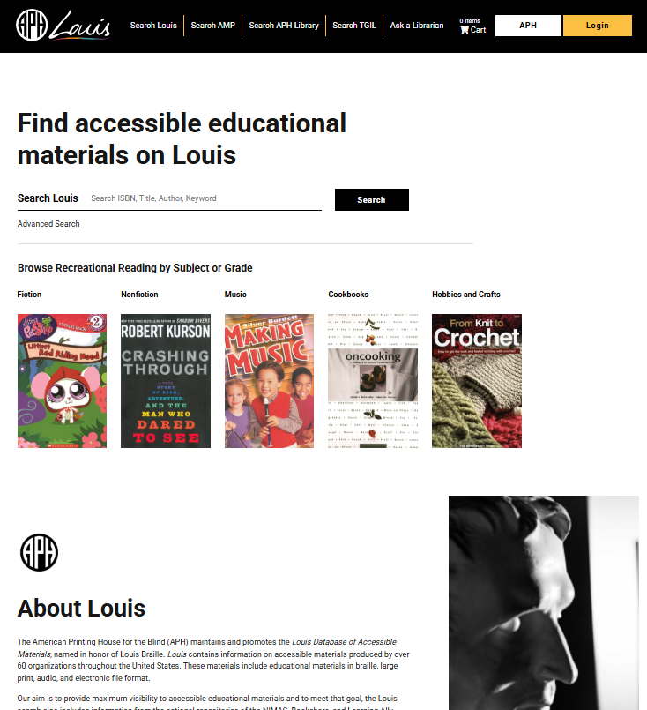
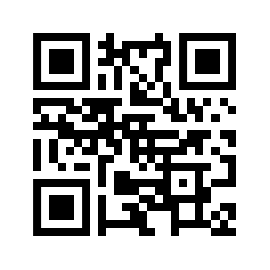
Searching Louis
ISBN searching is recommended for K-12 instructional materials.
However, the basic search function is a keyword search that includes the entire record (e.g., title, series, author).

Slide 24
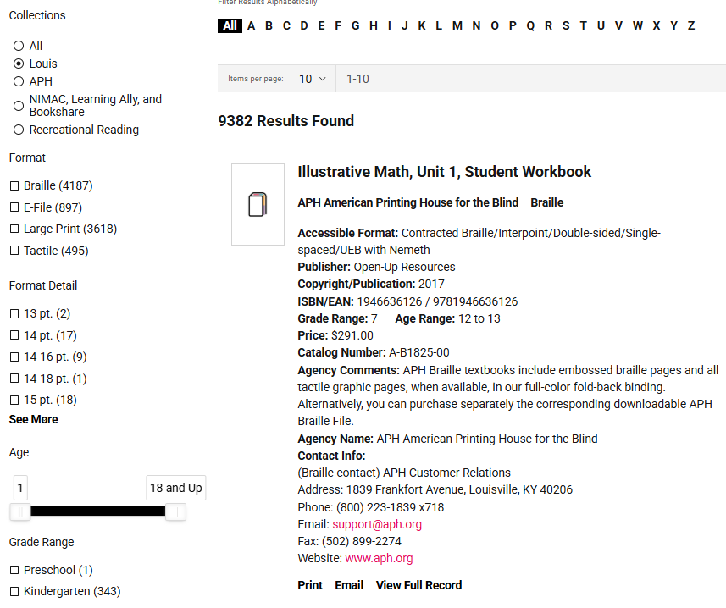
Refining Search Results
Search results can also be filtered by:
Format
Format Detail
Age
Grade Range
Language
Copyright/Publication Date

Slide 25
Louis Accessible Format Search Workflow
Is the needed accessible format in Louis?
Refer to provider details in Louis
Contact provider for hard copy braille or large print book
Check Louis for NIMAC file
Contact NIMAC State Coordinator
for further assistance
Obtain digital or audio formats directly from Bookshare or Learning Ally sites
Yes
No

Slide 26
How Long Will it Take Customers to Receive Accessible Formats?
The timeline for receiving materials can vary greatly depending on the format and whether the accessible format has already been produced or is a new order for the provider.
In the case of some accessible digital formats, students may be able to receive the materials immediately.
A new order for hard-copy braille, however, may require several months for the initial volumes to be completed – due to the time required to create tactile graphics and to emboss the material.
Customers should inquire of any provider what the timeline is for the student to receive the material.

Slide 27
Customer Assistance

Slide 28
Providing Further Assistance to Customers
In many or most cases, customers will be able to locate what they need in Louis.
In those cases, they will reach out directly to the provider(s) for more information.
If they need help in searching Louis, please have them reach out to us. We are happy to help!
resource@aph.org
502-899-2705

Slide 29
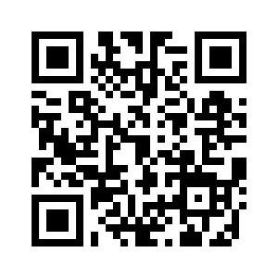
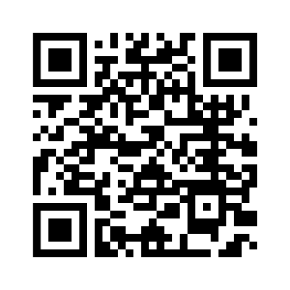
When Materials are Not Found in Louis
For braille and large print:
For all formats:
APH Trustee Directory
NIMAC State Coordinator Directory

Slide 30
Assisting students who aren’t NIMAS eligible
As mentioned earlier, students must have an IEP and a qualifying disability to be served by NIMAS-sourced materials.
If your customer is working with ineligible students, they may still be able to purchase some materials on Louis—not everything in Louis is NIMAS-sourced, including all Learning Ally audiobooks!
You can always direct those folks to their NIMAC State Coordinator—they will be able to point them to the correct resources in their state.

Slide 31
Accessible Format Handout
Along with these slides, we have a one-page handout that includes:
  Key terms
  Sample customer service language
  Contact information if you (or your customer) needs additional assistance

Slide 32
Additional Resources for Digital Accessibility
Digital instructional materials accessibility guidance, National Center on Accessible Digital Educational Materials and Instruction (NCADEMI)
Global Certified Accessible program, Benetech

Slide 33
Questions?

Slide 34
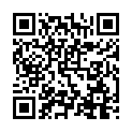
Exit Survey

Slide 35

Contact Us
NIMAC
nimac@aph.org
877-526-4622
Louis
resource@aph.org
502-899-2705
The contents of this resource was developed under a grant from the US Department of Education, #H327E210001. However, these contents do not necessarily represent the policy of the US Department of Education, and the reader should not assume endorsement by the Federal Government. Project Officer: Rebecca Sheffield.

