Slide 1
Braille 2000: NIMAS Textbook Transcription from Start to Finish
all sessions at 2pm Eastern
Session 6: eBraille conversion and Q&A (Tuesday, July 21st)

Slide 2


Braille 2000 Session 5: Alphabetic References
& Math

Slide 3
Day 5 Overview
Alphabetic References
  Glossary
  Index
Math/MathML

Slide 4
Learning Objectives
Learn how to format alphabetic references in Braille 2000
Learn how to create a running footer with guide words in a glossary or index
Understand how Braille 2000 and BrailleBlaster import math from NIMAS

Slide 5
Alphabetic References
(Formats Section 21)

Slide 6
Alphabetic References: Index
NIMAS follows print book formatting; transcriber may need to edit.
Formats 21.4.4: Change subentries in paragraph form to a nested list.
Change braille dash to hyphen where needed (e.g., joining two print page numbers)
Typeforms: Some print page numbers in index are intentionally shown in bold type or italics, necessary for reference. Avoid whole-section emphasis adjustment.
Braille 2000 may insert a numeric termination indicator where Formats does not require it. Use whole section substitution/omission.

Slide 7
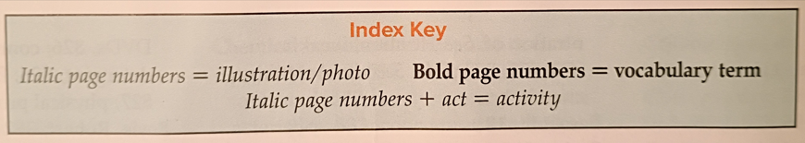
Alphabetic References: Index Key
Importance of retaining typeforms in index.
Example of Index Key at beginning of Index

Slide 8
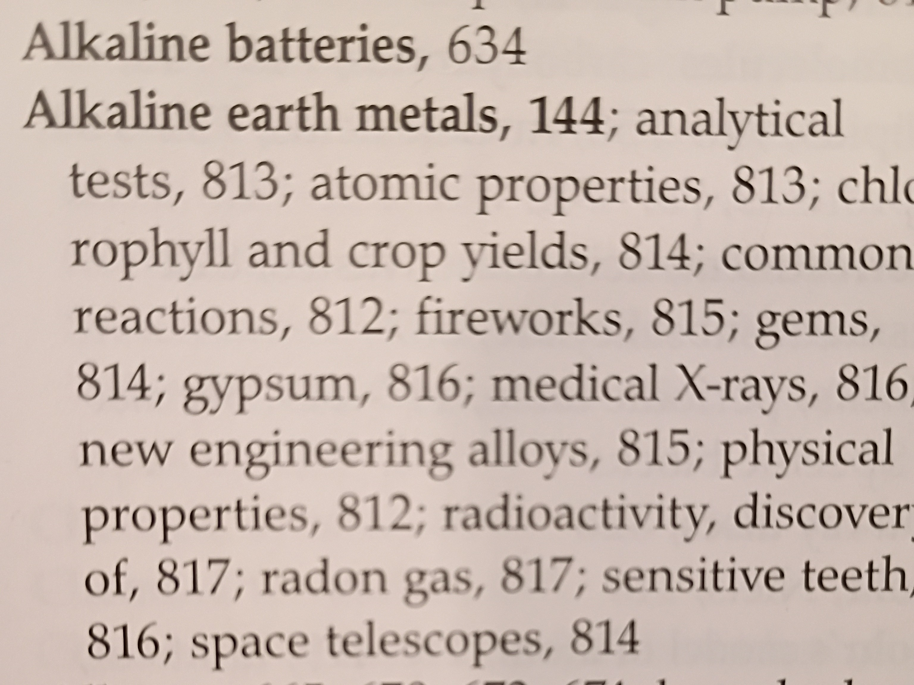
Alphabetic References: Index Subentries
Example of paragraph subentries in paragraph; need to edit

Slide 9
Alphabetic References: Glossary
Glossaries are covered in Formats 21.6.
NIMAS and Braille 2000 follow print book formatting.
Typeforms: some print books may use bold type for entry words. Change emphasis in braille.
Check with agency to see if dual languages should be transcribed.
Braille 2000 will help convert a section of a text into another language.
Formats 21.6d: The language by which the glossary is organized should be used for guide words.
Formats 21.6d: List foreign language symbols on Special Symbols Page.

Slide 10
Glossary (continued)
Glossary (Formats 21.6--SEE SAMPLES)
  Formats 21.6e: English and foreign language glossary words may appear as separate entries on the same page. Use 1-5 margins for the main entry words, 3-5 margins for the subentry words.
  Formats 21.6f: English and foreign language glossary word entries may appear on facing pages. Combine the entries into a nested list as above, and use combined print page numbers.
  Glossaries with samples:
    Omit irrelevant illustrations.
    Retain diagrams in math and science.
    Adjust headings, guide words, etc. See Formats 21.6.5.

Slide 11
Alphabetic References: Guide Words
Guide Words (Formats 21.3)
  Formats 21.3.1: Omit print guide words unless the text is teaching readers how to use guide words.
  Formats 21.3.2: Add braille page guide words to all alphabetic references except bibliographies. (agency discretion)
  Guide words will be generated by transcriber. (See examples in Formats manual.)

Slide 12
Setting Guide Words in Braille 2000
Braille 2000 Generates Glossary Guide Words
Do (alt d) > Running Footer (o) > (cell 1 guide words)
Braille 2000 populates footer with first word(s) of first and last entries on page
To change entry in footer, highlight the word(s)
Do (alt d) > Guide Word Text (w)
Braille 2000 will change word(s) in footer; check and edit

Slide 13
Setting Guide Words in Braille 2000 (cont.)
To see a video of this setup and other tools, go to the YouTube channel Braille Tips
Braille2000 Generates Glossary Guide Words
Shared with permission of Jonathan Powers

Slide 14
Math

Slide 15
Math
Math ML
BrailleBlaster to Braille 2000 conversion
Braille 2000 direct import Version 2 depends on the file
Braille 2000 Version 3 still in development
Information as of July, 2026.

Slide 16
Nemeth
Current BrailleBlaster conversion for UEB with Nemeth shows some features:
  Fraction indicators
  Radical symbolization (for square and other roots)
  Nemeth switch indicators are present ; need to edit based on surrounding content
  BrailleBlaster still in development

Slide 17
UEB Technical
Current BrailleBlaster to Braille 2000 conversion
Current Braille 2000 conversion
Sample elementary math
Upper level math

Slide 18
DEMO Overview
Alphabetic References
  Glossary—pronunciation key, multilingual glossary, setting guide words
  Index—nested list, setting guide words
Math/MathML
  Nemeth
  UEB Technical

Slide 19
Recap
Alphabetic References
  Glossary—pronunciation key, multilingual glossary, setting guide words
  Index—nested list, setting guide words
Math/MathML
  Nemeth
  UEB Technical

Slide 20
Q&A?

Slide 21
Coming Up!
all sessions at 2pm Eastern
Session 6: eBraille conversion and Q&A (Tuesday, July 21st)

Slide 22
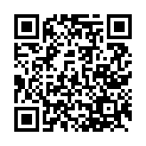
Exit Survey

