Slide 1
Braille 2000: NIMAS Textbook Transcription from Start to Finish
all sessions at 2pm Eastern
Session 4: Editing and Formatting: Headings, tables, and speed braille keys (Tuesday, July 7th)
Session 5: Math and alphabetic references (Tuesday, July 14th)
Session 6: eBraille conversion and Q&A (Tuesday, July 21st)

Slide 2


Braille 2000 Session 3: Editing & Formatting: Typeforms, Lists, TOCs

Slide 3
Day 3 Overview
Slides:
  Explore Braille 2000 features for editing and formatting:
  Typeforms
  Lists
  Table of Contents
  Search and Edit
Demo:
  Explore Braille 2000 features for editing and formatting:
  Typeforms
  Lists
  Table of Contents
  Search and Edit

Slide 4
Learning Objectives
Understand how to use Braille 2000 Search and Replace features to edit typeforms in NIMAS files
Learn how to use Braille 2000 to edit lists from NIMAS files
Learn how to edit a NIMAS file to create a Table of Contents in Braille 2000

Slide 5
Typeforms

Slide 6
Adjusting Typeforms
Typeforms in NIMAS reflect print design, and they may need to be edited to align to Formats requirements.
BrailleBlaster conversion allows some initial all-file conversions:
  Remove All Emphasis from Headings
  Remove Emphasis from List Prefixes
  Remove emphasis from Alphabetic Reference Entry Words.
Demonstrated on Day 1
Notes:
--Read slide.
--Braille 2000 also has some automatic emphasis removal when imported.
--The transcriber will still have to check this against the print copy.
--Types of emphasis can include bold, italics, underlining and script.

Slide 7
Adjusting Typeforms in Braille 2000
Adjust Emphasis tool
  Adjust (Alt A)→ Emphasis (E) → (Select from options in dialog box)
In-file editing options
  Single entry manual edit
  Search & Replace
  Partial or global file edit
Notes:
--Just read. Following slides show the tools

Slide 8
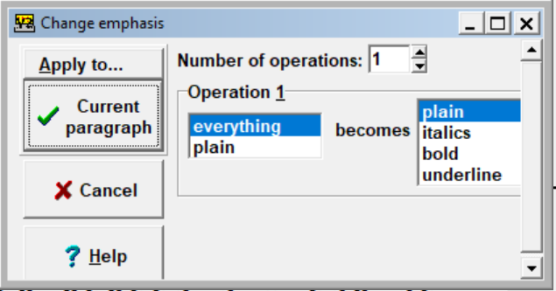
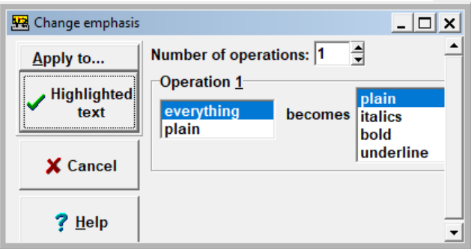
Adjust Emphasis Tool in Braille 2000
→ (Select from Apply To)
Notes:
--Open this menu with
--Adjust (Alt A)→ Emphasis (E) → (Select from options in dialog box)
--I don’t use this tool as much. Global changes scare me, and they’re hard to undo. NEXT SLIDE

Slide 9
Adjusting Typeforms Manually
In-file editing
  Individual entries—do manually
  Select/Highlight text portions
  Use Search, Find & Replace
Search > Find (direct entry) > Replace with (direct entry) >
CHECK FOR “HIGHLIGHTED AREA: OR “WHOLE FILE” >
Replace from (Top, cursor, next) > Replace all
Notes:
--I prefer to use these tools to adjust typeforms
--Search > Find (direct entry) > Replace with (direct entry) > CHECK FOR HIGHLIGHTED AREA OR WHOLE FILE > Replace from (Top, cursor, next) > Replace all
NEXT SLIDE

Slide 10
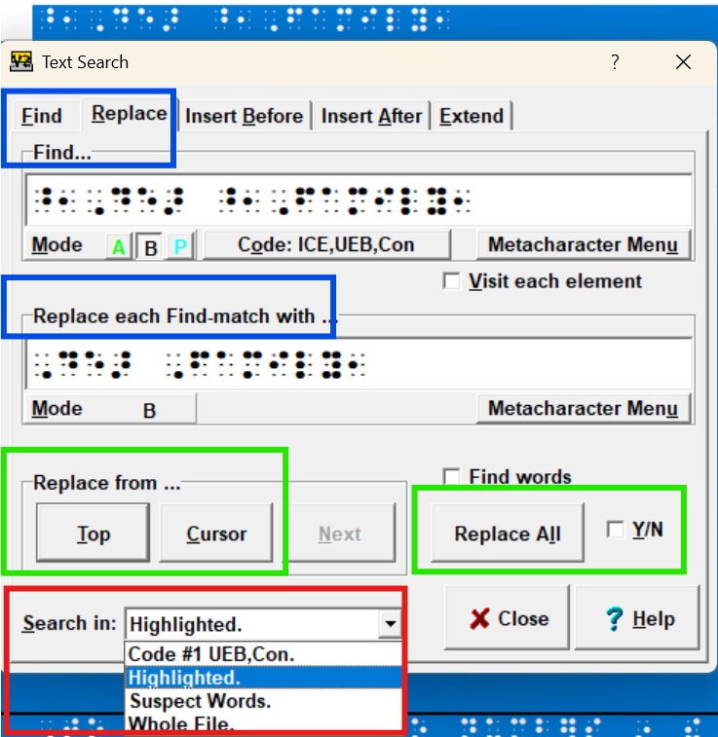
File Adjustment in Braille 2000
Search (Alt S) > (Find) F
Direct entry
Replace (Alt R)
Direct entry
Choose Top or Cursor
Check “Search in” box
Notes:
--Careful attention to “Highlighted” vs. “Whole File”. I try to check EVERY TIME. Braille 2000 will sometimes default to Whole File!
--DEMO later;

Slide 11
Table of Contents
(Formats 2.10)

Slide 12
Formats: Table of Contents
Pagination: TOC begins on braille page p1
Set up entire TOC in first volume (Formats 2.10.2d)
Headings (Edit NIMAS import according to Formats 2.10)
  Center print contents heading (e.g., TOC)
  Volume 1 (in transcriber’s note indicators); no blank line
  Other Volumes (in transcriber’s note indicators)
  Identifiers in cell 1, following blank line (2.10g)
  Nested list format (2.10.6)
No entries on lines 1 or 25, because of page numbers
Notes:
--Refer to Formats fpr details
--TOC is a type of LIST format

Slide 13
Setting Up Table of Contents
Page Numbers (2.10.7): Braille 2000 adds guide dots between entry and page number; retains 6 cell distance between text and margin; keeps line 25 blank.
Important to check/proofread
Sidebars and other displayed material in TOC (Formats 2.10.2i; 2.10.7b): Retain six cell right margin; do this manually in Braille 2000
Retain capitalization and font attributes in TOC (Formats 2.10.8)
Notes:
--I used to set up Tables of Contents manually, until I started using Braille 2000 and learned this set-up tool.
--This saves me hours.
s--”Page numbers” here refers to page number in the TOC

Slide 14
Setting Up Table of Contents (continued)
Pre-editing saves time
  Spacing of numbers
  Check numbers when lesson number precedes another number.
Highlight portion to convert.
Do (Alt D) → Line number (L)→(Select With guide dots) → Auto-contents (C) → (select options) → OK/Enter
Check braille copy carefully. The conversion is a great time-saver, but it doesn’t perfectly catch every print division.
Notes:
--Read slide
-- For some reason, some NIMAS files import the TOC without space between the name of a lesson and the page number. I’ll show this later, and an easy edit.
--Because of vast differences in textbook design, including type forms--especially in TOCs--the NIMAS translated files have to be proofread and edited carefully.

Slide 15
Table of Contents in Braille 2000 Video
To see a video of this setup and other tools, go to the YouTube channel Braille Tips
Braille2000 Tip - Contents and 6 cell indent
Shared with permission of Jonathan Powers
Notes:
--Jonathan shows the tools used here, as well as
how to remove the 6-cell indent where needed, and
how to format your TOC in Word.

Slide 16
Using Table of Contents to Divide Volumes
Volume division
  Divide volumes between chapters or sections.
  Use Table of Contents to help decide where to end volume.
  On title page, use continuation numbers where relevant.
    Print text--where print layout begins a new section on the same print page as the previous section
    For continuation of a print page within the TOC
Notes:
--Explain “continuation numbers”.
--If the final print page in a volume uses more than one braille page, show the continuation number (e.g., page c145) for the final page on the Title Page.
--Sometimes in larger texts, where section headings are not always at the top of a print page, the beginning print number of a braille volume may need a continuation number.
--In the Table of Contents, show the continuation number for any relevant section

Slide 17
Setting Up Subsequent Volume(s)
Subsequent volumes
  Copy and paste OR
  Save (file) As (new volume name); edit volume and page numbers.
When copying from finished file in the same work:
  Edit to reflect new file information (Volume #, Section names, page numbers)
  Edit Table of Contents
Notes:
--Two possible ways of doing this.
--I’ll demonstrate this later.s

Slide 18
Lists
(Formats Section 8)

Slide 19
Lists
Formats 8.1.1: Lists can be a series of words, phrases, or sentences. ... A list may be preceded by a heading.
Types of lists:
  simple (embedded, vertical, columns) lists
  nested lists
  bulleted lists
  outlines
  annotated lists
See Formats 8 for explanations and samples.
The TOC is an example of a list.

Slide 20
Lists (continued)
NIMAS translation converts lists as in print.
Some need for transcriber to edit:
  List prefixes may be in bold type, based on print appearance.
  Bullets are not always converted in NIMAS file and may need to be added in braille.
  Numeric and/or alphabetic identifiers are not always converted in NIMAS file and may need to be added (e.g., numbers of exercises).
  Note: If print layout shows a list in columns, transcriber may need to move items or simply do direct entry.

Slide 21
DEMO Overview
Explore Braille 2000 features for editing and formatting:
  Typeforms
  Lists
  Table of Contents

Slide 22
Recap
Explore Braille 2000 features for editing and formatting:
  Typeforms
  Lists
  Table of Contents

Slide 23
Q&A?

Slide 24
Coming Up!
all sessions at 2pm Eastern
Session 4: Editing and Formatting: Headings, tables, and speed braille keys (Tuesday, July 7th)
Session 5: Math and alphabetic references (Tuesday, July 14th)
Session 6: eBraille conversion and Q&A (Tuesday, July 21st)

Slide 25

Exit Survey

