Slide 1

NIMAC for Publishers and Vendors:
Basics & File Submission
Nicole Gaines, NIMAC Project Director
ngaines@aph.org
Liz Schaller, NIMAC Director
eschaller@aph.org
July 2026

Slide 2
Mark Your Calendar!
NIMAS File Creation: Resources & XML Best Practices (Webinar 2)
  For a more in-depth look at the technical side of creating NIMAS XML files, please join us for the next installment of the series.
  Part 2 will be offered twice (same content both days):
    Wednesday, July 22, 9am ET
    Thursday, July 23, 2pm ET
NIMAS File Creation: Metadata Best Practices (Webinar 3)
  For a deep dive on NIMAS Metadata, please join us:
    Tuesday, August 11, at 9am ET
How to Assist Your Customers Looking for Accessible Formats (Webinar 4)
  For guidance on how to assist customers in locating accessible formats, please join us:
    Wednesday, August 12, at 2pm ET

Slide 3
Topics for Today’s Webinar
  Intro to the NIMAC
  Publisher account overview
  NIMAS file submission process
  File review & certification
  A brief demo of the publisher portal

Slide 4
Learning Objectives
Participants will understand the role of the NIMAC and how we work with publishers.
Participants will understand the key functions of the publisher account.
Participants will understand the two methods of file submission and how to successfully deliver files to the NIMAC.

Slide 5
NIMAC: The Basics

Slide 6
The NIMAC Project
  Created by IDEA 2004, the National Instructional Materials Access Center is the national source file repository for K-12 textbooks and core instructional materials.
  We make NIMAS files available to states for use in producing accessible formats (such as braille) for qualifying students in K-12.
  Files in the NIMAC are not distributed directly to students.

Slide 7
The NIMAC: Key Dates & Numbers
  The NIMAC has been in continuous operation since opening in December of 2006.
  States and districts have been able to require NIMAS in their instructional materials contracts since July of 2006.
  To date, we have received over 90,000 file sets from over 200 publishers.
  Over 61,000 files have been downloaded for use in producing accessible formats for students with disabilities.

Slide 8
States and the NIMAC
IDEA does not require that states work with the NIMAC, but all 50 states, the six eligible territories, and DoDEA have chosen to do so.
States and districts that coordinate are legally obligated to:
  require NIMAS from publishers in their textbook adoption contracts; and
  abide by the eligibility requirements of IDEA and copyright law in the use of NIMAS files.
States are also required to designate and manage a small number of Authorized Users for their state.

Slide 9
Student Eligibility
IDEA 2004 defines the eligibility requirements for receiving materials produced from NIMAS.
To qualify, students must be in elementary or secondary education and have:
  a qualifying disability per the eligibility guidelines of the National Library Service for the Blind and Print Disabled (NLS) and
  an Individualized Education Program (IEP).
NIMAC is not involved in determining eligibility for individual students.

Slide 10
The NIMAS Specification
  NIMAS is the National Instructional Materials Accessibility Standard.
  It is an XML-based source file format based on the DAISY standard.
  It is designed for use in producing formats such as braille, DAISY, EPUB, and large print.
  It is not intended for distribution directly to students.
  NIMAS is the only format the NIMAC can receive.

Slide 11
Materials within Scope for NIMAS
Under IDEA, States and districts direct publishers to submit files to the NIMAC when they purchase instructional material for use by all students.
The NIMAC accepts a range of student-facing materials, from textbooks and workbooks to supplementary readers and ancillary materials like blackline masters.
Materials not “published primarily for use in elementary and secondary education” are not within scope for the NIMAC.

Slide 12
NIMAS & Digital Instructional Materials
A “Notice of Interpretation” issued by the U.S. Department of Education in 2020 permits the NIMAC to accept NIMAS for some digital instructional materials.
However, materials that already meet WCAG 2.0 AA accessibility criteria are categorically exempt from NIMAS.
The NIMAC strongly recommends that States and districts require that digital materials be accessible “out of the box,” in accordance with ADA Title 2.
For more information on digital materials that can be accepted by the NIMAC, contact us or see our FAQ on NIMAS & Digital Materials.

Slide 13
NIMAC Requests to Publishers for NIMAS Files
States and districts that coordinate with the NIMAC are legally obligated to require NIMAS in their instructional materials contracts.
However, with over 13,000 school districts in the U.S., this does not always happen.
The NIMAC will reach out to publishers to request a file when there is a need to produce braille or another accessible format for an eligible student.
We greatly appreciate publishers’ assistance and support of students in response to these requests.

Slide 14
Beyond NIMAS: Helping Teachers & Schools Locate Accessible Formats
NIMAS files are only used in the first production of an accessible format.
Once produced, braille and other formats can be reproduced, as needed, to serve additional qualifying students.
If you are helping your customers locate accessible formats for your materials, the best resource is the Louis Database of Accessible Materials.
We are also happy to help your customers locate materials or help them get connected to resources in their state.
If you’d like to learn more, please join us for Part 4 of this webinar series on August 12th!

Slide 15
Publisher Accounts &
File Submission

Slide 16
Publisher Accounts: Managing Inventory
NIMAC publisher accounts allow companies to:
  Manually upload new inventory to the NIMAC system (files up to 250 MB each)
  Manually replace inventory
  Search, view, and download their own inventory
  Export inventory reports

Slide 17
Publisher Accounts: Other Functions
These accounts also provide the ability to:
  Create additional user accounts for others at your company or for your conversion vendors
  Download the NIMAC Validation Wizard
  Generate correctly formatted OPF metadata using the “Excel to OPF” tool
  Export reports of user downloads for your materials

Slide 18
Creating and Managing User Accounts
Publisher primary account holders can create as many additional “sub users” as needed.
To add or manage users for your company just click:
User Information → My Sub Users
To add a new user, just click “Add User” and fill in the name, email address and role.
Sub users with the “publisher” role have full access to the publisher account.
The “vendor” role provides all the needed access to upload and manage inventory but cannot create new users or download files.

Slide 19
Submitting NIMAS Files
Part 1: Validation

Slide 20
NIMAC System Validation
Automated file validation is the first step in the file certification process.
The NIMAC online system validation checks to ensure that
  the XML is well formed;
  images referenced in the XML are present in the images folder; and,
  the file validates to the NIMAS DTD (and to the MathML DTD if MathML is present).
Automated validation will also detect some errors related to missing or invalid OPF metadata, as well as some XML tagging errors.
Warnings or Best Practices feedback may also be provided for some issues.

Slide 21
NIMAC Validation Wizard
The NIMAC Validation Wizard provides in a free, stand-alone tool the same validation checks that files must pass in order for the system to accept them for upload.
To avoid delays in getting your files certified, we ask that publishers/vendors validate all files using the wizard before submitting or uploading to the NIMAC.
If a file fails validation at the point of upload or batch delivery, it will be rejected for upload by the system, and the publisher/vendor will be required to address the validation errors and resubmit the file.

Slide 22
How to Use the Tool
The validation wizard is available in Windows and Mac versions.
Once you have installed the tool on your machine, just navigate to the location of the zipped file for the complete NIMAS file set.
Then click the Validate button.
When the validation is complete, the results will display on the screen.
These results can also be exported as a .csv file, if desired.

Slide 23
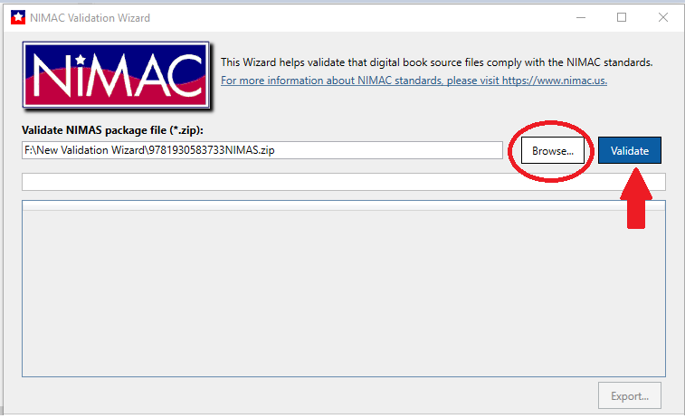
Navigation to the Zipped File

Slide 24
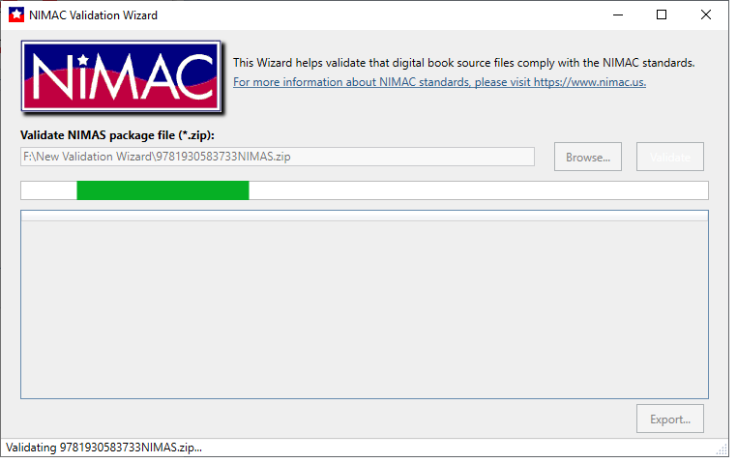
Validation in Progress . . .

Slide 25
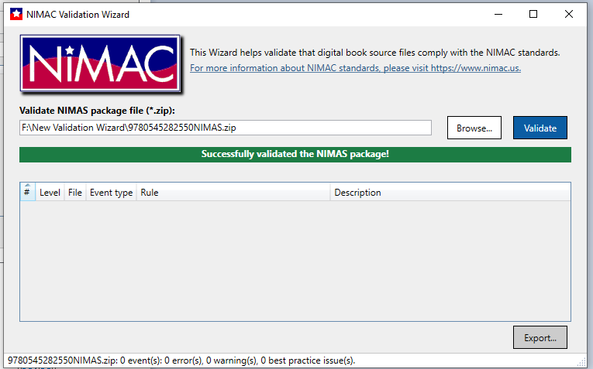
Successful Validation Output

Slide 26
Types of Validation Output
Errors: Must be corrected or file cannot be uploaded to NIMAC system.
Warnings: Correction is recommended but not required for upload. (Further review will be done by NIMAC after upload.)
Best Practice: Information to consider in preparing NIMAS files.

Slide 27
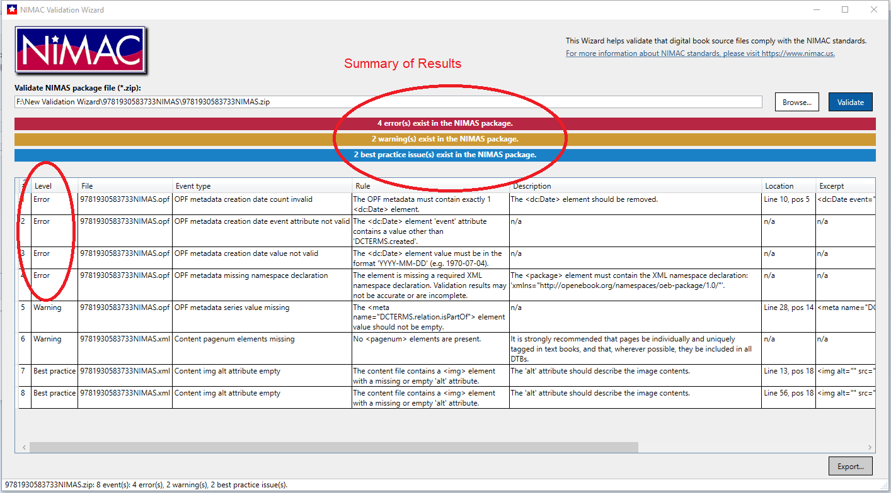
Validation Output Showing Errors

Slide 28
Corrupt Zip Files
Occasionally files will fail upload or batch processing due to the zip files being corrupt.
After zipping your NIMAS file sets, it’s a good idea to check to ensure that the files were not corrupted during the compression process.
Just click on the zip file. If it opens, the file is probably okay and not corrupt.

Slide 29
Submitting NIMAS Files
Part 2: File Delivery

Slide 30
Manual File Upload

Slide 31
Manual File Upload to the Online System
Files up to 250 MB each can be manually uploaded to the NIMAC system by logging into your publisher or vendor account.
When you log into your account, your inventory will always be your landing page.
Add Inventory is used to upload a file that has not been previously submitted. (The ISBN is not already in the system.)
Replace Zip File is used to replace the zip if the file has been previously submitted. (The ISBN is already in the NIMAC.)

Slide 32
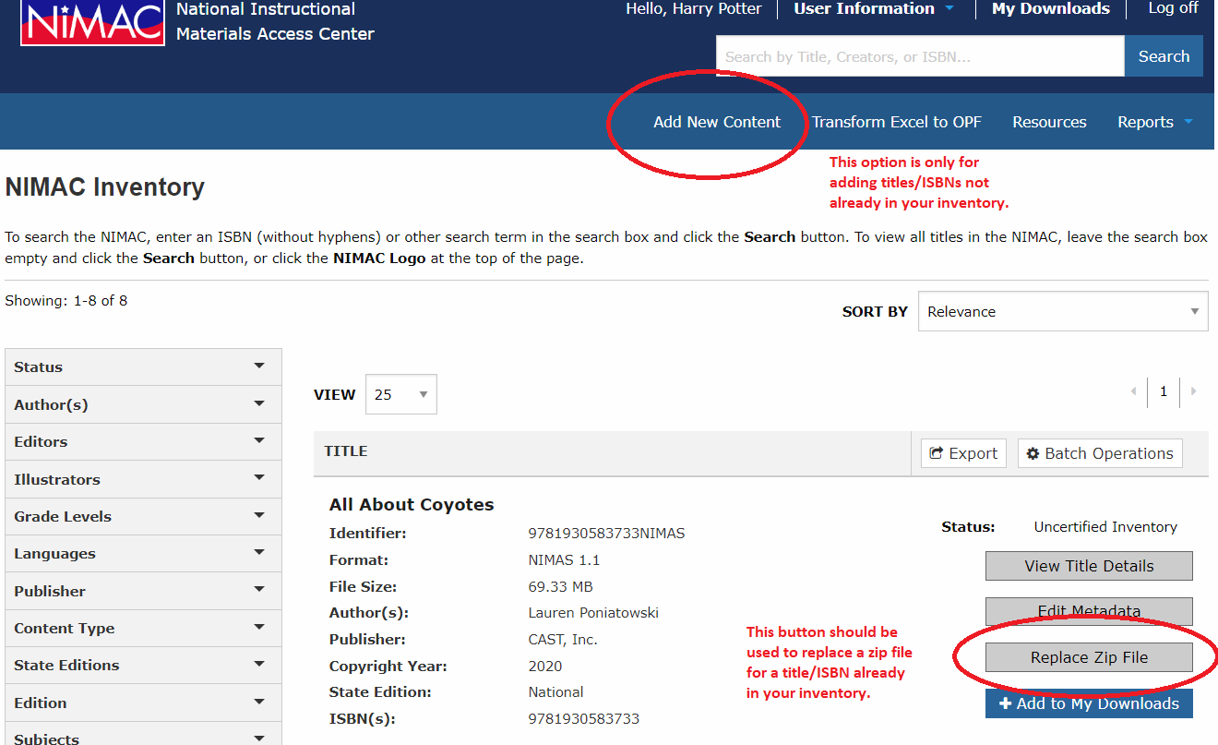
Add New Content vs. Replace Zip File

Slide 33
Manual Upload Process
When files are uploaded, the file first undergoes automated validation.
If the file fails validation, the system will display the errors.
If the file passes, the system will extract the OPF metadata to create a system record and open it up in edit mode.
The record can then be reviewed and edited, if needed. (Any changes made to the record will also be saved to the OPF.)
When the file is saved to the system, it will appear in your Uncertified inventory.

Slide 34
Manual Upload vs. Batch Delivery
While files up to 300 MB may successfully upload to the system, the upload time will be slower the larger the file is.
For this reason, we advise delivering files that are over 250 MB each by FTP.
There is no minimum or maximum file size for submitting files by FTP.
There is no minimum or maximum number of files that can be submitted by FTP at one time.

Slide 35
Batch Delivery (FTP)

Slide 36
Delivering files by FTP
Files that are over 300 MB must be delivered directly to our system vendor, OverDrive, by SFTP.
The host location of the FTP is:
transfer.overdrive.com
If you do not yet have an FTP login, you can request one by emailing OverDrive:
nimac-support@overdrive.com

Slide 37
Requesting FTP Access
In your request, include your NIMAC login ID for the specific publisher’s account.
If you are a publisher, you will need to create a NIMAC “sub user” account for each conversion vendor that needs to upload files on your behalf.
If you are a vendor, you will need a separate NIMAC login ID and FTP account for each publisher account to which you need to upload files.

Slide 38
Automated Processing of FTP Deliveries
Files delivered by FTP are processed nightly (U.S. Eastern time).
The automated process can only detect and retrieve files that are in the ROOT directory of the FTP.
Files located on the FTP inside folders are invisible to the automated process and will be skipped.
Transfer only the individual zip files themselves – no folders!
If you have any questions, just let us know.

Slide 39
The Daily Batch Delivery Report

Slide 40
Batch Delivery Report
If you have submitted files by FTP, the following morning you will receive an automated report that details the processing results.
This report is sent to the email address associated with the FTP account.
If you are a vendor that supplies files for multiple publishers, you will receive a separate report for each publisher.

Slide 41
Side Note on Spam filters
If you have submitted files by FTP but do not see the automated email the following morning in your Inbox, please be sure to check your Spam or Junk folder.
You may need to whitelist noreply-NIMAC@overdrive.com or the domain “overdrive.com” to successfully receive the emails.

Slide 42
Reviewing the FTP Report
Please be sure to review all reports you receive.
The daily report is your only notification if an FTP delivery fails.
Important Note: If a vendor’s email address changes, or the vendor contact associated with the FTP account leaves their company, OverDrive will need to update the email address associated with the FTP login or create a new account.
Please contact the NIMAC if you have questions or need further assistance.

Slide 43
Reading the Report
At the top of the report, you will see a summary of the upload results:
If the report shows no failed uploads, you do not need to take any further action.
If the report does show failed uploads, please review the Details column information, correct the issue, and deliver the file again.

Slide 44
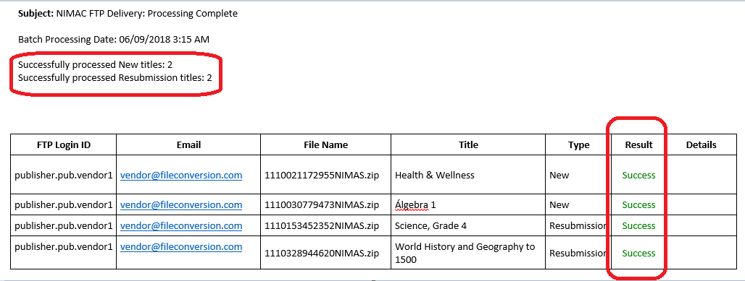
Report showing all uploads successful

Slide 45
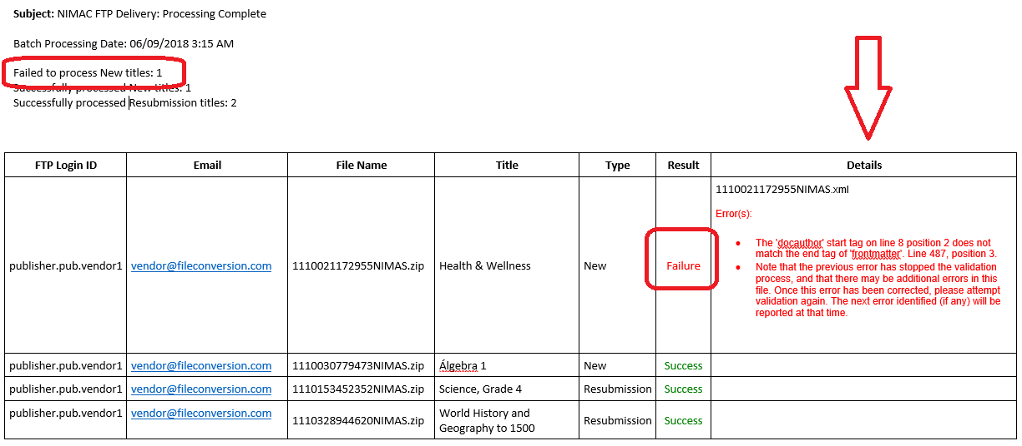
Report including failed upload

Slide 46
Failed uploads
If a delivery fails, the Details column in the daily report will provide the information related to the error that prevented upload.
Just make the needed correction(s) and deliver the file again by FTP (or via the portal).
The daily report is your official notification regarding failed uploads.
If you are expecting a report but do not receive one, check to ensure your zip files are not located inside a folder on the FTP.
If you have any questions about an error on a report, contact the NIMAC.

Slide 47
Resubmission of Certified Inventory
Files that are in Certified inventory cannot be overwritten. They must be moved out of Certified by NIMAC to be replaced.
If you need to resubmit a file that has already been certified, please contact the NIMAC at nimac@aph.org to request that the file be moved out of certified inventory.
Files that were certified within the prior 12 months can be moved by NIMAC into Stalled for resubmission without any further steps.
However, the NIMAC is instituting a new process to review resubmissions for new printings submitted a year or more after certification of the original file.

Slide 48
Incompatible Printings & Accessible Format Production
When two printings of the same ISBN are not classroom compatible, this can create significant challenges for teachers and for accessible format producers – and ultimately, barriers to participation for students with disabilities.
Ideally, when a new printing contains significant changes to content, such as adding new instructional material, rearranging chapters, and/or changing the pagination throughout the book, a new ISBN will be assigned, and the new version considered to be a different edition.
The NIMAC strongly encourages educational publishers to issue a new ISBN when a new printing of a textbook cannot be used side-by-side in the classroom with the previous printing.

Slide 49
Certified Resubmissions & Incompatible Printings
The NIMAC system can currently only house one zip file for a given ISBN.
However, we are exploring how we might provide access to an earlier certified NIMAS file if the more recent submission is not classroom compatible – and both printings continue to be used in schools.

Slide 50
Certified Resubmission Review
If a certified resubmission is requested for an updated printing 12 or more months after file certification, the NIMAC will request that the vendor deliver the new file for review in advance of uploading it to the system.
The NIMAC will do a quick comparison of the new submission with the certified file before the certified file is overwritten.
If the two printings are not classroom compatible, the NIMAC may archive the original certified file so that it can be supplied upon request by an Authorized User.
We appreciate your cooperation as we continue to explore the best approach to addressing this challenge.

Slide 51
File Review & Certification

Slide 52
NIMAC Certification Review Queue
Newly uploaded files appear in Uncertified inventory and are automatically placed in the file review queue.
Files are generally reviewed in the order received, but we are happy to expedite files when there is an immediate need.
If you have a deadline for certification, please let us know at the point of file submission (or in advance, if possible.)

Slide 53
Certificate Numbers
To be accepted into the NIMAC, files must pass automated validation (upon upload) and a manual review by NIMAC staff.
When files are certified, they move into your Certified inventory, and the “super user” receives an automated email with the digital certificate number.
You can also add up to three additional email addresses to receive these emails.
The certificate numbers can also be found in the individual system records and in inventory reports exported from your account.

Slide 54
File Review Checks
NIMAC staff review the metadata submitted with the file set to ensure it is correct and complete. (We will discuss metadata in-depth in Part 3!)
There are some additional checks to the XML to ensure that some required tags (such as page numbers) are present, and that common content (e.g., TOC and glossary) are tagged correctly.
If present, alt text will also receive a spot check for quality.
NIMAC does not receive print books and does not do a page-by-page comparison to evaluate the tagging in the XML.

Slide 55
File Feedback
NIMAC staff routinely make minor metadata corrections at the point of file review and certify the files without requiring that files be resubmitted.
However, tagging issues in the XML and other file issues will generally require vendor correction and resubmission of the file.
When files require correction, staff will send detailed feedback to the individual that uploaded the file.
Files awaiting resubmission are placed in “Stalled” inventory.

Slide 56
File Review Timeline
The time for a delivery to be reviewed and certified varies depending on the number of files received at a given time and the number of files in the review queue.
When submissions are relatively light, a file may be certified the day it is uploaded to the system.
However, if a delivery is large or many other files are in the queue, it may take 2 weeks or longer.

Slide 57
Certification Deadlines
Publishers: If you have an upcoming contract deadline with a customer, please notify us via email so that we know to expedite your file(s) for review.
The NIMAC is not involved in state or district procurement processes, and we will only know about a file submission deadline if the publisher relays this information to us.

Slide 58
Expediting Certification
We encourage publishers to submit files at least two weeks in advance of a deadline.
This helps ensure that if there are any issues with the files, your vendor will have time to make the needed corrections and resubmit the files, if this is needed.
Files are usually certified in the order received, but we are happy to prioritize files to help a publisher meet a deadline.

Slide 59
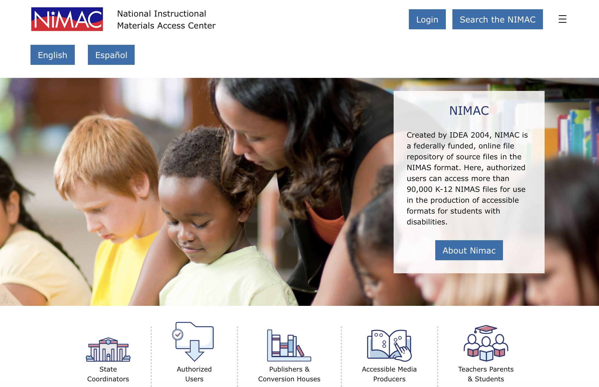
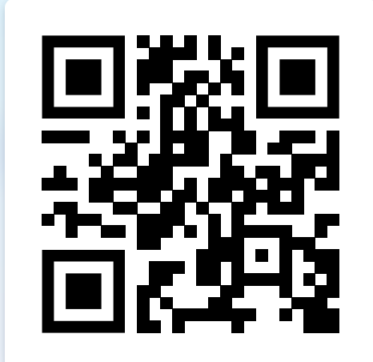
NIMAC Informational Website

Slide 60
Brief Demo!

Slide 61

Questions?
For any questions about the status of files in the NIMAC system, feedback provided by our staff, or anything else, don’t hesitate to get in touch:
nimac@aph.org
877-526-4622
The content of this resource was developed under a grant from the US Department of Education, #H327E210001. However, these contents do not necessarily represent the policy of the US Department of Education, and the reader should not assume endorsement by the Federal Government. Project Officer: Rebecca Sheffield.

Slide 62
Coming Up!
NIMAS File Creation: Resources & XML Best Practices (Webinar 2)
  For a more in-depth look at the technical side of creating NIMAS XML files, please join us for the next installment of the series.
  Part 2 will be offered twice (same content both days):
    Wednesday, July 22, 9am ET
    Thursday, July 23, 2pm ET
NIMAS File Creation: Metadata Best Practices (Webinar 3)
  For a deep dive on NIMAS Metadata, please join us:
    Tuesday, August 11, at 9am ET
How to Assist Your Customers Looking for Accessible Formats (Webinar 4)
  For guidance on how to assist customers in locating accessible formats, please join us:
    Wednesday, August 12, at 2pm ET

Slide 63
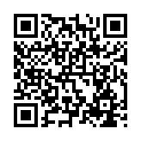
Exit Survey

