Slide 1
Braille 2000: NIMAS Textbook Transcription from Start to Finish
all sessions at 2pm Eastern
Session 3: Editing and Formatting: Typeforms, lists, and TOCs (Tuesday, June 30th)
Session 4: Editing and Formatting: Headings, tables, and speed braille keys (Tuesday, July 7th)
Session 5: Math and alphabetic references (Tuesday, July 14th)
Session 6: eBraille conversion and Q&A (Tuesday, July 21st)

Slide 2


Braille 2000 Session 2: File Set Up and Transcriber-Generated Pages

Slide 3
Points Covered Today
Purpose:
Process:
Convert NIMAS files into braille text using Braille 2000 transcription program
Access file from NIMAC site as Accessible Media Producer (AMP)
Download, Save, & Convert NIMAC file to braille file (using BrailleBlaster & Braille 2000)
Format, edit, proofread files to reflect print copy, using Braille Formats: Principles of Print-to-Braille Transcription, 2016.

Slide 4
Day 2 Overview
Slide Overview:
  Initial formatting
  Transcriber-Generated Pages (Formats 2.2, 2.2)
    Title page(s) (Formats 2.3-2.4)
    Special Symbols page (Formats 2.5)
    Transcriber’s Notes page (Formats 2.6)
    Back cover of book (Formats 2.8)
  Pagination (Formats 2.7)
  Running Heads (Formats 1.8)
  Using Bookmarks in Braille 2000
Demo:
Transcriber-Generated Pages
  Title page(s)
  Special Symbols page
  Transcriber’s Notes page
  Back cover of book
Pagination
Running Heads
Using Bookmarks in Braille 2000

Slide 5
Learning Objectives
Learn how to use a NIMAS file to create a title page in Braille 2000
Learn how to set up transcriber-generated pages, including pagination and running head, in Braille 2000
Learn how to use bookmarks for navigation in Braille 2000

Slide 6
Initial Formatting of Braille Files
Braille Formats: Principles of Print-to-Braille Transcription, 2016.
  Accessible on BANA (Braille Authority of North America) website
  www.brailleauthority.org → Codebooks and Guidelines → Braille Formats, 2016; Note recent updates and addenda
  Available Versions:
    Downloads (BRF or PDF files)
    Hard Copy (available through APH)
    Online (HTML) includes customized search function

Slide 7
Initial Formatting of Braille Files (cont.)
Braille Formats: Principles of Print-to-Braille Transcription, 2016. (continued)
Braille Formats Updates
  Addendum to Braille Formats 2016 (posted June 2024).
  Braille Formats Errata (approved March 2024, posted June 2024).
  Updates to Braille Formats 2016 (approved March 2024, posted June 2024).
  Changes to Foreign Language Sections of Braille Formats 2016 (approved March 2024, posted June 2024).

Slide 8
Formatting – Volume Setup
Formats… Sections 1 & 2
Section 1.1: Fundamentals “…This document is a set of guidelines that should be used to make structuring decisions….”
  NIMAS files provide general formatting, but transcriber must adapt the file. (1.1.1. – 1.1.2.)
  Accuracy and Consistency
  Agency preferences (1.1.3): Follow SPECS for Title Page.
  Examine print copy (1.1.7) before beginning, in order to “structure the text consistently.” Make initial formatting decisions before starting.
  Transcriber does NOT edit text, but may have to edit formatting, based on formatting decisions (e.g., placement of headings: centered, cell 5, cell 7, etc.)

Slide 9
Formatting – Volume Setup
Formats… Sections 1 & 2 (continued)
  Volume info (1.6)
    Volume size (1.6.1): Follow agency guidelines; end with logical break in contents (more important than uniform volume size)
    Page size, line length, & line spacing (1.7)
    Braille 2000 default set up is according to Formats: 11x11.5 in paper; 25 lines; 40 cells per line; single-line spacing.
    For help with any other parameters, contact Braille 2000 Customer Support.

Slide 10
Formatting – Volume Setup
Creating Multiple Volumes
  Volume info (1.6)
    From imported NIMAS file, create individual files for transcription
    Main Volumes
    Preliminary Volume (1.6.3) composed entirely of transcriber-generated pages, table of contents, and other front matter
    Supplemental Volumes (1.6.4) composed entirely of segments of back matter (Glossary, Index, etc.)

Slide 11
Title Pages
(Formats 2.3)

Slide 12
Title Page (Formats 2.3)
Agency guidelines/templates
Check copyright date against print text.
Use NIMAS PDF (title page) and print text to clarify information.
Edit to follow required formatting.
Initial volume--Copy and paste relevant information from NIMAS file
  Title segment (2.3.4) (See Formats Errata)
  Author segment (2.3.5)
  Publisher and Copyright segment (2.3.6) (see addendum posted June 2024)
  Transcriber/Transcription segment (2.3.7)
  Volume Information segment (2.3.8)

Slide 13
Title Pages Set Up
Complete title appears on:
  First line(s) of Title Page
  Centered on first page of text
  Braille 2000 set up: Do (Alt D) → Page control (C) → “Omit running head” → enter
Second title page (Formats 2.4) – Information that will not fit on the title page, as well as additional information in the book's front matter.
From NIMAS file, select relevant information to copy & paste, or delete unnecessary information.

Slide 14
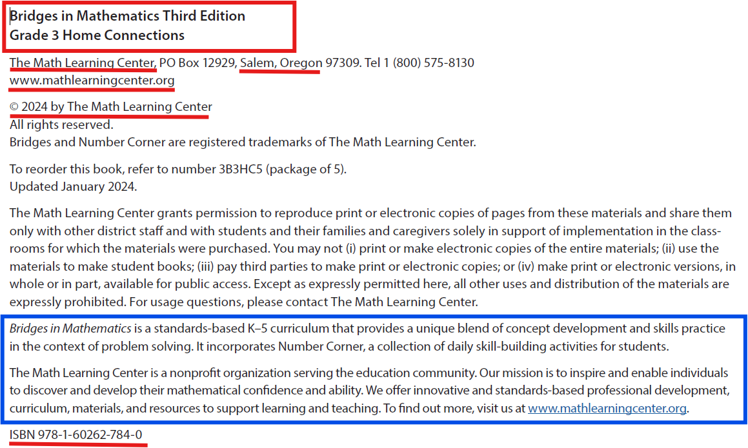
Title Page Set Up (cont.)

Slide 15
Pagination
(Formats 1.11-1.15)

Slide 16
Setting Pagination in Braille 2000
Title, Special Symbols, & Transcriber’s Notes (Formats 2.2
  No print page numbers
  Braille page numbers preceded by the letter t, (e.g., t1, t2, etc.) (Formats 2.2.1)
Table of Contents (Formats 2.10)
  Follows Transcriber's Notes page(s), and is braille page p1, with no text page number. When there is other book cover/jacket information, the table of contents is the last of this information. (Formats 2.10.2)

Slide 17
Setting Pagination in Braille 2000 (cont.)
Table of Contents (2.10.2)
  Follows Transcriber's Notes page(s), and is braille page p1, with no text page number. When there is other book cover/jacket information, the table of contents is the last of this information.
Body Matter (Formats 2.12.1)
  Follow print page numbers
  Braille page numbers begin with 1

Slide 18
Generating Pagination
  Initial page set up in Braille 2000
  Pagination for entire volume is automatically generated in Braille 2000
  Do (Alt D) → Page numbering (P) → Quick setup for: → (Explore Options)

Slide 19
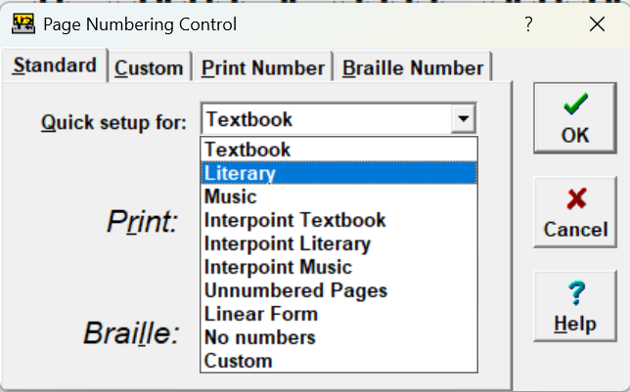
Page Numbering Control
  Do (Alt D) → Page numbering (P) → Quick setup for: → (Dropdown menu)

Slide 20
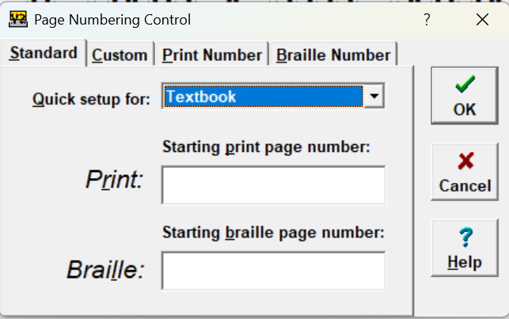
Page Numbering Control (cont.)
  Choose Textbook
      Starting print and braille page numbers : direct entry

Slide 21
Advancing Pages in Braille 2000
  Options in Braille 2000
  Advance to next braille page: Do (Alt D) → Page Control (C) → (Options)
    Default: To next braille page (Enter)
    Braille 2000 automatically adds continuation numbers
  Advance to next print page number: Do (Alt D) → Next print page (N)
    Page change line and new print page number
    When cursor is on line 25, this command will insert blank line on line 25 and advance to next page

Slide 22
Running Heads
(Formats 1.8)

Slide 23
Running Heads (Formats 1.8)
Running Heads
  Easy set up in Braille 2000: Menu → Do (Alt D) → Running Head (R) → (Enter braille, direct entry) → OK (Enter)
  Centered on first line of every page
  Exceptions: Title Page and first page of text
To omit running head from first page of text in Braille 2000:
  Braille 2000 set up: Do (Alt D) → Page control (C) → “Omit running head” → enter

Slide 24
Special Symbols & Transcriber Notes Pages
(Formats 2.5 & 2.6)

Slide 25
Special Symbols & Transcriber Notes Pages (Formats 2.5 & 2.6)
Special Symbols page: Lists symbols found in the volume that may be unfamiliar to the reader (Formats 2.5)
See Formats 2.5.2 for details.
Braille2000 Generates Special Symbols Page (Shared with permission of Jonathan Powers)

Slide 26
Special Symbols & Transcriber Notes Pages (cont.)
Transcriber’s Notes page: If a special format or usage occurs more than once in a volume, include it on the Transcriber’s Notes page.
See (Formats 2.6) for details.

Slide 27
Transferring File Sections
Annotations in Braille 2000
  Check for these when transferring pages from one work to another (e.g., Special Symbols or TN pages).
  In older versions of Braille 2000, these may carry over and need to be removed.
  Search (Alt S) > Find annotations > (Running heads, pagination)

Slide 28
Using Bookmarks in Braille 2000
Bookmarks in Braille 2000: Use to navigate between transcription & selected pages (e.g., Special Symbols page)
  Panel (Alt P) → Bookmark (B) → Set (S) OR Jump to (J) → (select X, y, or z)

Slide 29
Book Cover & Jacket
(Formats 2.8)

Slide 30
Book Cover & Jacket
(2.8.1) Include information from the front and/or back covers of a book only in the first volume of the braille edition.
  The cover/jacket material is inserted as the first front matter page p1, and no print page number is used. Insert a transcriber's note to explain this format.
    (Transcriber’s Note): The following material is from the back cover of the book.
  Include book jacket or inside cover information not included within the text, e.g., lists of author's works, author's biography, etc.
  Do not include advertising material, reviews by other authors, etc.

Slide 31
Book Cover & Jacket (cont.)
Examine print text for book cover & jacket information.
Use Braille 2000 search to locate book cover text within the NIMAS translation. It may or may not be included in a particular NIMAS file.
Transfer information to braille page p1 in first volume only.

Slide 32
Textbook Sample File–
NIMAS 1.1 Textbook Exemplar
This file is provided to support the learning and use of braille transcription software
Images are not included in a folder
For today’s demo, focus on front matter pages i-viii
The sample file is in 2 parts:
  XML file - 978xxxxxxxxxxNIMAS.xml
  PDF - 978xxxxxxxxxxNIMAS.pdf

Slide 33
DEMO Overview
Transcriber-Generated Pages
  Title page(s)
  Special Symbols page
  Transcriber’s Notes page
  Back cover of book
Pagination
Running Heads
Using Bookmarks in Braille 2000

Slide 34
Recap
Transcriber-Generated Pages
  Title page(s) (Formats 2.3-2.4)
  Special Symbols page (Formats 2.5)
  Transcriber’s Notes page (Formats 2.6)
  Book cover and Jacket (Formats 2.8)
Pagination (Formats 2.7)
Running Heads (Formats 1.8)
Using Bookmarks in Braille 2000

Slide 35
Coming Up!
all sessions at 2pm Eastern
Session 3: Editing and Formatting: Typeforms, lists, and TOCs (Tuesday, June 30th)
Session 4: Editing and Formatting: Headings, tables, and speed braille keys (Tuesday, July 7th)
Session 5: Math and alphabetic references (Tuesday, July 14th)
Session 6: eBraille conversion and Q&A (Tuesday, July 21st)

Slide 36
Contact Us
If you have any questions about working with the NIMAC or using NIMAS files, please reach out to us!
nimac@aph.org
877-526-4622

Slide 37
Q&A?

Slide 38
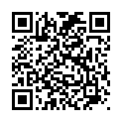
Exit Survey

