Slide 1
Braille 2000: NIMAS Textbook Transcription from Start to Finish
all sessions at 2pm Eastern
Session 2: File set up and transcriber-generated pages (Tuesday, June 23rd) Session 3: Editing and Formatting: Typeforms, lists, and TOCs (Tuesday, June 30th)
Session 4: Editing and Formatting: Headings and tables (Tuesday, July 7th)
Session 5: Math and footnotes (Tuesday, July 14th)
Session 6: eBraille conversion and Q&A (Tuesday, July 21st)

Slide 2

Session 1: NIMAS Files and Braille 2000 Basics

Slide 3
Learning Objectives
Identify components in NIMAS file set (PDF, XML, OPF, images) and how they are used for transcription
Access NIMAS file as an Accessible Media Producer (AMP)
Download, Save, & Convert NIMAS to braille file with Braille2000 or BrailleBlaster.

Slide 4
Steps Covered Today
Purpose:
Process:
Convert NIMAS files into braille text using Braille 2000 transcription program.
Access file from NIMAC site as Accessible Media Producer (AMP).
Download, Save, & Convert NIMAC file to braille file (using BrailleBlaster &/or Braille 2000).
Format, edit, proofread files to reflect print copy, using Braille Formats: Principles of Print-to-Braille Transcription, 2016.

Slide 5
NIMAC Background

Slide 6
What is NIMAC?
Created by IDEA 2004, the National Instructional Materials Access Center (NIMAC) is the national source file repository for K-12 textbooks and instructional materials.
We make NIMAS files available for use in producing accessible formats for K-12 instructional materials.
We have received over 90,000 file sets from over 200 publishers.
All 50 states, the eligible territories, and DoDEA work with the NIMAC.
Each State that works with the NIMAC designates Authorized Users who have full access to the repository.

Slide 7
What is a NIMAS file?
NIMAS stands for the “National Instructional Materials Accessibility Standard.”
It is an XML-based source file format.
NIMAS is designed for use in producing formats such as braille, DAISY, EPUB, large print.
NIMAS files cannot be directly embossed – they require translation into braille (or another format) before being used by a student. NIMAS files are not distributed directly to students.

Slide 8
Types of Materials in the NIMAC
Per IDEA, NIMAC receives files when states and districts require NIMAS in their textbook adoption contracts with publishers.
The wide range of student-facing instructional materials received by the NIMAC include: textbooks, workbooks, supplementary readers, and ancillary materials such as blackline masters.
Not all materials used in the classroom are within scope for the NIMAC. Examples of materials that are usually exempt include: teacher’s editions, pre-2006 titles, trade books, college textbooks, and reference books.

Slide 9
AMP Accounts
Any individual or organization that produces accessible formats on behalf of eligible K-12 students can sign up for a free NIMAC AMP account.
AMP accounts can have multiple subusers, so you can have one account for an organization or district with multiple subusers, or you can opt for individual accounts for each person.
AMPs can only download NIMAS files that are assigned to them by an Authorized User.

Slide 10
How to Obtain NIMAS Files
Authorized Users can either provide you with NIMAS files directly, or they can assign them to you in your NIMAC AMP account.
Authorized Users work under a State Education Agency. If you need a NIMAS file assigned to you, it would be assigned by an Authorized User in the state in which the accessible format is needed.
If you need help getting connected with an Authorized User, please reach out to the NIMAC and we can help!

Slide 11
How to Register as a NIMAC AMP
In order to get registered for a free AMP account, send an email to nimac@aph.org
We will add you in the system, and you will receive an email with a link to complete the online registration.
You will also receive a Limitation of Use Agreement (LUA). Please initial each page of the agreement, and fill out/sign section 14.0.
Once you complete the registration and send us your LUA, we will activate your account.

Slide 12
Accessing files from the NIMAC

Slide 13
Accessing files from NIMAC site
Overview
Receive email notifying you of NIMAS File Assignment.
Go to NIMAC portal and Log in.
Select assigned file; click on Add to My Downloads.
Receive confirmation email from NIMAC: (Title) Successfully Processed for Download.
Return to NIMAC portal:
  Go to My Downloads.
  Download file to PC.
Downloading NIMAS Files for AMPs on YouTube https://www.youtube.com/watch?v=v8aKAl84K8k

Slide 14
File Assignment
Confirmation Email
Request access to NIMAS file from contracting agency.
Example of NIMAS file assignment notification email:

Slide 15
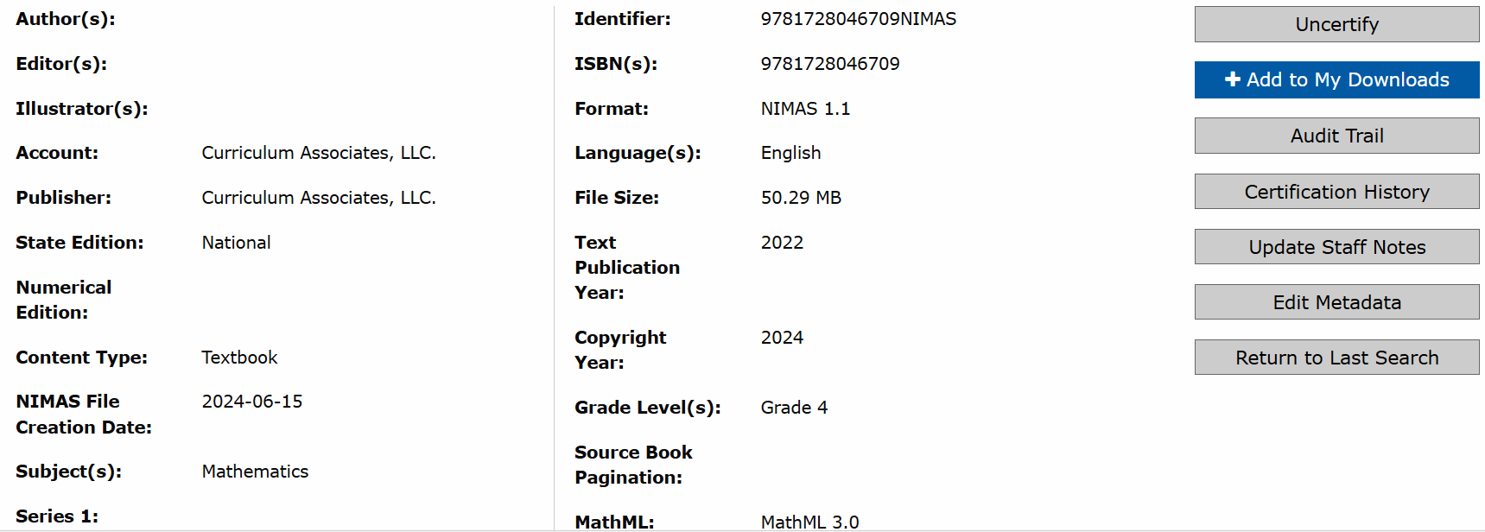
Title Details Page
Go to NIMAC portal and Log in.
View Title Details.

Slide 16
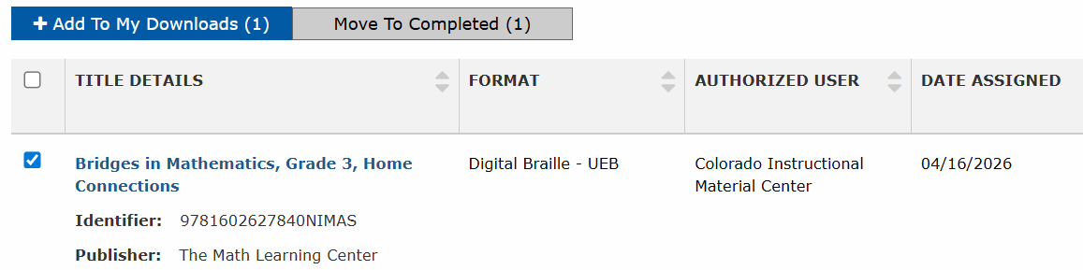
Title Assignments Page
Go to NIMAC portal and Log in.
Select assigned file; click on Add to My Downloads.

Slide 17
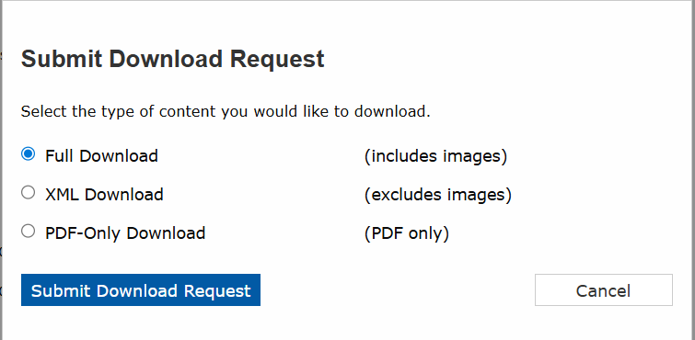
Accessing file from NIMAC site
Select from “Type of Content” menu and Submit Request

Slide 18
Download Confirmation Email
Receive another email confirmation when file is available for download.

Slide 19
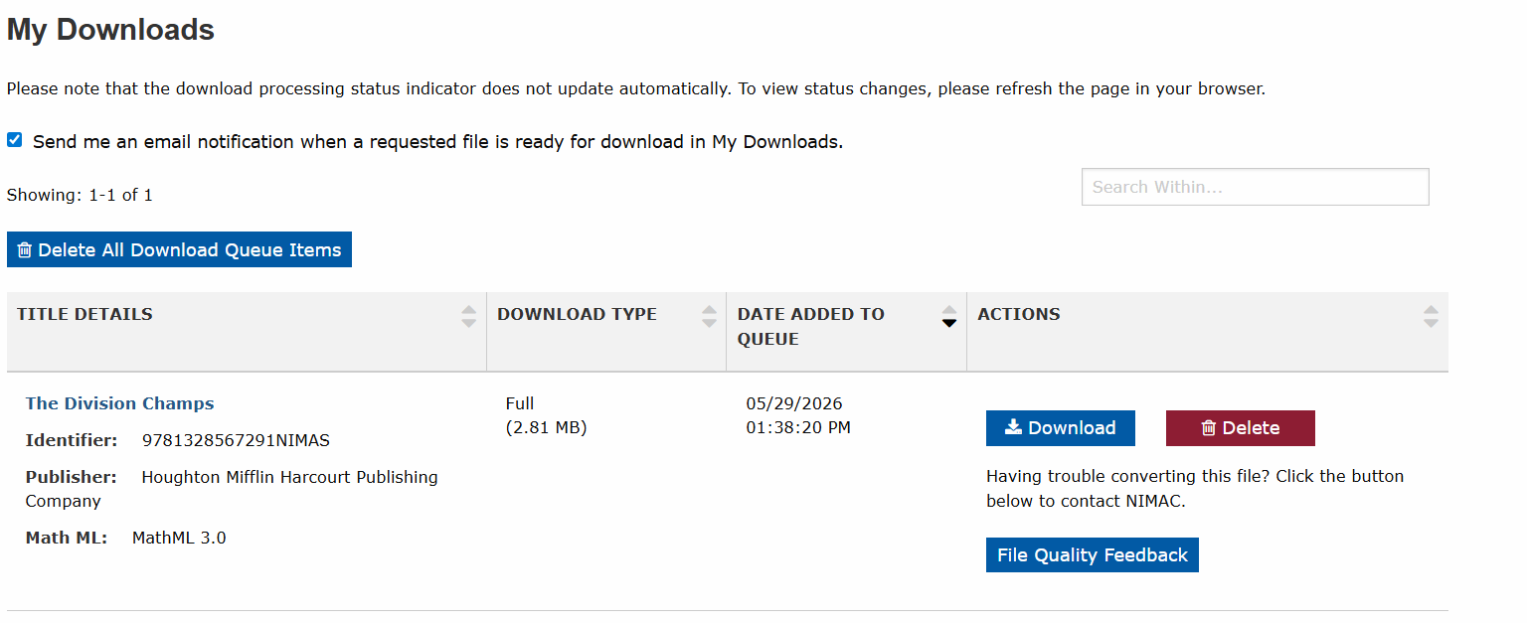
Downloading File
Navigate to My Downloads page
Download file to PC

Slide 20
NIMAS File Set Components

Slide 21
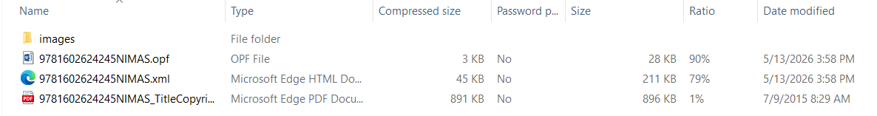
Overview of NIMAS File Components
Images: individual image file--illustrations & math diagrams, equations
PDF: title and copyright pages
XML: contents and structure of the material
OPF: file metadata

Slide 22
How to set up NIMAS Files on PC
PC files
  Open zipped NIMAS file from downloads.
  Copy and Save files to project folder.
    Images: individual image file--illustrations & math diagrams, equations
    XML: contains entire text to be converted
    OPF and PDF only needed for reference.

Slide 23
Converting NIMAS Files
Using Braille 2000

Slide 24
Braille2000
BRL2000 is a comprehensive tool for producing braille. Braille2000 is fully Internet-aware, making it as simple as a mouse click to send a braille document to a braille production center, to a school, to a blind student, or to a fellow transcriber.
Braille2000 allows you to read and write braille XML files as well as translate XML print text into braille.
Braille2000 is for Windows 7, Windows 8, Windows 8.1, Windows 10, and Windows 11.

Slide 25
Versions of Braille 2000
Version 2.42: Current release (May 2026)/version used in this training
Version 2.39: Previous version
  Will not convert some larger files with certain math tagging
  Will convert non-technical texts, and some smaller math files
Version 2.275: converts the larger math files
  Math will need to be done by the transcriber.
  You can request a link to re-download this version from Bob Stepp.
Version 3.00: still in development.
It’s possible to download a demo version of Braille2000.
Braille2000 can speak - the "Talking Edition" is self voicing

Slide 26
Converting NIMAS File to Braille File
Using Braille2000 (continued)
Braille2000 can read the entire XML file at once.
Most modestly-new computers should be able to handle full files.
If you do extensive editing tasks on the entire book, you may need a modern computer to respond fast enough to be useful (the largest factor is how much RAM your computer has—it should be about 512MB or more).
Braille2000 can help you navigate through the material in a structured way and see how the book was crafted; for example, looking at all the headings.

Slide 27
Braille 2000 Technical Support
Robert Stepp, creator of Braille 2000, offers free technical support to program users.
Braille2000, LLC
6801 Southfork Circle
Lincoln NE 68516
402 423-4782 (central time)
Contact information for technical support

Slide 28
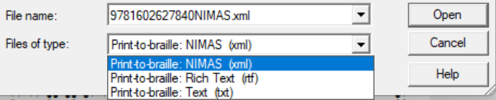
Converting NIMAS File to Braille File
Using Braille2000 (Direct import)
Open Braille 2000.
In tool bar, Open > Source File > Find and select relevant NIMAS XML file.
At the bottom of the "open" dialog box, you may need to change "Files of type" to XML > Open.
In Braille 2000 dialog box, select Transcription settings > OK. (see next slide)

Slide 29
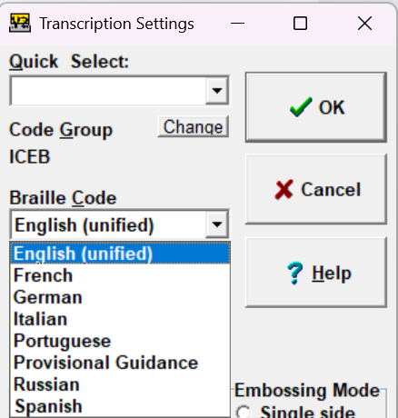
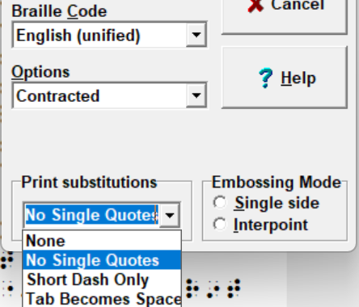
Converting NIMAS File to Braille File
Using Braille2000 (Direct import—continued)
When braille file opens, Save As > (title) in project folder.

Slide 30
Converting NIMAS File
Using BrailleBlaster

Slide 31
Converting NIMAS file to braille file using BrailleBlaster as intermediate step
“BrailleBlaster takes advantage of the rich markup contained in NIMAS (National Instructional Materials Accessibility Standard) files to automate basic formatting and gives you tools to make advanced tasks quicker and easier. Designed primarily for editing textbooks that meet the specifications published by the Braille Authority of North America...”
See the Documentation section for more information!

Slide 32
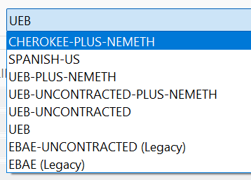
BrailleBlaster Translation Settings
File > Open (choose NIMAS XML file)
  Some helpful features
    Settings > Translation > Select (from Standard Settings) > (UEB, contracted or not, etc.)
    Settings > Translation > (other translations available)

Slide 33
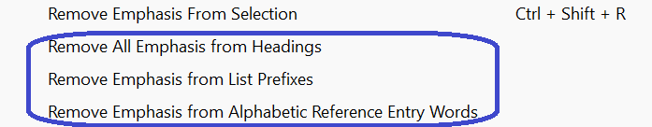
BrailleBlaster Settings (continued)
File > Open (choose NIMAS XML file)
  Some helpful features (continued)
    Emphasis (helpful for time saving and consistency) > (transcriber choice)

Slide 34
Converting NIMAS file to braille file using BrailleBlaster (continued)
File > Open (choose NIMAS XML file) (continued)
  Save as brf (NEW PROCEDURE, with latest version)
    File > Export > Save brf/PEF > (BRF file appears in PC Downloads) > Click on downloaded file > Assert Braille Code (popup window in Braille 2000) > Select UEB (dropdown menu) > OK
    File opens in Braille 2000. Save As (title) in Project Folder.

Slide 35
Transcription File Setup on PC

Slide 36
How to Setup Braille File on PC
Save As multiple files (retain original for reference)
  Original
  Working copy
  Large text portions (front matter; back matter; glossary; index; etc.)
  Search process: Search (Alt S) > Find text (F) > (enter text) > (Select “Top” or “Cursor”) > Enter
  Graphic file, if relevant.

Slide 37
Overview of Demo
Set up NIMAS files on PC.
  Save downloaded NIMAS file to Project Folder.
  Look at Images folder to see what’s available.
Convert NIMAS xml to Braille 2000 via direct import (OR)
Convert NIMAS xml to Braille 2000 with BrailleBlaster as intermediary.
Save large texts as multiple files.

Slide 38
Recap
Access file from NIMAC site as Accessible Media Producer (AMP).
Reviewing elements of NIMAS file
Download, Save, & Convert NIMAS file to braille file (using Braille 2000 direct import).
Download, Save, & Convert NIMAS file to braille file (using BrailleBlaster as intermediary step).
Setting up multiple working files for large transcription projects.
Using Search feature in Braille 2000

Slide 39
Coming Up!
all sessions at 2pm Eastern
Session 2: File set up and transcriber-generated pages (Tuesday, June 23rd)
Session 3: Editing and Formatting: Typeforms, lists, and TOCs (Tuesday, June 30th)
Session 4: Editing and Formatting: Headings and tables (Tuesday, July 7th)
Session 5: Math and footnotes (Tuesday, July 14th)
Session 6: eBraille conversion and Q&A (Tuesday, July 21st)

Slide 40
Contact Us
If you have any questions about working with the NIMAC or using NIMAS files, please reach out to us!
nimac@aph.org
877-526-4622

Slide 41
Q&A?

Slide 42
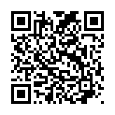
Exit Survey

