Slide 1
Duxbury/NimPro: NIMAS Textbook Transcription from Start to Finish
Session 5: Math
Ensure the NIMAS XML file has MathML tagging
Unicode characters
What to be aware of while transcribing math and technical materials
UEB Typeforms and Nemeth indicators

Slide 2
Duxbury/NimPro Webinar Series
Session 6: eBraille Overview and Series Q&A (Wednesday, July 1st)

Slide 3
Recap
What we did last session
  Learned how to make changes to Rear Matter using NimPro
  Learned how to format Glossaries and Indices
  Learned how to apply foreign language styles
  Learned about transposed material and how best to account for their location and braille page sizes in the current transcription project

Slide 4
Today’s Agenda
What we are going to do this session
  Verify the NIMAS file contains MathML
  Determine which DBT template to use for a project
  Learn what math related styles are in the DBT template
  Learn what types of content may not be tagged math

Slide 5
Learning Objectives
Learn how to identify an XML document with MathML
Learn about math templates and associated style in DBT
Learn about content that may not appear in MathML tags

Slide 6
Resources
Braille Formats https://www.brailleauthority.org/braille-formats-principles-print-braille-transcription-2016
Nemeth Code https://www.brailleauthority.org/nemeth-code
Rules of UEB and Guidelines for Technical Material https://iceb.org/publications/ueb/
Unicode 2200 Mathematical Operators Chart https://www.unicode.org/charts/PDF/U2200.pdf
MathType https://www.wiris.com/en/mathtype/
Stay up to date! Consistently check for errata and updates.

Slide 7
Math Files and Templates

Slide 8
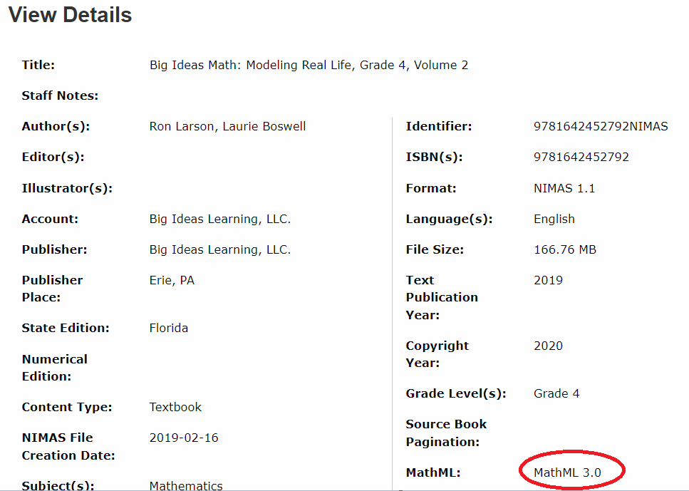
Verify the NIMAS XML contains MathML
If you download a file from the NIMAC, you can check the system metadata to see if the file contains MathML:

Slide 9
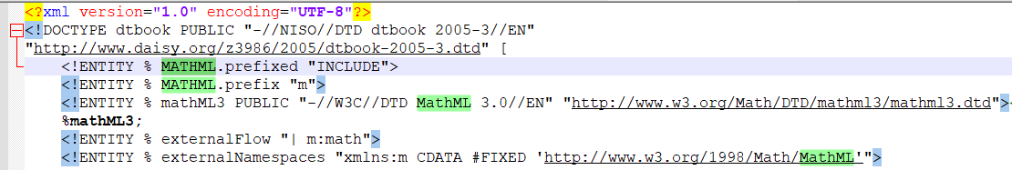
MathML in NIMAS
If you already downloaded a file, or received a NIMAS file from an agency, you can open the NIMAS XML file in Notepad and check for the MathML DTD at the top of the file:

Slide 10
DBT template English (UEB) - BANA with Nemeth
Nemeth Code within UEB Styles
<math> Inserts Nemeth code indicators, both with required spaces
<math-separation> Words and problem identifiers
<math-TextInMath> Text that is part of the math, such as abbreviations
<OneWordBridge> Inserts Single-word switch indicator and contracts the word
<math-NLE Nemeth> Inserts Nemeth code indicators, required space only with opening indicator
  Useful with tables and laying out pages for tactile graphics

Slide 11
DBT template English (UEB) – BANA
UEB math Styles
<math> for math
<math-TextInMath> use within the math style for literary

Slide 12
Unicode

Slide 13
Unicode
Unicode is a standard for characters and symbols
Each character or symbol has its own unique number associated with it
There are numerous Unicode charts
DBT Help contains valuable Unicode information

Slide 14
Chart 2200 Mathematical Operators Characters
Copy and paste math characters from this Unicode chart
  https://www.unicode.org/charts/PDF/U2200.pdf
DBT translates many of these beautifully
  Should you come across a character that translates oddly, please contact support@duxsys.com
Not every math character resides in the 2200 chart, such as 211d Double-Struck Capital R ℝ

Slide 15
Entering Unicode Characters
Unicode characters have 4-6 digits
In the 2200 chart, each have 4-digit numbers that corresponds to that unique character.
Example of how to enter a Unicode character:
  00d7 is the Multiplication Cross ×
  In DBT, ctrl+] and type 00d7 in the field and press OK to enter × in the file.
  In Word, type 00d7 ensuring a space is before it. With the cursor after the last digit 7, press alt+x to convert 00d7 to ×.

Slide 16
Math
Be Aware of…

Slide 17
Isolated Characters and Math Style Errors
Monetary and percentages $, ¢, and %
Prime and double prime ′ ″
Slash /, meaning per, over, or divided by
Degree °
Tilde ~
Positive/Negative numbers +/-
Angle ∠
Decimal numbers 3.14
The fractions ¼ ½ ¾
Ellipsis …
Ratio and proportion ∶ ∷
Invisible operators (U+2061, U+2062, U+2063, U+2064)
Greek letters ϖ φ
Chemistry O₂
Enclosed lists (1, 3), {∞, 0}, or (∞, 0]
Abbreviated function names sin cos tan
Superscripts and subscripts O₂ 10⁵
Isolated signs of operation or comparison <, >, or =
Scientific numbers 3.5 × 10⁵
Shapes/arrows → ▭ △
Tally marks ||||| |||
Series of two or more letters in mathematical context CD

Slide 18
Watch for formatting, Nemeth Single-word switch indicator use, and Excessive tagging
Abbreviations separated from their associated value
Abbreviations and text needing <math-TextInMath>
Literary word needing <OneWordBridge>
Characters may be superscripted *, †, ‡, ®, or ™
Words used in equations
Table with math content
Nemeth opening indictor ends typeform
Sequence of math (<, >, or =) or itemized math
Grouping indicators needing to be in associated code
Spatial material alignment and format

Slide 19
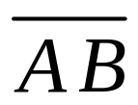
Possible Improper Codes in DBT
Mixed numbers and complex fractions 2½
Barred characters as images
Interpunct (· 00b7) character used instead of the dot operator
(⋅ 22c7)
Nemeth contracted form of bar over/under a single digit x
Enlarged grouping indicators: DBT code [big]

Slide 20
Typeform termination with Opening Nemeth Code Switch Indicator
Nemeth 4.6.7
  A switch from UEB to Nemeth Code terminates the effect of a UEB typeform indicator. No UEB typeform terminator is required.
Use only the opening typeform style in the UEB text when a passage is prior to the opening Nemeth Code indicator
  Enter only the opening typeform style as a code using [es~ ]

Slide 21
Word Find and Replace

Slide 22
Find and Replace without Using Wildcards
Find what | Replace with | why?
^l | ^p | Changes line breaks to paragraphs
Format > Font… > Superscript | In the field enter: [[*ps*]]^&[[*pe*]] Remove the superscript in Format > Font… > Superscript | Removes superscript style and surrounds the replaced text with the associated codes for DBT
Format > Font… > Subscript | [[*bs*]]^&[[*be*]] Remove the subscript in Format > Font… > Subscript | Removes subscript style and surrounds the replaced text with the associated codes for DBT

Slide 23
Find and Replace Using Wildcards
Find what | Replace with | why?
^13{1,} | ^p | Removes multiple empty paragraph marks. Best done after changing line breaks ^l to ^p
\((*)\) | Leave the field blank, and choose the style TechnicalNotation | All enclosed lists will be in Nemeth Code. Beware, this will also alter text within paragraphs. Best to Find each instance and review text. Best done after applying super/subscript codes.
\$([0-9.,]{1,}@) | Leave the field blank, and choose the style TechnicalNotation | All monetary amounts will be in Nemeth Code.
([0-9.,]{1,}@)\% | Leave the field blank, and choose the style TechnicalNotation | All percentages will be in Nemeth Code.

Slide 24
Demo time!
Check XML file for MathML
Look at DBT templates and styles for math
Entering Unicode characters
What to be aware of while transcribing math and technical materials
UEB Typeforms and Nemeth indicators

Slide 25
Contact Us
If you have any questions about working with the NIMAC or using NIMAS files, please reach out to us!
nimac@aph.org
877-526-4622

Slide 26
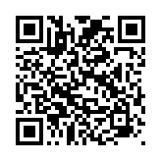
Exit Survey

