Slide 1
Duxbury/NimPro: NIMAS Textbook Transcription from Start to Finish
Session 4: Rear Matter
Make changes to the Rear matter in NimPro
Work with alphabetic references and transposed material
Language switching

Slide 2
Duxbury/NimPro Webinar Series
Session 5: Math (Thursday, June 25th)
Session 6: eBraille Overview and Series Q&A (Wednesday, July 1st)

Slide 3
Recap
Used NimPro to make large scale changes to the entire Body Matter and also to make refined changes to Chapter 1
Learned about DBT codes and styles
Inserted files in DBT to build the braille volume
Learned about customizing for special braille formats in DBT

Slide 4
Outline of today’s session
Learn how to make changes to Rear Matter using NimPro
Learn how to format Glossaries and Indices
Learn how to apply foreign language styles
Learn about transposed material and how best to account for their location and braille page sizes in the current transcription project

Slide 5
Learning Objectives
Learn how to use NimPro to make changes to the Rear matter
Learn strategies on how to format Glossaries with foreign language
Learn about transposed material and how best to account for their location and braille page sizes

Slide 6
Resources
DBT 14.1 documentation https://www.duxburysystems.com/documentation/dbt14.1/
NimPro 3.0 https://www.duxburysystems.com/nimpro.asp
Braille Formats https://www.brailleauthority.org/braille-formats-principles-print-braille-transcription-2016
Rules of UEB https://iceb.org/publications/ueb/
Braille Certifications and Instruction Manuals
https://nfb.org/programs-services/braille-certification
Additional codebooks and guidelines https://www.brailleauthority.org/
National Braille Association Ask An Expert https://www.nationalbraille.org/forums/
Stay up to date! Consistently check for errata and updates.

Slide 7
Rear Matter

Slide 8
Rear Matter Examples
Alphabetic references (Braille Formats §21)
  Glossaries
  Indices
  Appendices
Sections to be transposed (Braille Formats §2.10.12)
  Answers
  Additional problems
  Extra Practice
  Endnotes
And others

Slide 9
Export Rear Matter Sections Individually
Export from NimPro each section individually
Format each section as its own file
Insert each section to its appropriate location in the project
This is helpful as the braille page count can be known of the individual sections before inserting into the transcription project

Slide 10
NimPro Glossary and Index Wizards
Change headings to centered
Clean up unneeded typeforms
  General Alphabetic References Braille Formats §21.2.2
  Multilevel Thesaurus Braille Formats §21.7.3
  Indices single letters Braille Formats §21.4.3
Be aware the Wizard will remove all font attributes from the entire section
  For example, using the Index Wizard to remove italics will remove all italics. It will remove it from both the unneeded italics on single letters (Braille Formats §21.4.3) and also from the needed italics on cross-references (Braille Formats §21.2.4)
Alphabetic references start on their own braille page (Braille Formats §21.2.1a)

Slide 11
English/Foreign Language Glossaries with separate entries
Glossaries with both English and foreign language as separate entries are nested (Braille Formats §21.6.3)
From NimPro after using the Glossary Wizard, choose between:
  Export to DXP and work in DBT. Increase the style level for the foreign language entries and apply the appropriate foreign language style to entries.
  -OR-
  Export to DOCX and work in Word. Use Find and Replace to adjust the styles appropriately. Open the DOCX in DBT.

Slide 12
Glossary/Glosario Example

Slide 13
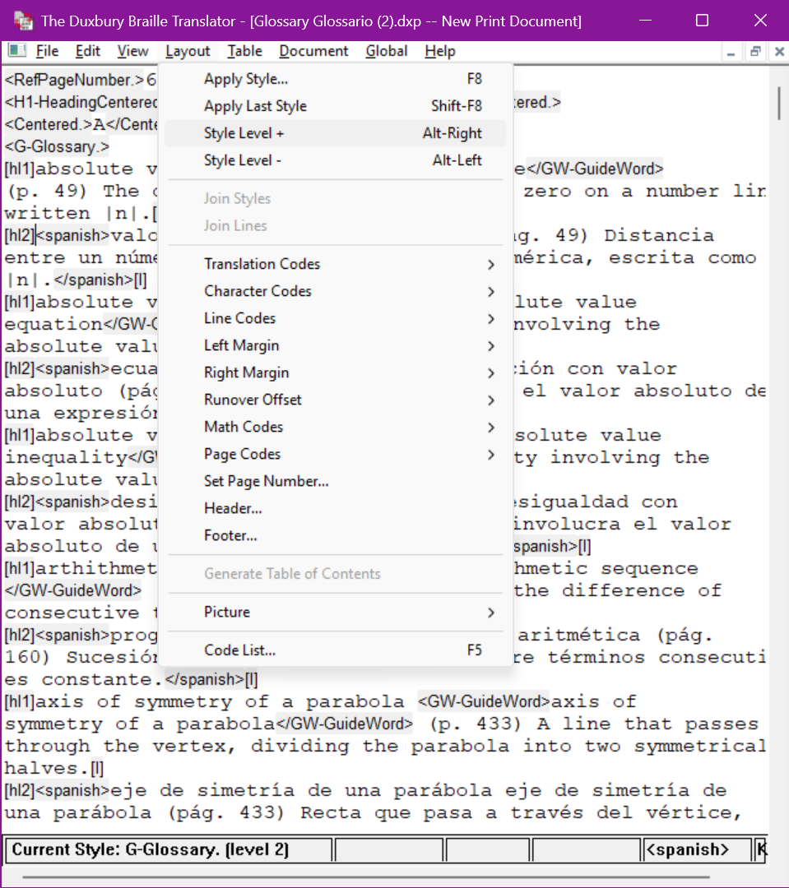
DBT
Increase the style level for the foreign language entries
  Layout > Style Level +
  Keyboard shortcut alt+right arrow
Apply the Spanish style to entries
  Layout > Apply Style …
  Keyboard shortcut F8

Slide 14
Using Find and Replace in Word
In the DOCX, all the entries will have the style Glossary applied. In order to nest these entries, the English entries need to change to Glossary1 and the Foreign Language entries need to change to Glossary2:
Use Find and Replace to change the style Glossary to Glossary1
Use Find and Replace to find accented letters in the foreign language and change the style to Glossary2
Use Find and Replace to find the style Glossary2 and replace with the style Spanish

Slide 15
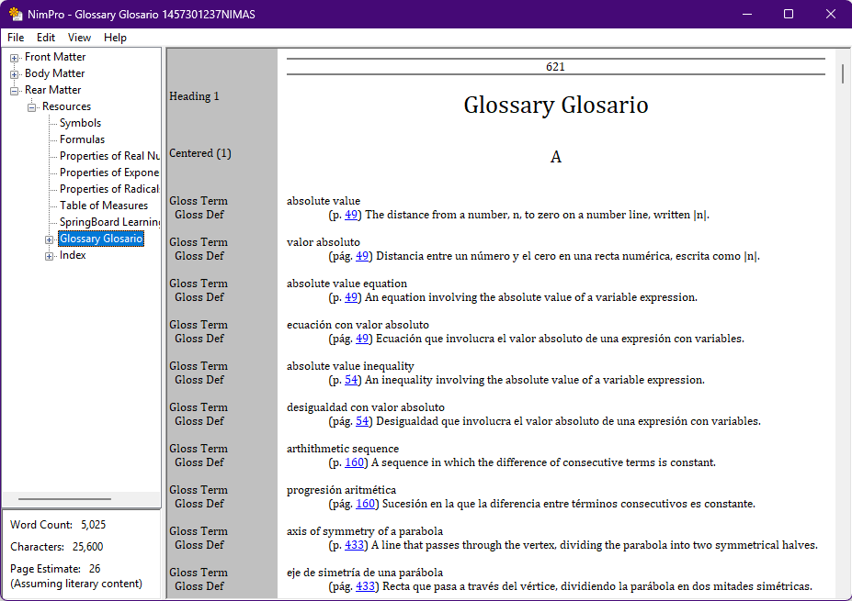
NimPro after Wizard

Slide 16
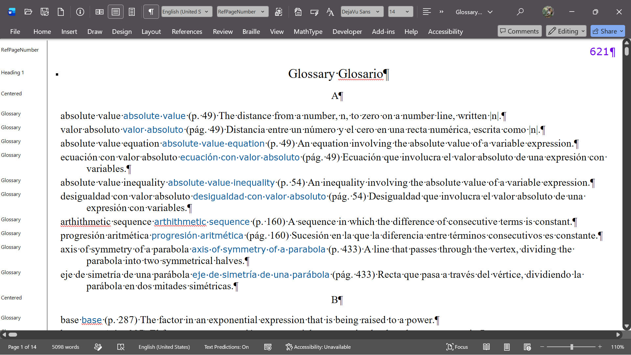
Opened in Word
Note all the entries have the style Glossary

Slide 17
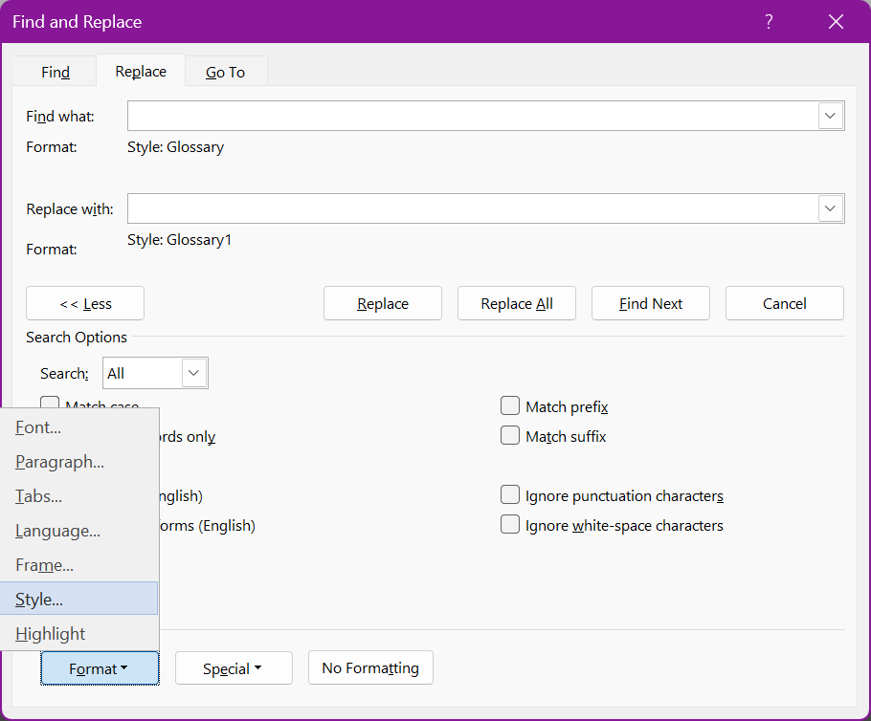
Use Find and Replace to change the style Glossary to Glossary1
In the Find What and Replace with fields, change the styles appropriately
Changing Styles:
  At the bottom of the Find and Replace window is the Find Section
  Expand the Format drop down and choose Style…

Slide 18
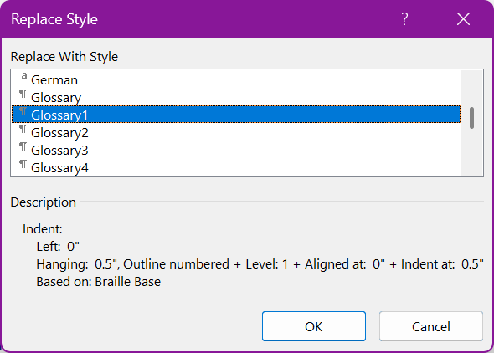
Selecting Styles
Select the appropriate style from the listing

Slide 19
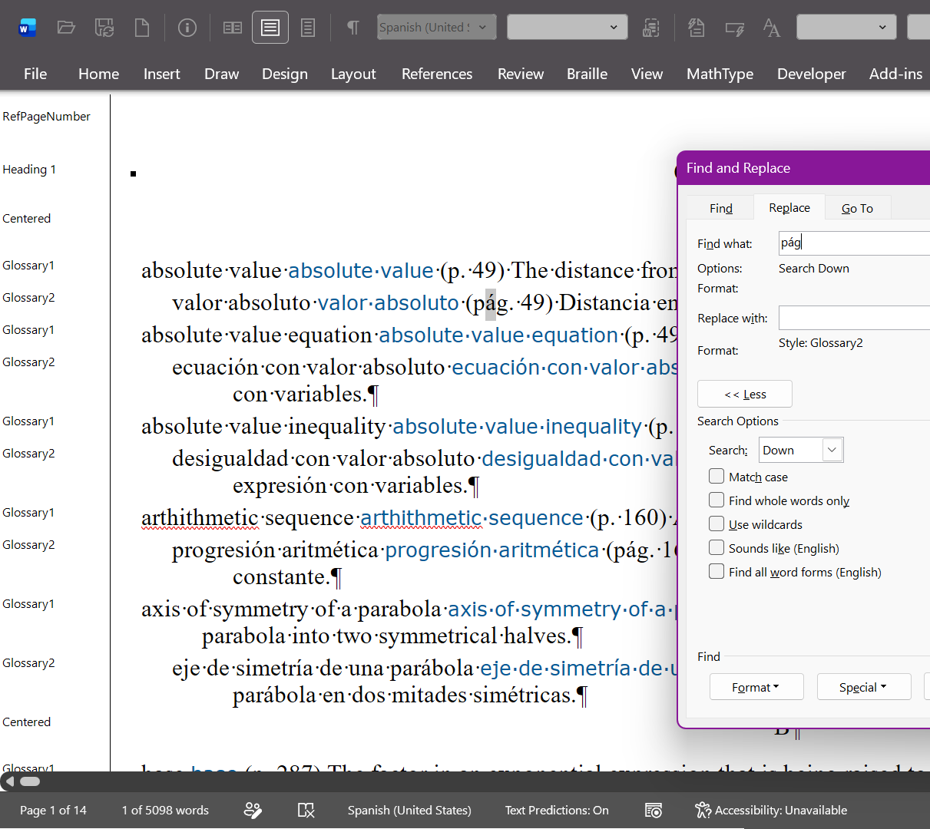
Use Find and Replace to change the Spanish entries to Glossary2
In this example, each Spanish entry has pág
Find pág and replace with style Glossary2

Slide 20
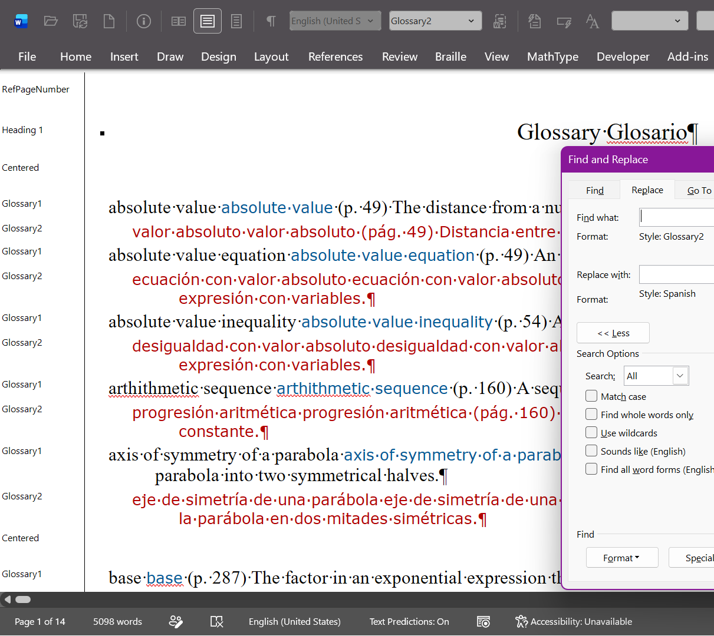
Use Find and Replace to apply the Spanish style to entries with the Glossary2 style
Find the style Glossary2
Replace with the style Spanish
The Spanish style is a character style while Glossary2 is a paragraph style
Both can be applied

Slide 21
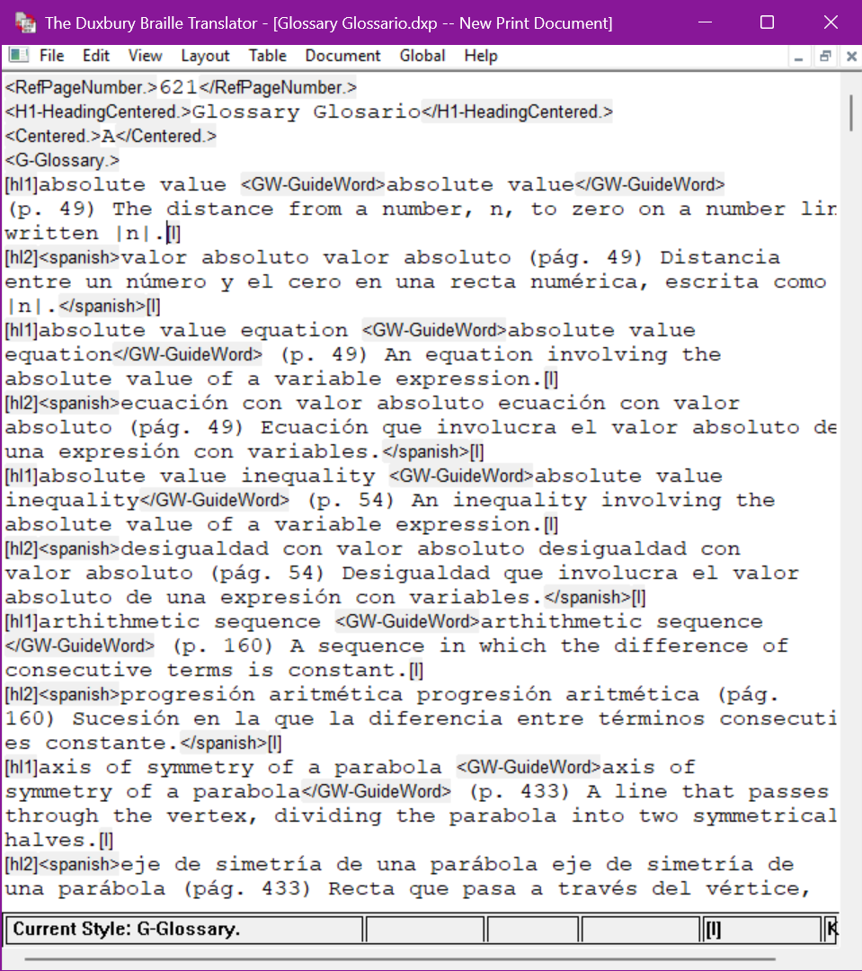
Open the Word file in DBT
The Word DOCX can be inserted directly into the current volume
Although, preference is to open the Word DOCX on its own in DBT, make any adjustments, save as a DXP, and then insert the DXP into the transcription project

Slide 22
Indices
An index is marked up as a list so its structure is different than a Glossary
Use the Index Wizard to get the nested structure for braille

Slide 23
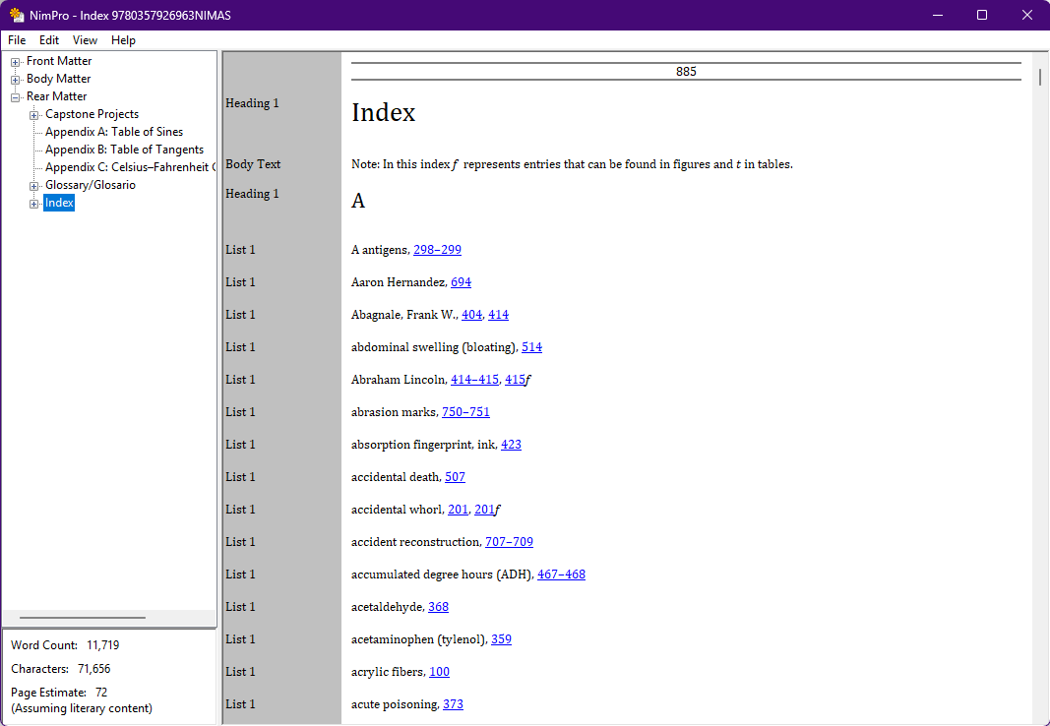
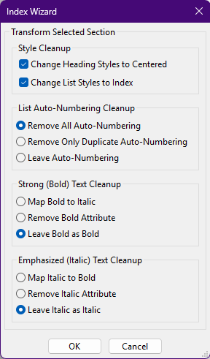
Index Wizard

Slide 24
Transposed Material

Slide 25
Braille Formats §2.10.12
Transposed Material
  Text moved from one location in the book to another location is considered transposed. … such as test questions, answers, endnotes, etc., moved from another location in the book (e.g., the back of the book) to the end of a chapter or volume, etc.
Use NimPro to export these sections to work on separately
Insert sections into the associated braille volume

Slide 26
Benefits of working on Transposed Material Sections Separately
By transcribing these rear matter portions separately by section, the number of braille pages is known
Transcription of the body matter can end at an appropriate location since the number of braille pages needed for the transposed material is known
Consistency and avoiding duplication of effort
  For example, the same image may be used in both the body matter and these transposed sections.

Slide 27
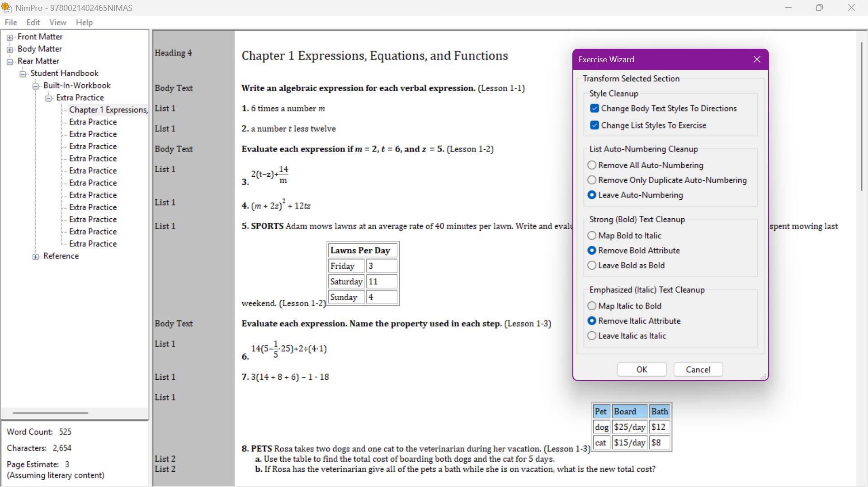
Example: Extra Practice section
In NimPro, use the Exercise Wizard to make large scale changes

Slide 28
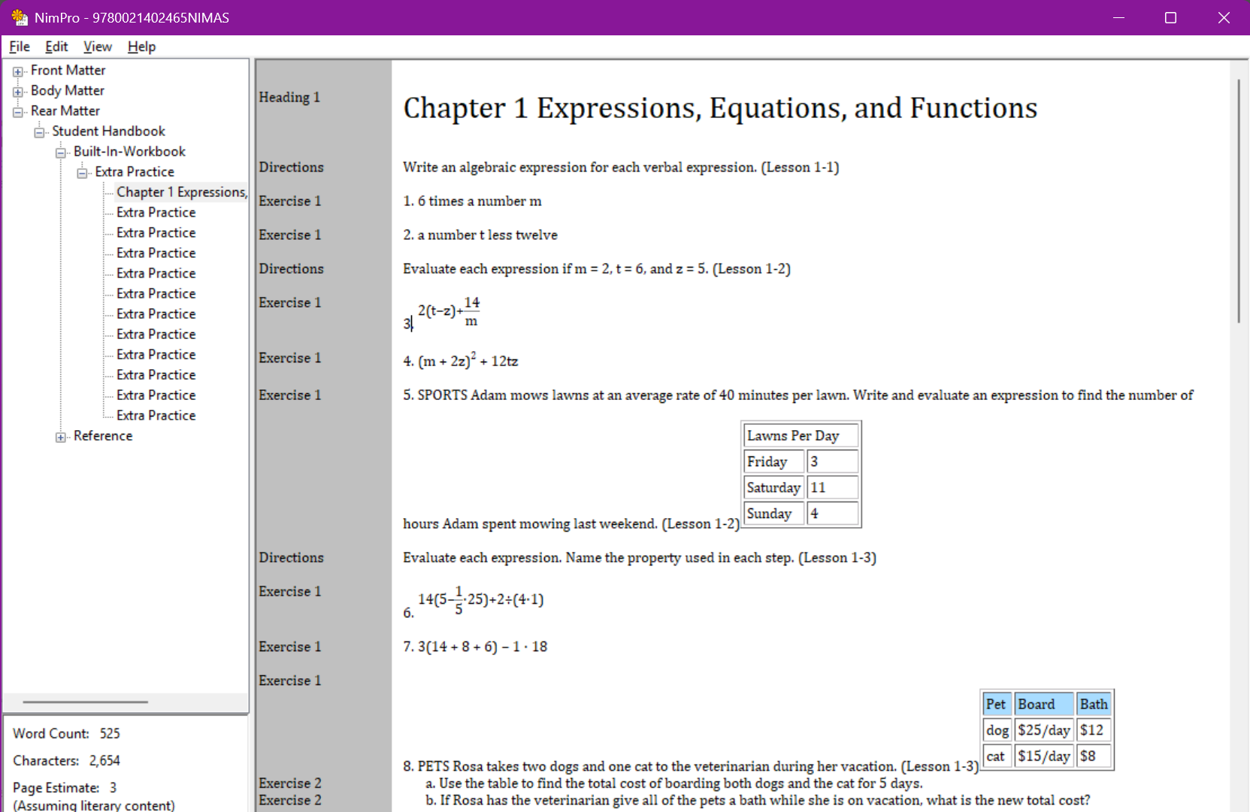
Example: Extra Practice section continued
Cleaned up and ready for export to its own file
  Word or DXP based on your preferred working style
Rinse and repeat for additional sections

Slide 29
Demo time!
Use NimPro to make changes to the Rear matter
Format a glossary containing foreign language
Learn about transposed material and how best to account for their location and braille page sizes

Slide 30
Contact Us
If you have any questions about working with the NIMAC or using NIMAS files, please reach out to us!
nimac@aph.org
877-526-4622

Slide 31

Exit Survey

