Slide 1
Duxbury/NimPro: NIMAS Textbook Transcription from Start to Finish
Session 3: Body Matter
Use NimPro to make large scale changes to Body Matter structure
Use NimPro to make refined changes to Chapters
Combine files in DBT to build a braille volume
Tips and tricks for working with codes and styles
Customizing for special braille formats

Slide 2
Duxbury/NimPro Webinar Series
Session 4: Rear Matter (Thursday, June 18th)
Session 5: Math (Thursday, June 25th)
Session 6: eBraille Overview and Series Q&A (Wednesday, July 1st)

Slide 3
Recap
What we did last session
  Created a template for future projects of transcriber-generated pages
  Based on that template, created a NOTES file to document decisions about the current project
  Used NimPro to format and export front matter to a Word document
  Initially formatted preliminary pages using SWIFT in MS Word
  Opened that Word document in DBT
  Saved to DXP and finalized the braille layout of the preliminary pages

Slide 4
Today’s Agenda
What we are going to do this session
  Using NimPro, make large scale changes to headings in the Body Matter
  Apply refined changes to Chapter 1
  Combine files in DBT to build a braille volume
  Learn tips and tricks for working with codes and styles
  Learn about customizing the paper size, line spacing, and learning tables for special braille formats

Slide 5
Learning Objectives
Learn how to make large scale changes to sections of text using NimPro.
Learn how to insert documents into DBT to compile a braille volume.
Learn how to use DBT codes for page layouts.

Slide 6
Resources
Duxbury Systems https://www.duxburysystems.com/
Braille Formats https://www.brailleauthority.org/braille-formats-principles-print-braille-transcription-2016
Rules of UEB https://iceb.org/publications/ueb/
Braille Certifications and Instruction Manuals https://nfb.org/programs-services/braille-certification
Additional codebooks and guidelines https://www.brailleauthority.org/
National Braille Association https://www.nationalbraille.org/
Stay up to date! Consistently check for errata and updates.

Slide 7
Use NimPro to make large scale changes to Body Matter

Slide 8
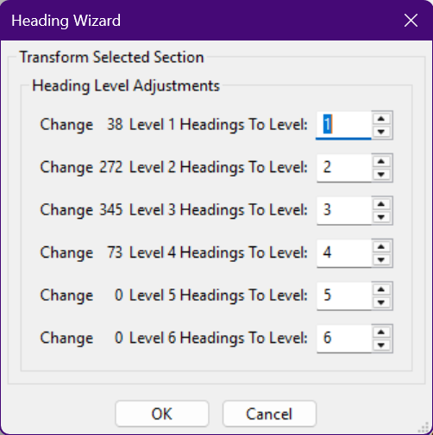
Evaluate Heading Hierarchy of the entire Body Matter and Use the Heading Wizard in NimPro
The Wizard applies to selection in the left pane
BF § 4.2.1 “When there are more than three distinct heading levels in print, cell-7 headings are applied only to the lowest hierarchy level; the use of centered headings is extended to one or more subsection levels as necessary.”
In the NOTES document, record these structure changes

Slide 9
After making large scale changes to the entire Body Matter - SAVE
Remember, NimPro has no undo/redo
SAVE the NimPro project file with an appropriate name to the task you performed.
  For example, Textbook Exemplar body matter.nimpro

Slide 10
Use NimPro to make changes in Chapter 1
Make a selection in the left pane to apply changes by Wizard
  For example, change generic List styles to Exercises
Make changes where the cursor is located by keyboard entry
  Arrow keys or the space bar to skip to the next paragraph
  B - Body text
  D - Directions
  E - Exercise
  H - Heading, thereafter #
  L - List Item, thereafter #
  T - Production Note (a.k.a., Transcriber's Note)
When completed, SAVE the NimPro project file with an appropriate name to the task you performed.
  For example, Textbook Exemplar Chapter 1.nimpro

Slide 11
Why all the NimPro file saving?
Saving files at each stage of the process as the project progresses creates a fall back for your work.
Were changes made in NimPro not suitable? Open the *.nimpro project file for the hierarchy above what you are working on to try again.
For example, changes made to Chapter 1 were unsuitable
  Open Textbook Exemplar body matter.nimpro
  Make changes to Chapter 1 again that are suitable
  Save as Textbook Exemplar Chapter 1.nimpro to replace the file with the unsuitable changes

Slide 12
Export Chapter 1
Once all the changes have been made in NimPro and the NimPro project file is saved, export the selection to the desired filetype. Append the filename appropriately to the task
  For example, Textbook Exemplar Chapter 1.dxp

Slide 13
In DBT, combine files to build the braille volume

Slide 14
In DBT, continue working on the same file from the previous session
In DBT, open the preliminary pages file from the previous session
At the end of the file, insert a new line by pressing Enter
Insert the Chapter 1 DXP file exported from NimPro
  Edit > Insert File...
  Navigate to the project folder
  Choose Textbook Exemplar Chapter 1.dxp
  Click Open
The formatted text will be inserted into the document

Slide 15
The power of Inserting files
Edit > Insert File... is a powerful way to build the braille volume
DXP and Word documents can be inserted
  Please refer to DBT Help for more file options that can be inserted
Examples of components to build a braille volume:
  TOC to insert each braille volume
  Answers found at the back of a book that must be moved to the volume in which the material appears. Separating out the Answer section to a separate file helps as the number of braille pages is known.
  A crazy table can be cleaned up separately from the main text

Slide 16
Troubleshooting - The text didn’t appear in the DXP after inserting a Word file
If the text didn’t appear after inserting the Word file, close the DXP and reopen it.

Slide 17
Codes and Styles in DBT

Slide 18
Codes
Mark-up to define how braille is translated and formatted.
  Formatting codes, structure and layout out on the page
  Translation codes, language or learning table
Short and abbreviated terminology
Layout > Code List (F5)
If you know the code, enter it with F9 or ctrl+[

Slide 19
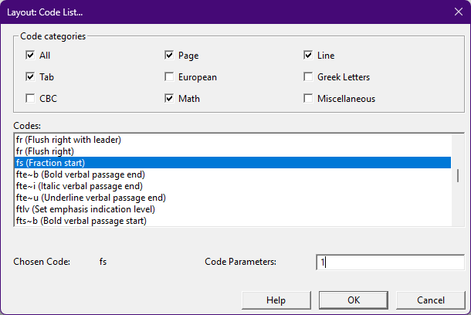
Code List
Layout > Code List (F5) to insert
Enter a Code Parameter for certain codes
For example with Fraction Start, enter 1 in the Code Parameter to get fs1 for Complex fractions

Slide 20
Styles
A collection of codes
The style can be named something descriptive
Layout > Apply Style (F8) and select the style to apply
  Styles ending with a period apply to the entire paragraph
  Styles without a period are character styles
Layout > Apply Last Style (shift+F8) will apply the style of the preceding paragraph

Slide 21
Find or Replace a Style
A style opening or closing on its own can be inserted as a code
To see the code of a style, select the style instance and press ctrl+[
An opening style starts with es~, and a closing style starts with ee~
This is helpful looking for punctuation occurring after a typeform
  For example, ee~i-italic entered as a code in the Find field will find the ending <i-italic> style

Slide 22
Special formats

Slide 23
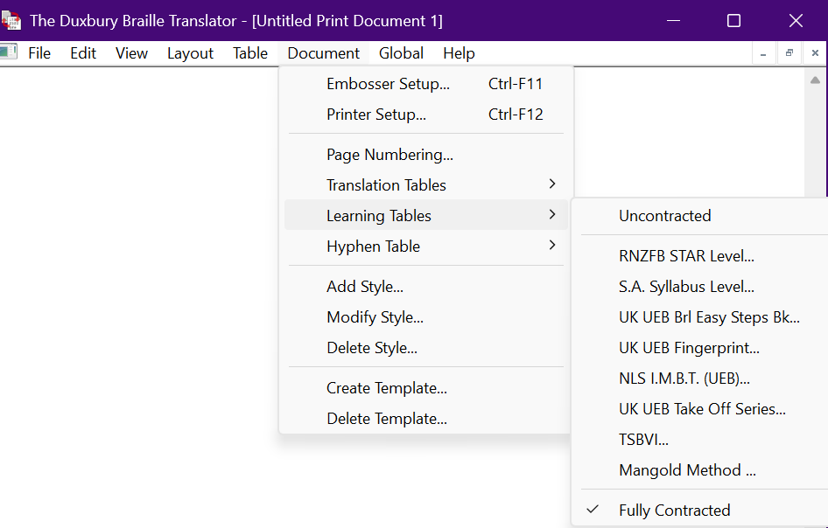
Learning Tables
Need specific contractions?
Check out Document > Learning Tables
The Help file details each course and the selected contractions

Slide 24
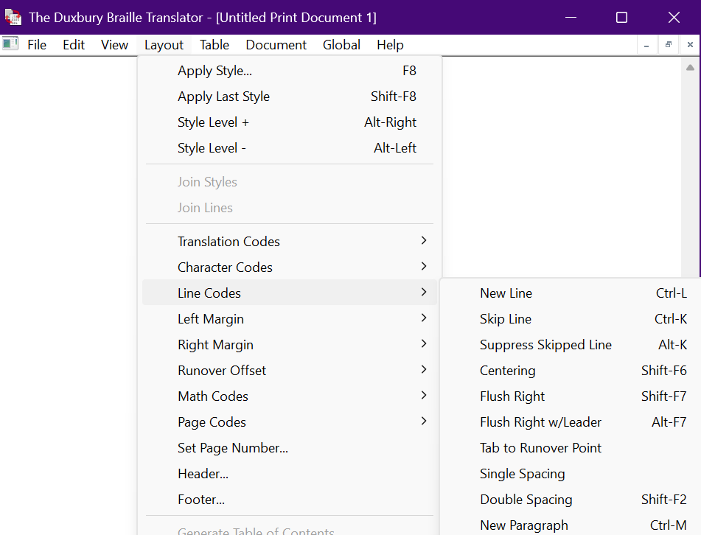
Line spacing
Check out Layout > Line Codes for Double Spacing
Braille Formats §1.7.2 guidelines regarding Double-spacing

Slide 25
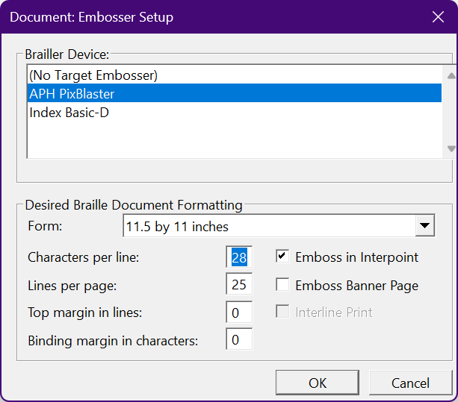
Paper size
Change the paper size in Document > Embosser setup
Making this change with the document open in the Document menu applies changes for that document
Making an embosser change in the Global menu will effect all future documents

Slide 26
Demo time!
NimPro Heading Wizard changes to Body Matter
NimPro to make refined changes to Chapter 1
Combine files in DBT to build a braille volume
Tips and tricks for working with DBT codes and styles
Customizing for special braille formats

Slide 27
Contact Us
If you have any questions about working with the NIMAC or using NIMAS files, please reach out to us!
nimac@aph.org
877-526-4622

Slide 28
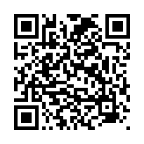
Exit Survey

