Slide 1
Duxbury/NimPro: NIMAS Textbook Transcription from Start to Finish
Session 2: Setting up for Success!
Documentation about the project
Using NimPro, make changes and export front matter
Using Word and SWIFT; designate pagination and set up

Slide 2
Duxbury/NimPro Webinar Series
Session 3: Body Matter (Thursday, June 11th)
Session 4: Rear Matter(Thursday, June 18th)
Session 5: Math (Thursday, June 25th)
Session 6: eBraille Overview and Series Q&A (Wednesday, July 1st)

Slide 3
Outline of today’s session
Documenting your transcription project
Front matter formatting with NimPro
Setting up in Word using SWIFT

Slide 4
Learning Objectives
Learn a new strategy for documenting your transcription project.
Learn how to format and export your textbook front matter using NimPro.
Understand how to set up your transcription project and format pagination in Word using SWIFT.

Slide 5
Resources
DBT 14.1 documentation https://www.duxburysystems.com/documentation/dbt14.1/
NimPro 3.0 https://www.duxburysystems.com/nimpro.asp
SWIFT https://www.duxburysystems.com/swift.asp
Braille Formats https://www.brailleauthority.org/braille-formats-principles-print-braille-transcription-2016
Rules of UEB https://iceb.org/publications/ueb/
Braille Certifications and Instruction Manuals https://nfb.org/programs-services/braille-certification
Additional codebooks and guidelines https://www.brailleauthority.org/
Stay up to date! Consistently check for errata and updates.

Slide 6
Documenting Your Project

Slide 7
Create a NOTES template and a Project NOTES document based on the template
Initial creation of a NOTES template document with:
  Title page outline
  Special symbols listing
  Transcriber’s Note page entries
Project specific document with additional considerations to include:
  Decisions made about project, e.g., running head, headings, typeforms, icons, etc.
  Who the transcript is for and how that informs the setup, e.g., Single-sided v. interpoint, contracted/uncontracted, spacing, paper size, etc.

Slide 8
Title page in 5 sections, Braille Formats §2.3
book title (on line 1)
subtitle (if any)
series name (if any)
author(s)
publisher's name
publisher's first or principal address (city and state only)
publisher's website (if listed in print)
copyright year and holder
reproduction notice
ISBN
printing history
year and base code of braille transcription and name of transcriber
Organization affiliation
Address of organization or transcriber (city and state only)
total number of braille volumes
number of the particular volume
inclusive braille pages
inclusive print pages (on line 25)
Title segment
Author segment
Publisher and Copyright segment
Transcriber/Transcription segment
Volume Information segment
Source of text: Instruction Manual for Braille Transcribing, Lesson 19
https://nfb.org/programs-services/braille-certification/literary-braille-transcribing

Slide 9
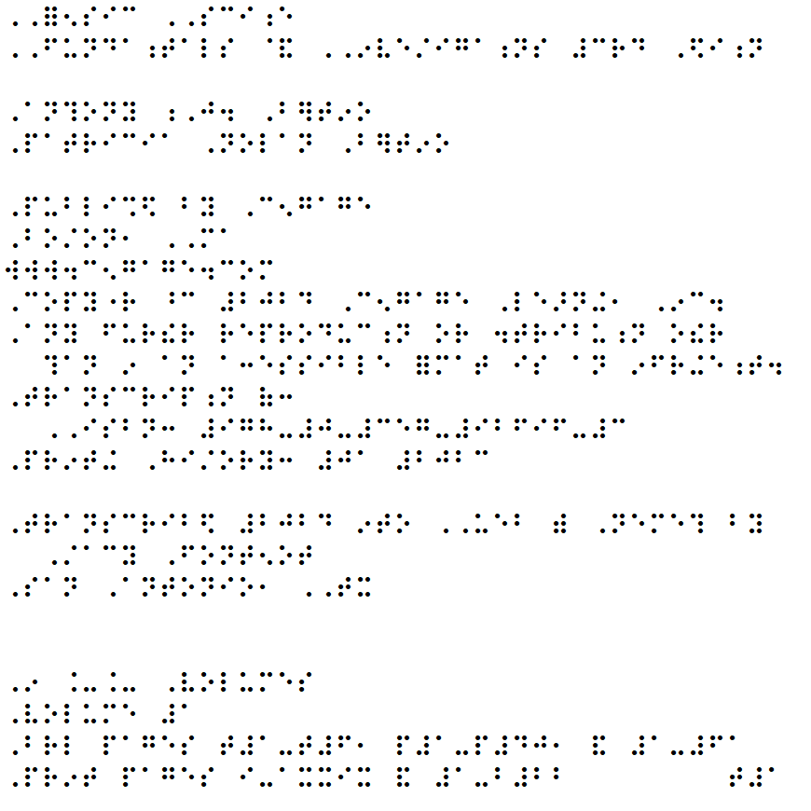
Title Page

Slide 10
Title page Reproduction Notice
Addendum to Braille Formats 2016 (posted June 2024). Changes what is in BF§2.3.6e
Required reproduction notice:
  Any further reproduction or distribution other than in an accessible format is an infringement.

Slide 11
Special symbols, Braille Formats §2.5
At this time, DBT does not have a way to automatically create a Special Symbols page listing
Track symbols used in your project
  In your NOTES documents, consider subheadings for each volume in the project
References
  Braille Formats §2.5 and Appendix G
  Rules of UEB Appendix 3

Slide 12
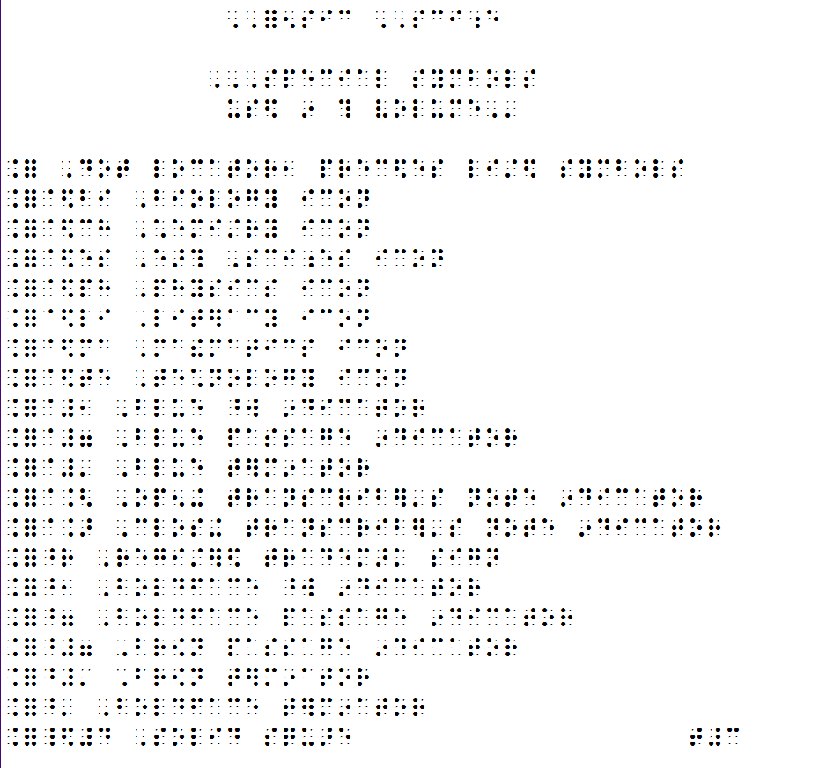
Special Symbols
Page

Slide 13
Transcriber’s Note page, Braille Formats §2.6
Refer to any project provisions provided by the agency requesting the transcription
Technical codes, for example:
  Mathematical content is transcribed according to The Nemeth Braille Code for Mathematics and Science Notation, 2022.
  Chemical content is transcribed according to Chemical Notation Using the Nemeth Braille Code, 2023.
  Tactile graphics are produced according to the Guidelines and Standards for Tactile Graphics, 2022.
At this stage, save as a template for future projects.
Create and save based on this document for the current project.

Slide 14
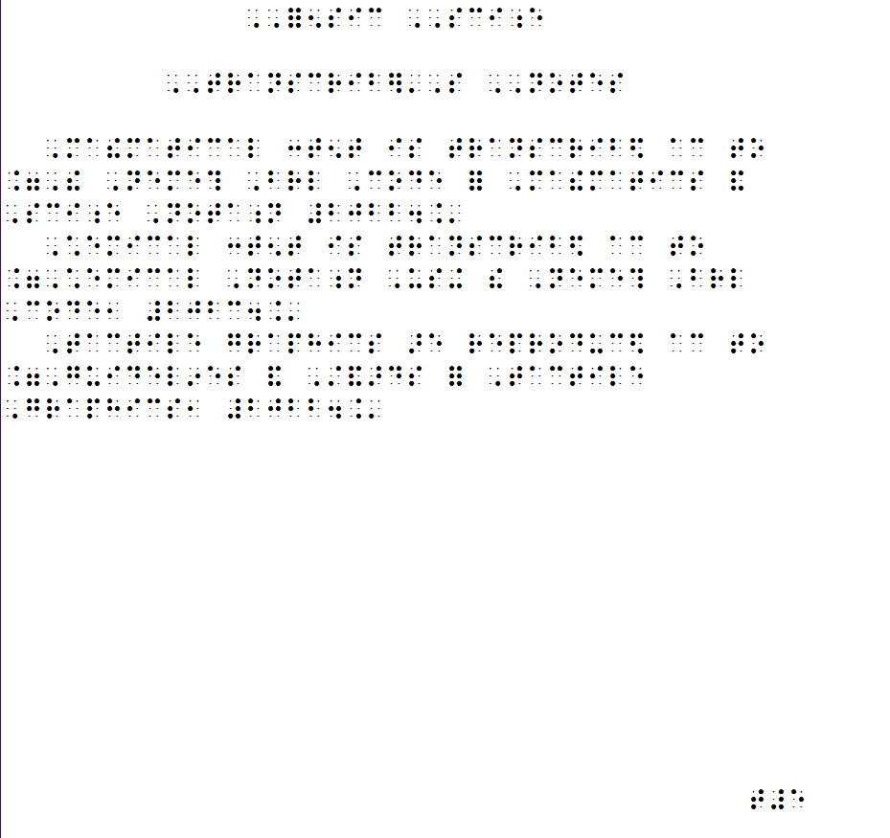
Transcriber’s Notes
Page

Slide 15
Document ANY and ALL decisions made
Running head
Headings changes
Typeforms, use of any transcriber-defined typeform indicators, Braille Formats Section 5 and Rules of UEB §9.5
Icons
Single-sided or interpoint
Contracted, uncontracted, or a specialized learning table (DBT: Document > Learning Tables)
Line spacing (DBT: Layout > Line codes)
Paper size (DBT: Document > Embosser setup)

Slide 16
NimPro and Front Matter

Slide 17
In NimPro, export front matter with changes
Run Wizards
Make style changes
Export front matter

Slide 18
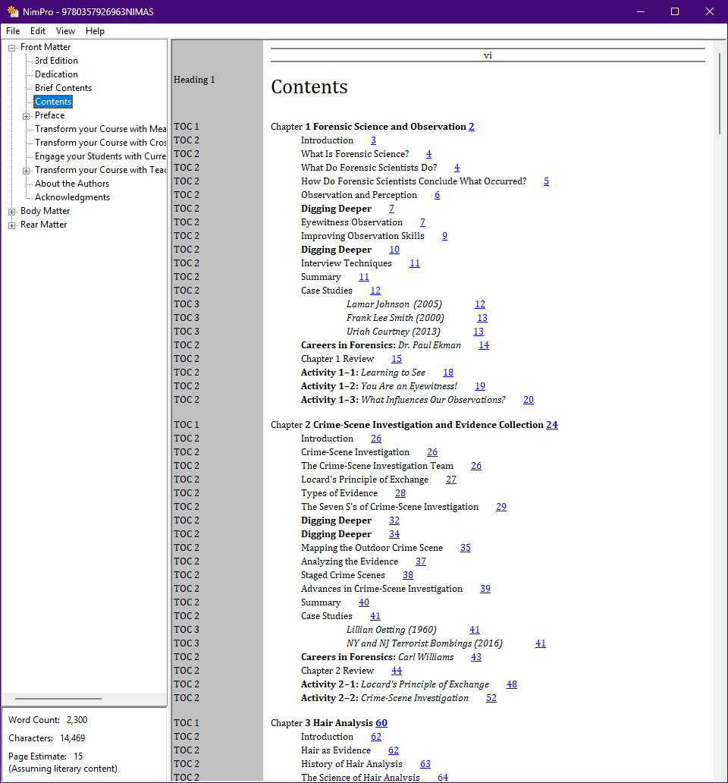
NimPro
Front Matter
Contents

Slide 19
Setting up in Word using SWIFT

Slide 20
In Word, designate t- and p-pages using SWIFT and the BANA template
Open the exported file in Word
Use SWIFT:
  Designate the t- and p-pages
  Add running head
  Start braille page numbering
  Stop Running head
  Restate title on page 1 as it appears on title page
  Reinstate running head
From the project’s NOTES document, copy and paste:
  Title page information
  Special symbols
  Transcriber’s Notes

Slide 21
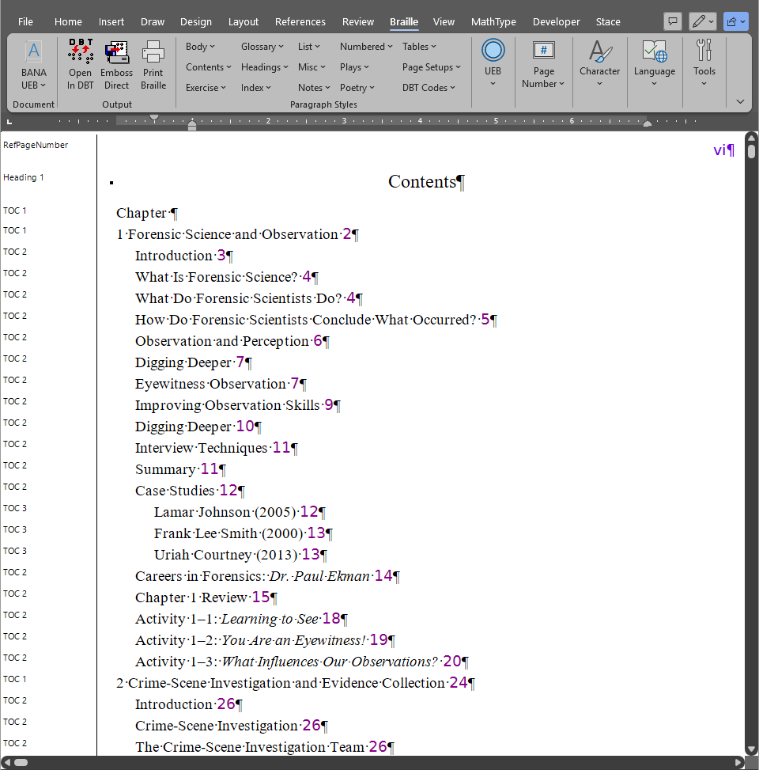
Word
Front Matter
Contents

Slide 22
Textbook Sample File

Slide 23
Practice with the file –
NIMAS 1.1 Textbook Exemplar
This file is provided to support the learning and use of braille transcription software
Images are not included in a folder
The sample file is in 2 parts:
  XML file - 978xxxxxxxxxxNIMAS.xml
  PDF - 978xxxxxxxxxxNIMAS.pdf

Slide 24
DEMO
Create personal NOTES document
Create a NOTES document for current project
Export from NimPro front matter to .docx
In Word, use SWIFT to format preliminary pages
In DBT, refine front matter for braille volume

Slide 25
Contact Us
If you have any questions about working with the NIMAC or using NIMAS files, please reach out to us!
nimac@aph.org
877-526-4622

Slide 26
Coming Up!
all sessions at 2pm Eastern
Session 3: Body Matter (Thursday, June 11th)
Session 4: Rear Matter (Thursday, June 18th)
Session 5: Math (Thursday, June 25th)
Session 6: eBraille Overview and Series Q&A (Wednesday, July 1st)

Slide 27
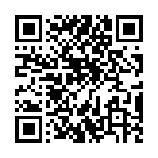
Exit Survey

