Slide 1
Duxbury/NimPro: NIMAS Textbook Transcription from Start to Finish
all sessions at 2pm Eastern
Session 2: Front Matter (Thursday, June 4th)
Session 3: Body Matter (Thursday, June 11th)
Session 4: Rear Matter (Thursday, June 18th)
Session 5: Math (Thursday, June 25th)
Session 6: eBraille Overview and Series Q&A (Wednesday, July 1st)

Slide 2
Upcoming ICEB Town Hall Event: Updates to choice and placement of grade 1 indicators
Recently approved a significant update to the choice and placement of grade 1 indicators, section 1.7 of the Guidelines for Technical Material (GTM).
Thursday June 4th @20:00 UTC (4 pm Eastern)
Register at https://iceb.org/

Slide 3
Session 1: NIMAS files & NimPro Basics
Duxbury Systems Products for Braille Transcription
NimPro
  NimPro 3.0 (Windows) or NimPro 2.0 (Mac)
Duxbury Braille Translator (DBT)
SWIFT and the BANA Template for Word
duxburysystems.com 978-692-3000 info@duxsys.com

Slide 4
Learning Objectives
Identify components in NIMAS file set (PDF, XML, OPF, images) and how they are used for transcription
Access NIMAS file as an Accessible Media Producer (AMP)
Download, Save, & Convert NIMAS to braille file with appropriate braille styles using NimPro.
Explore NimPro features that help with initial formatting–e.g., headings, Table of Contents.

Slide 5
Outline of today’s session
Review Duxbury products and the environment they provide for braille transcription.
Access the NIMAC to obtain a NIMAS file.
Unzip and review the contents of a NIMAS file.
Tour the interface of NimPro.

Slide 6
Software and Workflow Overview

Slide 7
NimPro
NimPro converts NIMAS XML files to working transcription files with structure, formatting, and math.
NimPro improves efficiency for transcribing braille materials, allows for changes to structure, assists with estimation of braille pages, and offers another level in a transcription project team environment.
Export from NimPro by sections, pages, or user selections. File options are RTF (Rich text file), Microsoft Word (*.doc/*.docx), and Duxbury print file (*.dxp).
To run NimPro an activated DBT license is required.

Slide 8
Duxbury Braille Translator (DBT)
DBT is for translating print to braille.
  Native format types are DXP (print file) and DXB (braille file)
  Save as BRF (braille ready file) or LBF (refreshable braille)
While DBT will open an XML file, it will not retain the formatting that exists in the NIMAS XML file.
DBT will open Word documents. It will not open RTF files.

Slide 9
Microsoft Word
Using Word is not necessary, but it is incredibly helpful.
Capitalize on the additional features of Microsoft Word to prepare text:
  BANA template, available during installation of DBT
  SWIFT, a free Duxbury product available during installation of DBT or available for free at www.duxburysystems.com
  Advanced Find & Replace with wildcards
  Macro capabilities in Word

Slide 10
What’s happening between these programs?
Between the programs, the structure and styles of the text are evaluated and remapped.
NimPro takes the tags in the NIMAS XML file and remaps them appropriately for the export option.
The Word BANA template has styles that align with styles in DBT. When DBT opens the Word document, the styles are remapped.
remap
NIMAS
NimPro
remap
remap
Word using BANA template
remap
DBT

Slide 11
The Transcription Workflow
Use NimPro to make heavy lifting changes and export selections. Revisit and use NimPro as needed throughout the project.
Choose between 2 choices in workflow:
  NimPro directly to DBT,
  -OR-
  NimPro, intermediary word processing, then to DBT.
Rinse and repeat as needed.

Slide 12
Screen Readers
DBT works with NVDA, Narrator with BRLTTY installed, and JAWS.
When using DBT with JAWS, most users prefer to uncheck the check box Support for UI Automation. This is found from the menu bar in Global > Internationalization. Insert + h or insert + q for help while in DBT.
NimPro help recommends using the hot-key for Speak-all or Read Active Window.

Slide 13
Resources
Duxbury Systems www.duxburysystems.com
duxuser User Group www.duxburysystems.com/discussion.asp
TGIL imagelibrary.aph.org
Rules of UEB www.iceb.org
BANA guidelines www.brailleauthority.org
Braille certifications nfb.org/programs-services/braille-certification
NotePad++ notepad-plus-plus.org

Slide 14
NIMAC AMP Accounts

Slide 15
NIMAC Basics
Created by IDEA 2004, the NIMAC is the national source file repository for K-12 textbooks and instructional materials.
We make NIMAS files available for use in producing accessible formats for K-12 instructional materials.
We have received over 90,000 file sets from over 200 publishers.
All 50 States, the eligible territories, and the DoDEA work with the NIMAC.
Each State that works with the NIMAC designates Authorized Users who have full access to the repository.

Slide 16
AMP Accounts
Any individual or organization that produces accessible formats on behalf of eligible K-12 students can sign up for a free NIMAC AMP account.
AMP accounts can have multiple subusers, so you can have one account for an organization or district with multiple subusers, or you can opt for individual accounts for each person.
AMPs can only download NIMAS files that are assigned to them by an Authorized User.

Slide 17
How to Obtain NIMAS Files
Authorized Users can either provide you with NIMAS files directly, or they can assign them to you in your NIMAC AMP account.
Authorized Users work under a State Education Agency. If you need a NIMAS file assigned to you, it would be assigned by an Authorized User in the state in which the accessible format is needed.
If you need help getting connected with an Authorized User, please reach out to the NIMAC and we can help!

Slide 18
How to Register as a NIMAC AMP
In order to get registered for a free AMP account, send an email to nimac@aph.org
We will add you in the system, and you will receive an email with a link to complete the online registration.
You will also receive a Limitation of Use Agreement (LUA). Please initial each page of the agreement, and fill out/sign section 14.0.
Once you complete the registration and send us your LUA, we will activate your account.

Slide 19
Get NIMAS files from the NIMAC
Login at nimac.us
Choose title in Title Assignments and click Add To My Downloads
Select the type of content and agree to the agreement to submit the request
Visit My Downloads to complete the download process
Downloading NIMAS Files for AMPs on YouTube https://www.youtube.com/watch?v=v8aKAl84K8k

Slide 20
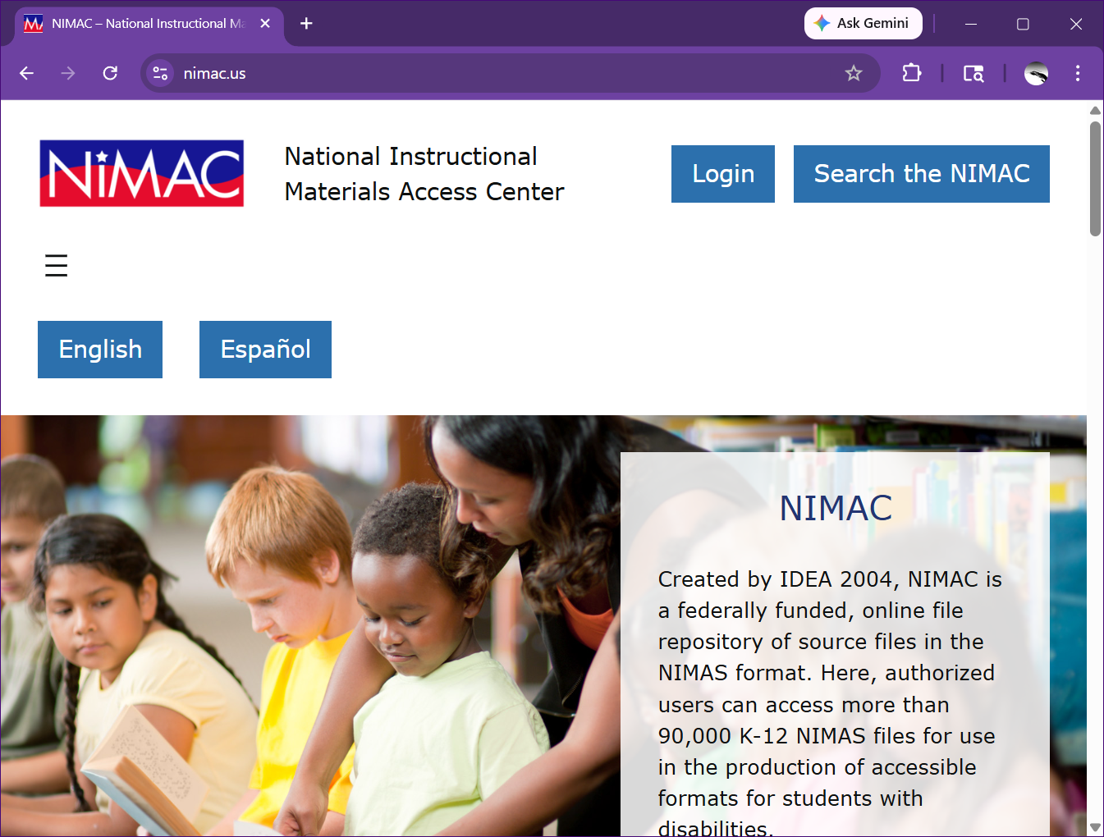
Login
Click the Login
button

Slide 21
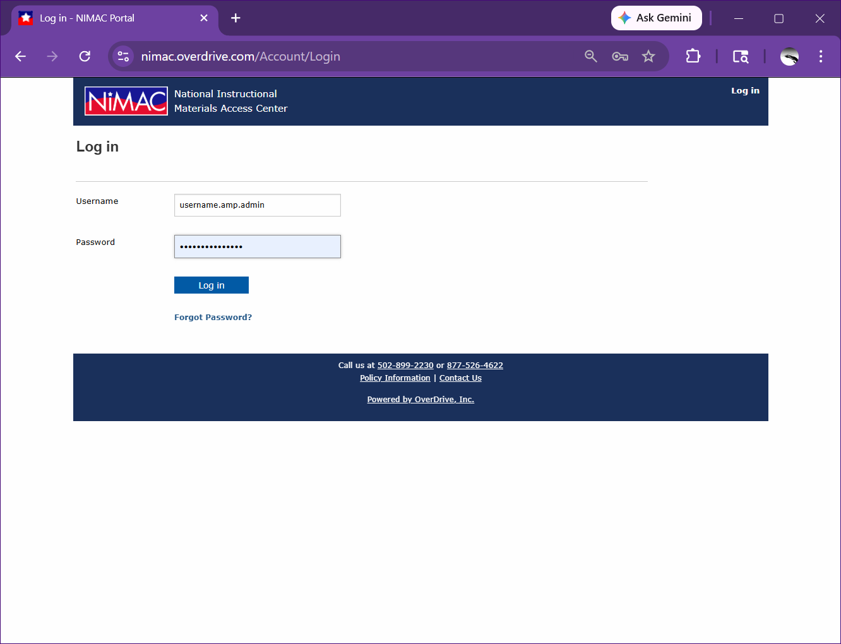
Login Screen
Enter your
Username and
Password
Username is not
an email address
The designated NIMAC
username format is username.amp.admin

Slide 22
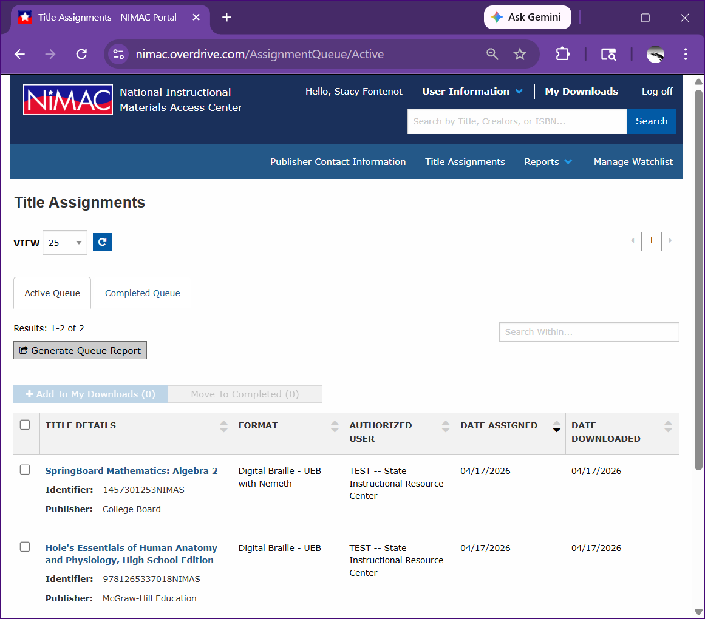
Title
Assignments
If not already at
Title Assignments,
click the “Title
Assignments” link to
view all currently
assigned titles.
As a reminder, you
will only have access
to files assigned to
you by an Authorized
User.

Slide 23
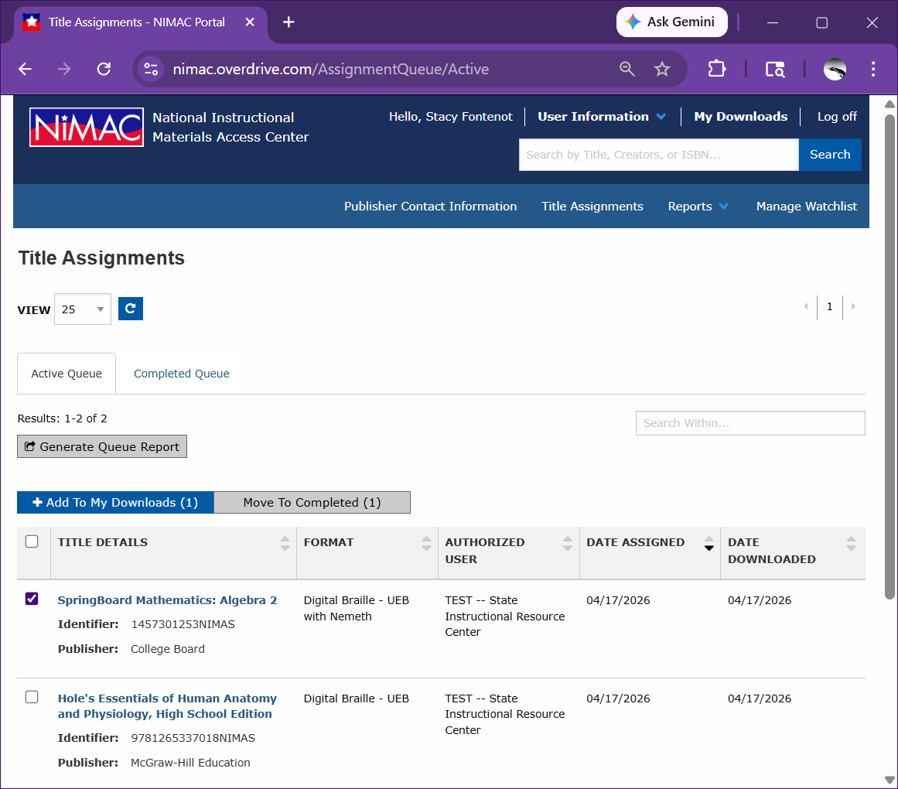
Add Download
Check the box for
the title
Click “Add To My
Downloads (1)”
  You can check more
  than 1 title at a time
  The number will
  reflect in the “Add to
  My Downloads (#)”
2.
1.

Slide 24
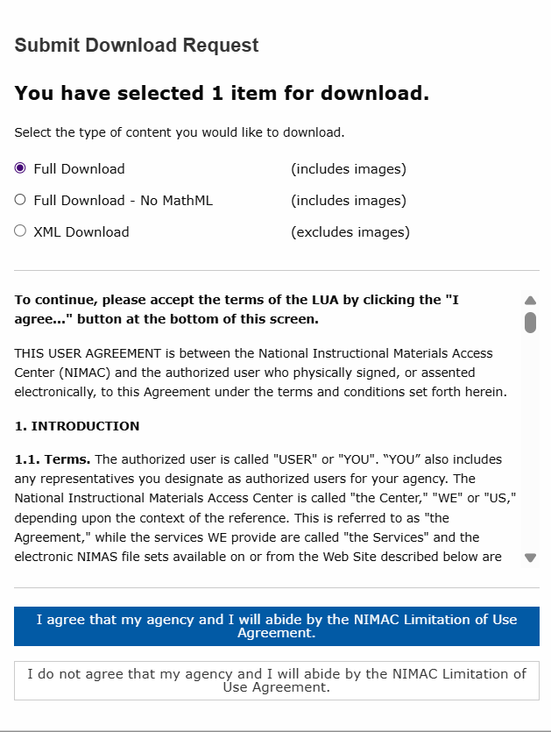
Choose type of content for download
Choose the radio button for the
type of content you want.
Some titles do not have MathML,
and that option will not be
available.
Click the button agreeing to
abide by the agreement.

Slide 25
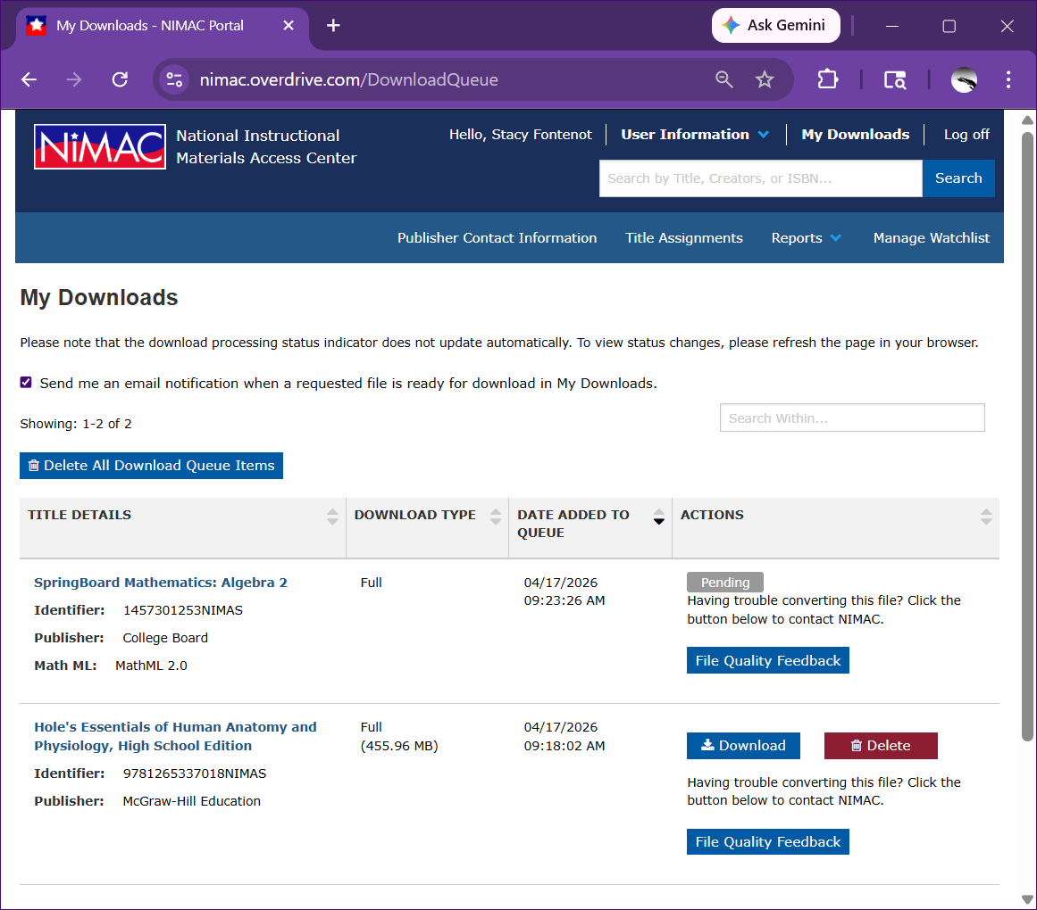
My Downloads
Click “My Downloads”
The title may show
“Pending” as the
download may
take a few minutes to
post to your downloads

Slide 26
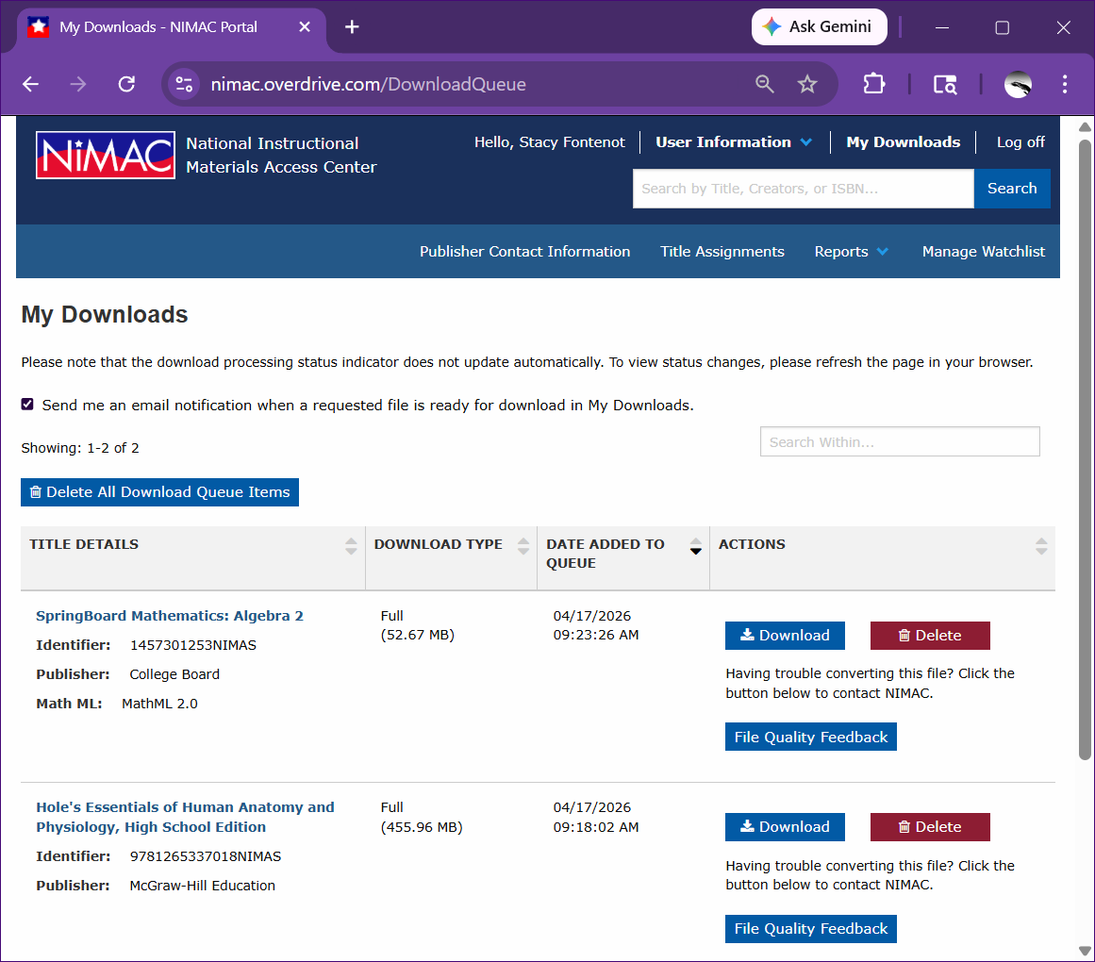
Get Notified
If you would like emails
when downloads are
ready, ensure the box
“Send me an email
when a requested file
is ready for download
in My Downloads” is
checked.

Slide 27
Download
Click the “Download”
button next to the title
you need

Slide 28
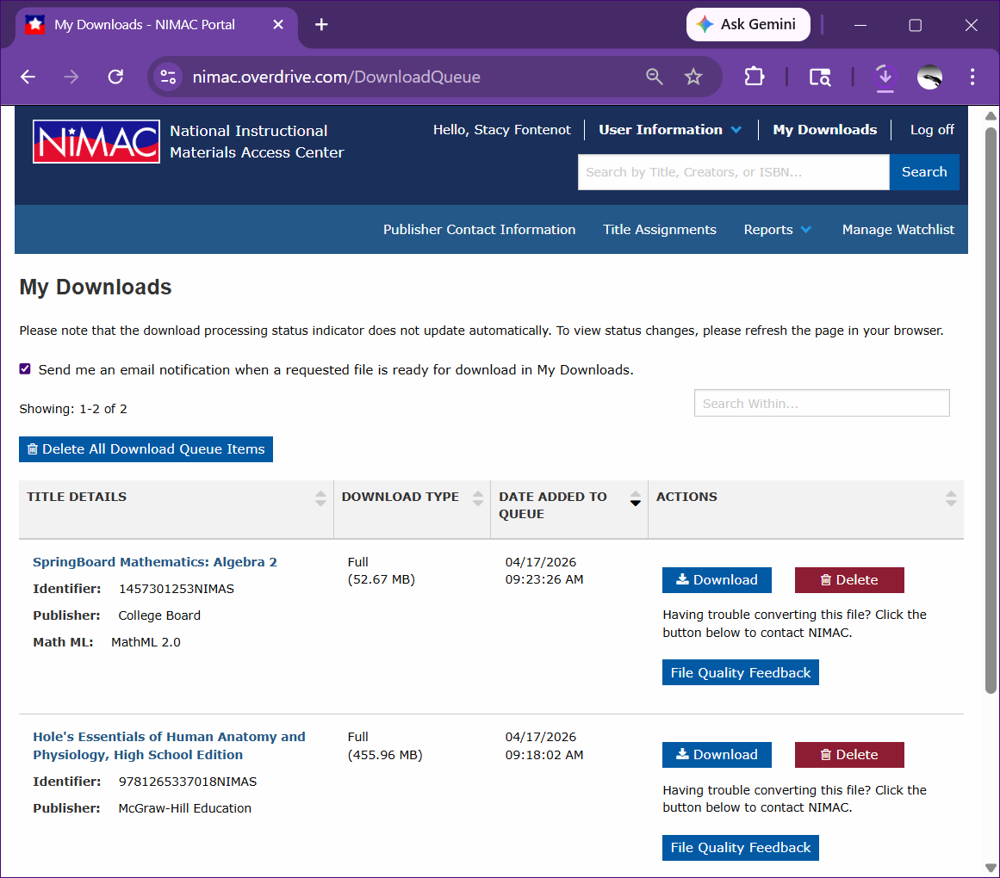
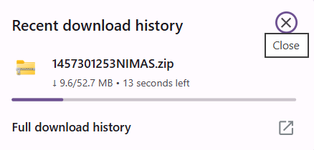
Download Processing
The download will
begin.

Slide 29
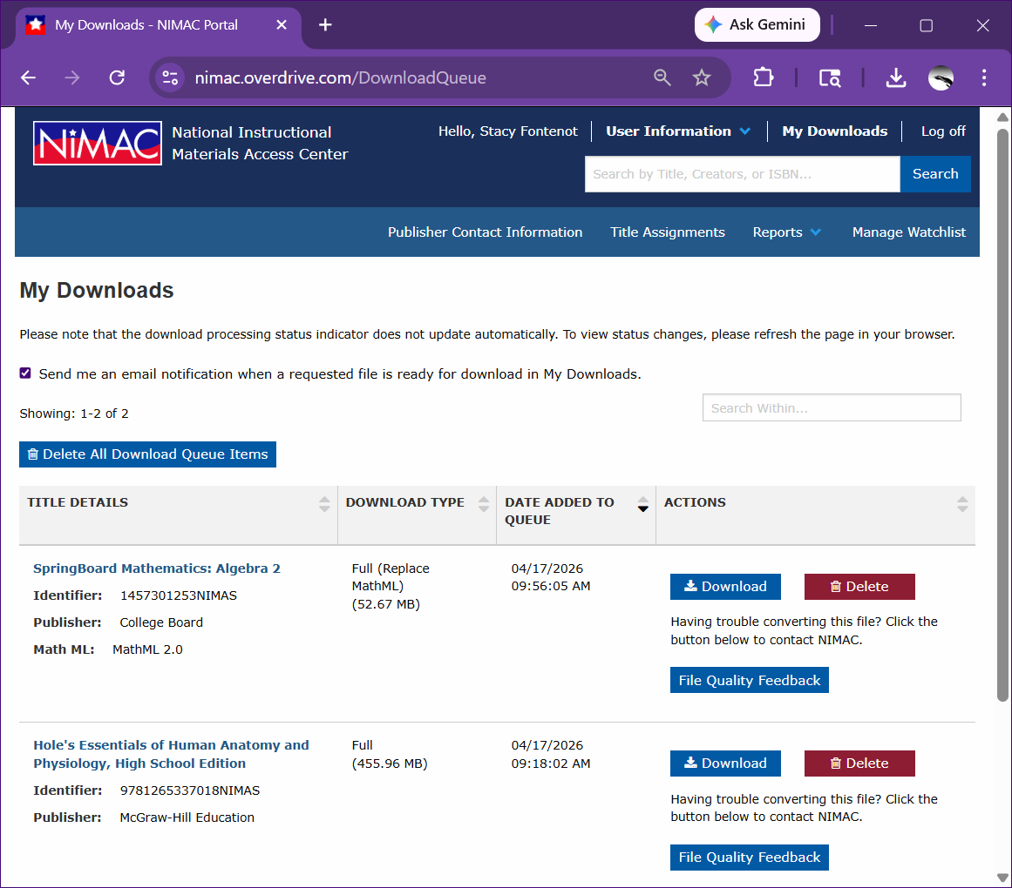
Do you need a different content type?
While in “My
Downloads,” click
“Delete” next to the
title.
Return to your “Title
Assignments” and
choose the title
again to “Add To My
Downloads (#)”

Slide 30
Provide
Feedback
Please provide
feedback using the
“File Quality
Feedback” button
should you find any
issues with the
NIMAS file.

Slide 31
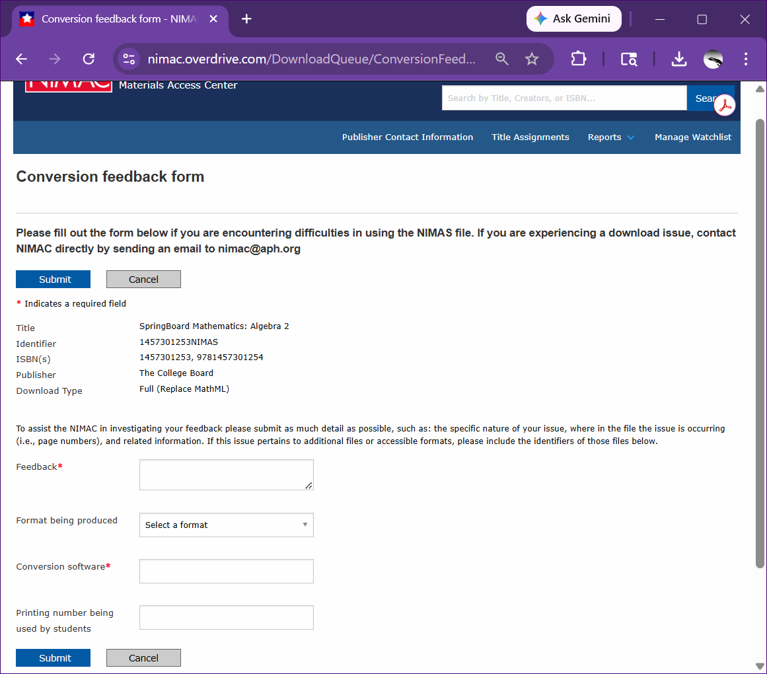
File Quality
Feedback
Using the “File Quality
Feedback” button is
the best way to notify
the NIMAC of any
issues with a NIMAS
file. The notification
the NIMAC receives
has all the file
information needed
along with your
feedback.

Slide 32
Log off
When you have your
download, Log off.

Slide 33
NIMAS File Set Components

Slide 34
Unzip the NIMAS package
NimPro can open the zip folder without unzipping.
Recommendation is to unzip the folder for interaction with the images folder.
Keep the original zip so you always have a pristine copy—although you can download the NIMAS file from the NIMAC again if you need to.

Slide 35
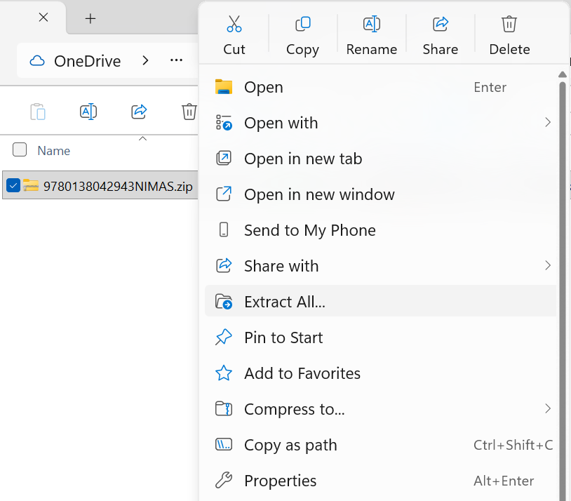
How to Unzip the NIMAS Folder
Right-click the zip folder and select “Extract All”. Follow the prompts for your chosen destination.

Slide 36
NIMAS package
Depending on the type of download, the zip may have a graphics folder and/or include MathML.
Zip folder contents: Images, OPF, PDF, and XML
  Images: subdivided by book structure
  OPF: metadata file
  PDF: ONLY the print copyright pages,
  XML: text contents of the book; this is the file to work with in NimPro

Slide 37
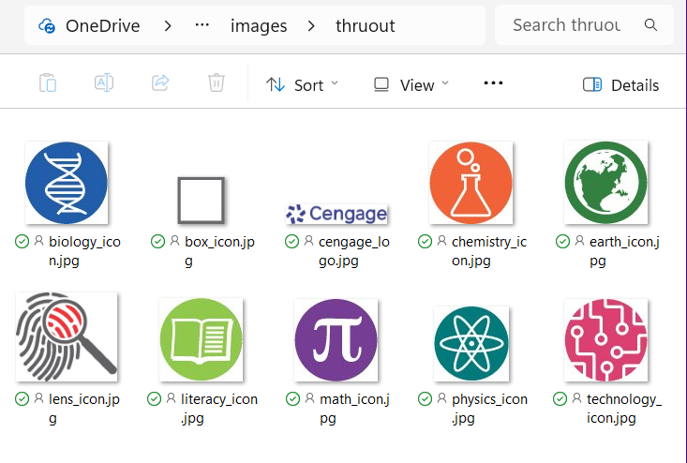
Images > thruout folder
Great place for understanding
images used throughout the
textbook that may need a
transcriber-defined symbol or
have an icon devised.

Slide 38
NimPro Overview

Slide 39
NimPro
The alterations you make in NimPro do not impact the original NIMAS file. Instead, they are saved in the NimPro Project File (*.nimpro).
There is no undo/redo feature in NimPro.
Save as you go.
  Save multiple NimPro files names for the type of action being performed.
NimPro only has one project open at a time.
https://duxburysystems.com/documentation/NimPro/

Slide 40
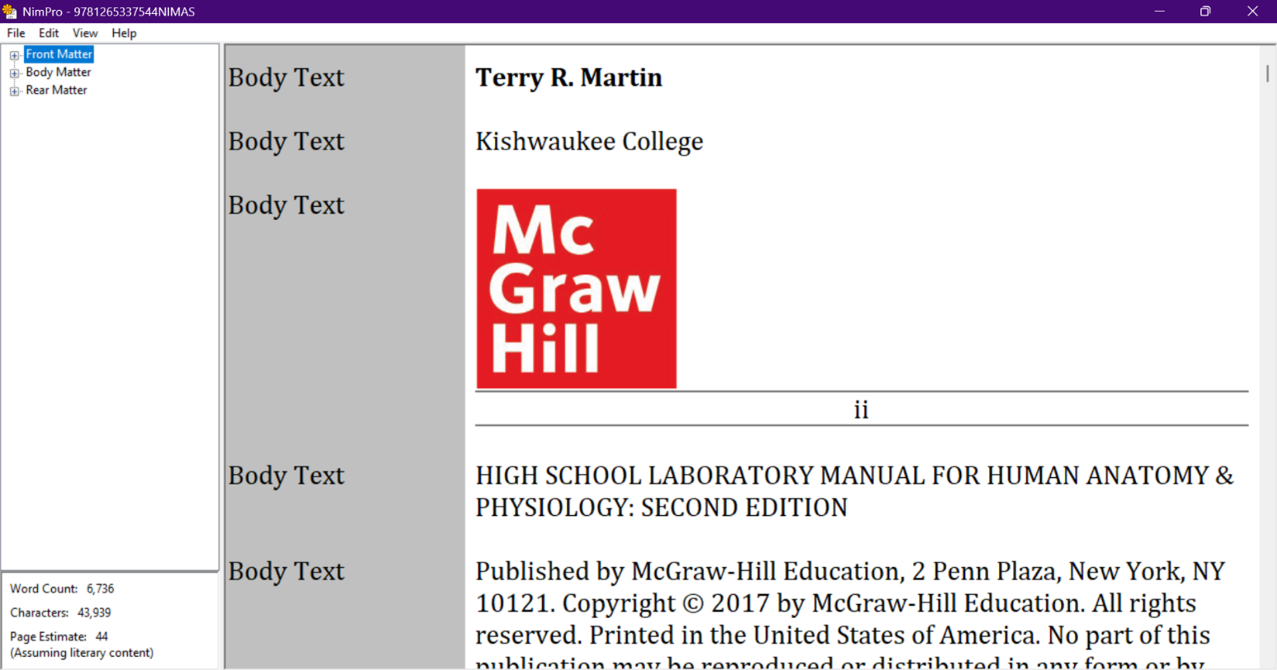
NimPro Interface

Slide 41
Left pane of NimPro Interface
Displays the structure of the book.
  From the View menu, choose By Page or By Section.
    In section view, expand and collapse the view by clicking the +/-.
  Use the Shift key for contiguous selections and the Control key for non-contiguous selections.
At the bottom of the Left pane is an Info panel with word and character counts along with a page estimation (based on literary context).
  Estimate the number of braille volumes in a technical transcription with images: for example with a math book, multiply the Page Estimate from the Left pane by 3 and then divide that by 160 (interpoint volume page count).

Slide 42
Right pane of NimPro Interface
Displays the book content of what is selected in the left pane.
This pane is divided vertically into 2.
The right side is the text content of the book.
The left side is a gray area indicating the styles applied to the text.

Slide 43
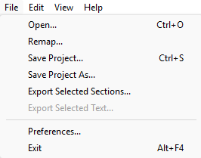
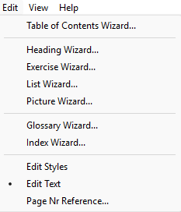
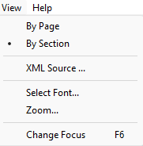
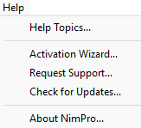
The Menu Bar
File • Edit • View • Help

Slide 44
File in the Menu Bar
File
Open and Save project. Exit NimPro.
Preferences are in the File menu.
There is no UNDO/REDO in NimPro. Save as you go.

Slide 45
File > Export
Export selection(s) chosen in the Left pane:
  RTF (Rich text file), for general word processing programs.
  Duxbury print file (*.dxp) for working directly in DBT
  Microsoft Word (*.doc/*.docx)

Slide 46
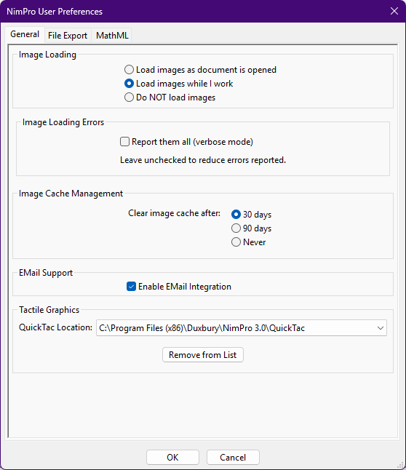
File > Preferences > General
General
  Image Loading options so your system doesn't get bogged down.
  Image Cache Management manages how your system saves images.
  Checkbox Email Support so if you run into any problems, a scrambled text file can be created and sent to Duxbury Systems to troubleshoot and assist you.
  Tactile Graphics identifies where QuickTac is located.

Slide 47
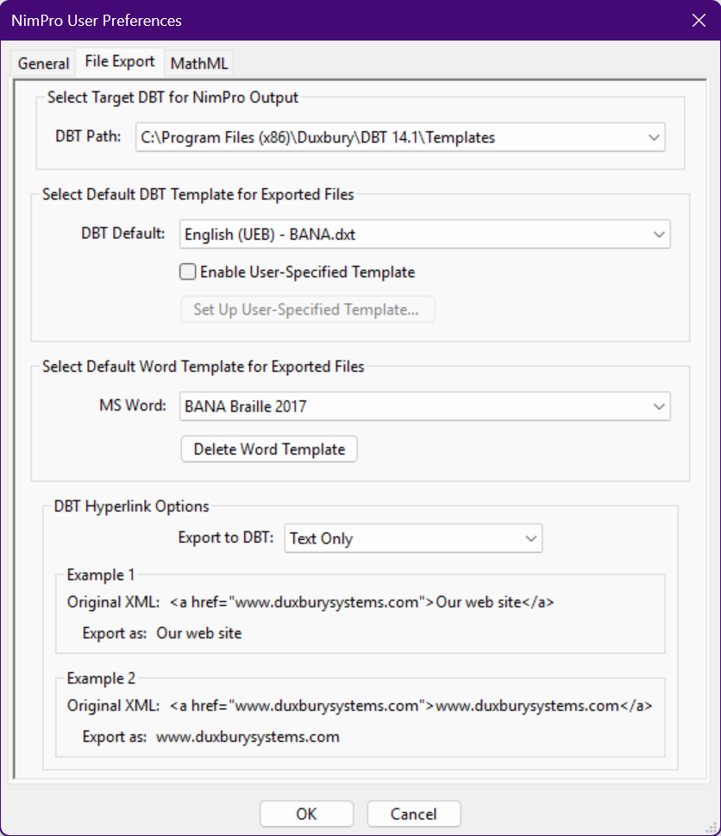
File > Preferences > File Export
File Export
  Leave as installed is best.

Slide 48
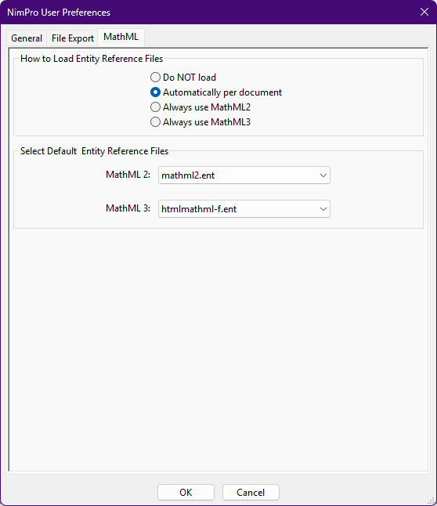
File > Preferences > MathML
MathML
  “Automatically per document” is best.

Slide 49
Edit in the Menu Bar
Wizards for Table of Contents, Heading, Exercise, List, Picture, Glossary, and Index
  These Wizards make quick work and do the heavy lifting. Make choices for Styles, cleanup Auto-Numbering, and Emphasis in text.
Edit Styles or Edit Text is a choice for whether to adjust the styles or to alter/add text while working with content in the Right pane.
Page Nr Reference... Suppresses page numbering until the page you enter
Again, there is no UNDO/REDO in NimPro. Save as you go.

Slide 50
View in the Menu Bar
  By Page or By Section changes the Left pane view of the book contents. By Section is the tree view with +/-.
  Zoom is most helpful for increasing the text size on screen.
  Change Focus, keyboard shortcut F6, to go between the Left and Right panes.

Slide 51
Help in the Menu Bar
  Read the Help text, activation of the software, request support, and check if there are updates.

Slide 52
Wizards in the Edit Menu
Based on the selection in the Left pane, choose a Wizard to make changes. The Wizard will make changes to EVERYTHING in the selection. Make a refined selection before applying the Wizard.
Use the style information in the gray area of the Right pane to help inform your choices.
The NIMAS XML has lists. It doesn’t designate exercise material, TOC, etc. NimPro Wizards do the heavy lifting of changing these to the appropriate style for the braille transcription.
In the Wizards, styles are changed to an appropriate braille style.

Slide 53
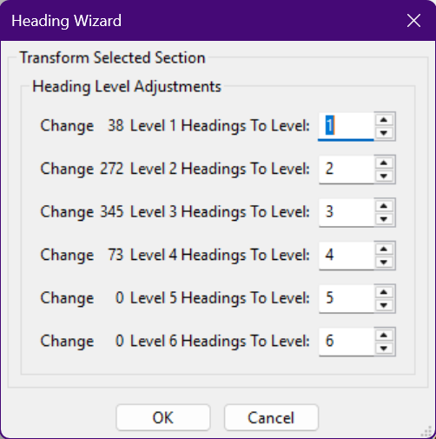
Heading Wizard
This wizard will change all headings in the NIMAS file of one level to another level.
Braille only designates 3 heading levels.
Braille Formats §4.2.1
  Cell-7 headings are applied only to the lowest hierarchy level
  Centered headings are extended as necessary

Slide 54
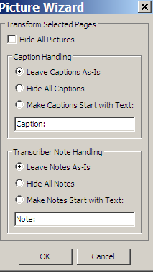
Picture Wizard
Check Hide All Pictures so they do not display in the Right pane.
To remove any associated captions or notes from the export, select the radio button.
Recommend leaving Captions and Notes As-Is. You can always delete them from the NIMAS file while transcribing.

Slide 55
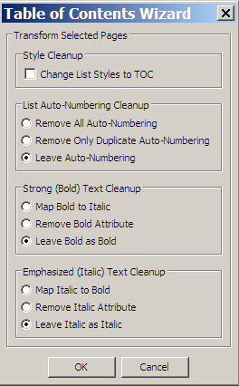
Table of Contents Wizard
Check the box to change the list style to the TOC style.
Remove Auto-Numbering if it is not in print.
Remove bold or italic as needed.
  For example, bold chapter numbers which are unneeded in braille. This is a great way to remove those with one selection.

Slide 56
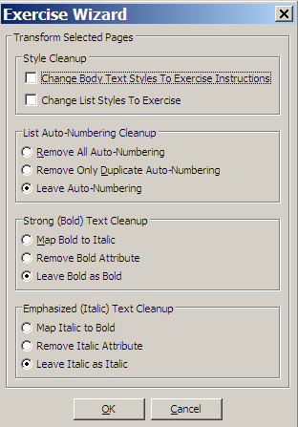
Exercise Wizard
Check the boxes to change the Body text styles to Directions and List styles to Exercise styles.
  Be aware of your selection because all Body Text styles will become Directions.
Remove Auto-Numbering if it is not in print.
Remove bold or italic as needed, such as item numbers.
  Be aware of emphasis within the material as this will also remove them.

Slide 57
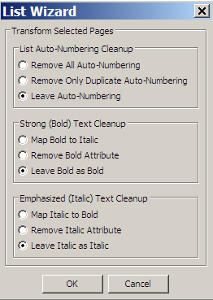
List Wizard
Remove Auto-Numbering if numbers are not in print.
Remove bold or italic as needed, e.g., bullets, numbers, or letters.
  Be aware of any other instances of bold or italic in the selection as this will also remove them.

Slide 58
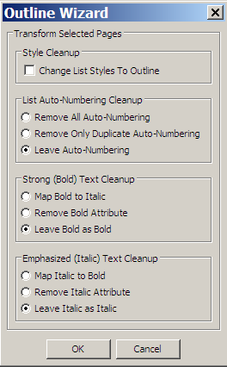
Outline Wizard
Check the box to change the List styles to Outline.
Remove Auto-Numbering if it is not in print.
Remove bold or italic as needed.
  Be aware of any other instances of bold or italic in the selection as this will also remove them.

Slide 59
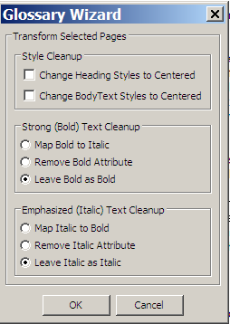
Glossary Wizard
Check the boxes to change Heading styles or BodyText to Centered headings.
Remove bold or italic as needed.
  Be aware of any other instances of emphasis in the material as this will also remove them.

Slide 60
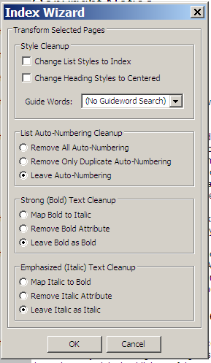
Index Wizard
Check the boxes to change List styles to Index style and Heading styles to Centered headings.
Remove Auto-Numbering if it is not in print.
Remove bold or italic as needed.
  Be aware of any other instances of emphasis in the material as this will also remove them.

Slide 61
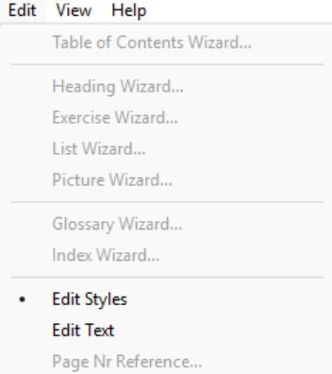
Quick Keys while working with Styles
Edit > Edit Styles
Keystroke not case sensitive | Style/Effect
space | Skip to the next paragraph at the beginning vs arrow keys
B | Body text (make this an ordinary text paragraph)
D | Directions
E | Exercise
H | Heading, thereafter #
L | List Item, thereafter #
T | Production Note (a.k.a., Transcriber's Note)

Slide 62
Contact Us
If you have any questions about working with the NIMAC or using NIMAS files, please reach out to us!
nimac@aph.org
877-526-4622

Slide 63
Coming Up!
all sessions at 2pm Eastern
Session 2: Front Matter (Thursday, June 4th)
Session 3: Body Matter (Thursday, June 11th)
Session 4: Rear Matter (Thursday, June 18th)
Session 5: Math (Thursday, June 25th)
Session 6: eBraille Overview and Series Q&A (Wednesday, July 1st)

Slide 64
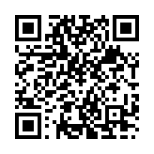
Exit Survey

