Slide 1
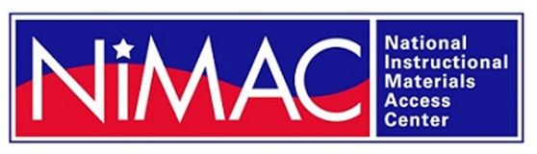
The NIMAC for State Coordinators:
Basics, Updates, and a Quick Demo
Liz Schaller, NIMAC Director
eschaller@aph.org
Alexa Miller, NIMAC Librarian
amiller@aph.org
April 2026

Slide 2
Today’s Webinar
Part 1: PowerPoint
  NIMAC Basics and Key Definitions
  NIMAS Eligibility
  2025 NIMAC Case Study
  Account Types and System Basics
Part 2: Live Demo
  Your Account Information
  Adding and Removing Authorized Users
  Searching the NIMAC

Slide 3
Learning Objectives
Learn what it means for states to “coordinate” with the NIMAC
Understand the requirements for NIMAS eligibility
Learn how to add and remove Authorized Users

Slide 4
NIMAC: The Basics

Slide 5
The NIMAC Project
  Created by IDEA 2004, the NIMAC is the national source file repository for K-12 textbooks and instructional materials.
  We make NIMAS files available for use in producing accessible formats for K-12 instructional materials.
  We have received over 90,000 file sets from over 200 publishers.
  All 50 states, the eligible territories, and the DoDEA work with the NIMAC.

Slide 6
What does it mean to “coordinate” with NIMAC?
Under IDEA 2004, working with the NIMAC is optional for states; however, all states and eligible territories have opted into the NIMAC (and have continuously coordinated for over 15 years).
States that coordinate agree to:
  Require NIMAS from publishers in their textbook procurement contracts
  Abide by the eligibility requirements of IDEA and copyright law in the use of NIMAS and distribution of materials produced from the files

Slide 7
The NIMAC and Districts
LEAs do not submit a Coordination Agreement to the NIMAC.
However, IDEA requires that they indicate in their IDEA assurances to the SEA whether they choose to coordinate each year.
To provide students access to a wealth of NIMAS-sourced accessible materials, we strongly encourage that all districts opt in.
IDEA requires that LEAs that opt in meet the same legal obligations as SEAs with regard to NIMAS eligibility and textbook procurement.

Slide 8
What is a State Coordinator?
Each state that coordinates with the NIMAC designates a State Coordinator.
This individual has two key responsibilities:
  To opt into the NIMAC on behalf of the state by signing the NIMAC Coordination Agreement
  To manage (add and remove, as needed) the NIMAC Authorized Users for the state
As will be discussed later, the SC also has a role in helping ensure that the SEA complies with the IDEA requirements related to instructional materials procurement.
The NIMAC does not require that a Coordination Agreement be submitted annually.
We only require a new agreement when a new SC assumes the role.

Slide 9
Key Definitions for NIMAC

Slide 10
What is NIMAS?
  Created by IDEA 2004, NIMAS stands for the “National Instructional Materials Accessibility Standard.”
  Based on the DAISY file format, the sole purpose of NIMAS is to support the production of accessible formats, such as braille, DAISY, EPUB, and large print.
  As a format that requires further conversion before use, NIMAS is not distributed directly to students.

Slide 11
More about NIMAS . . .
  Under IDEA, NIMAS is the only format the NIMAC is permitted to accept.
  NIMAS is not generated automatically as a part of print or digital book production—it must be produced separately after the book has been finalized.
  Publishers outsource the production of NIMAS to conversion vendors who specialize in this service.
  NIMAS production can take many weeks.

Slide 12
Types of materials we receive
  NIMAC receives a range of student-facing materials “published primarily” for use in K-12.
  These materials include textbooks, workbooks, supplementary readers—and ancillary materials such as blackline masters.
  Generally exempt are pre-2006 titles, trade books, college textbooks, and reference books.
  We can also accept NIMAS files for some digital instructional materials.

Slide 13
Digital Materials
In May of 2020, the Department published a Notice of Interpretation (NOI) permitting the NIMAC to accept NIMAS for some digital instructional materials.
The NIMAS specification has not changed, and only some digital products can be produced in NIMAS format.
For example, highly interactive materials cannot be captured as a NIMAS file.
For more information, see our NIMAS & Digital Materials FAQ.

Slide 14
How we get files
  Under IDEA 2004, there was no blanket requirement for publishers to submit files to the NIMAC.
  The only mechanism to require NIMAS from the publisher is the book adoption contract or purchase agreement.
  Including NIMAS language in all SEA and LEA contracts is essential to ensuring that the NIMAC will receive the files students need.

Slide 15
Requiring NIMAS from publishers is a legal obligation
All states and all districts that coordinate with the NIMAC are obligated under IDEA to require publishers to submit files to the NIMAC as a part of any instructional materials adoption process or contract.
This is a requirement under the legislation and not optional.

Slide 16
Sample Contract Language from NCADEMI
“By agreeing to deliver the materials marked with “NIMAS” on this contract or purchase order, the publisher agrees to prepare and submit on or before [month/day/year] a NIMAS fileset to the NIMAC that complies with the terms and procedures set forth by the National Instructional Materials Access Center (NIMAC) (IDEA Title I, Part D, sec. 674(e)).
The publisher also agrees to mark up materials eligible for NIMAS submission that contain mathematical and scientific instructional content by using the MathML modular extension of the DAISY/NIMAS Structure Guidelines , as posted and maintained at the DAISY Consortium website [refer to the latest applicable version].
Should the vendor be a distributor of the materials and not the publisher, the distributor agrees to immediately notify the publisher of its obligation to submit NIMAS filesets of the purchased materials to the NIMAC. The files will be used for the production of accessible formats as permitted under the law for eligible students [IDEA Title I, Part B, sec. 612(a)].”

Slide 17
Curriculum Created/Published by a State
The NIMAC can accept NIMAS for materials published by SEAs for use in the classroom.
SEAs can establish publisher accounts with the NIMAC and are welcome to submit files to us.
If you have any questions or would like more information about this, please reach out.

Slide 18
NIMAC Watchlist
  If we don’t have a file that you need, we can research the item for you and reach out to the publisher to request a file if the material is within scope for the NIMAC.
  Authorized Users (and Accessible Media Producers) can just add the needed ISBN to the Watchlist in their NIMAC account, and we will research/request the item.

Slide 19
Watchlist versus Contracts
  While we are happy to provide this service to users, it is important to note that timely delivery is affected when the file is not already in the NIMAC.
  It can take up to six to eight weeks (and sometimes even longer) for NIMAS to be produced upon request.
  In addition, the NIMAC does not have the authority to require any publisher to submit files. We rely on the goodwill of each publisher when there is not a contractual obligation.
  So, while the Watchlist is an important service to meet students’ needs, it is not a replacement for including NIMAS language in contracts.

Slide 20
NIMAS Eligibility

Slide 21
Eligibility in IDEA 2004
For students to be eligible for NIMAS, IDEA 2004 imposes two requirements:
  The student must have an Individualized Education Program (IEP).
  The student must have a qualifying disability per the eligibility guidelines of the National Library Service for the Blind and Print Disabled (NLS).

Slide 22
NLS Guidelines
On February 12, 2021, the NLS published updated guidelines to align them with changes to U.S. copyright law made by the Marrakesh Treaty Implementation Act (MTIA).
These regulations can be found at: NLS Eligibility Guidelines

Slide 23
Reading Disabilities
The new guidelines remove the requirement for certification by a medical doctor for those with reading disabilities.
Professionals who are included as “competent authority” can certify individuals in any category of disability.

Slide 24
Competent Authority Expanded
(2) Eligibility must be certified by one of the following: doctor of medicine, doctor of osteopathy, ophthalmologist, optometrist, psychologist, registered nurse, therapist, and professional staff of hospitals, institutions, and public or welfare agencies (such as an educator, a social worker, case worker, counselor, rehabilitation teacher, certified reading specialist, school psychologist, superintendent, or librarian).

Slide 25
NIMAC Case Study on Timely Delivery of Accessible Materials

Slide 26
NIMAC Case Study
In 2025, the NIMAC worked with True North Evaluation on a case study on timely delivery of accessible formats.
Data collection focused primarily on three states–Ohio, Oregon, and Utah–while a few surveys and focus groups targeted a wider, national audience.
The case study sought to address two key questions:
  What are the positive benefits to timely delivery of newly created accessible instructional materials when NIMAS files for the materials are already in the NIMAC system?
  What practices, including procurement contracts, facilitate the timely delivery of accessible instructional materials?

Slide 27
Case Study Report
The full report, which you are welcome to share with colleagues, is now available on the NIMAC website: Case Study Report (PDF) and Case Study Report (Accessible Word)
The NIMAC will be developing a condensed report with key takeaways as well. We will share that out with you!
The NIMAC is using feedback and recommendations from the case study to improve our technical assistance efforts.
Please don’t hesitate to reach out if you have any questions about the case study, or suggestions for implementing recommendations.

Slide 28
NIMAC Account Types and System Basics

Slide 29
What is an Authorized User?
An Authorized User is someone who has been designated by their State Coordinator to have full access to the NIMAC repository.
They can search and download files or assign files to registered Accessible Media Producers (AMPs).
They are individuals who are involved in some way in the production of accessible formats for students with print disabilities in their state.

Slide 30
Authorized Users
AUs may directly work in accessible media production, or they may manage work done by others.
They are usually from within the state educational structure (IRCs, state schools for the blind).
“Authorized entities” under Chafee, such as Bookshare and APH, can also be designated as AUs.
Most states have five or fewer AUs.
The system automatically supplies 5 AUs per state (not including a hybrid SC). We can add more users for your state, if needed.

Slide 31
Accessible Media Producer Accounts
An AU may work as an accessible media producer, but for the purposes of the NIMAC, an AMP is an organization or individual that has an AMP account.
This is a more restricted account that allows the user to download only those files assigned to them for download by an Authorized User.
These users do not have to be designated by a state coordinator.
It is important to note that the NIMAC does not vet AMPs that register and that having a registration is not an endorsement by the project.
AMPs can be for-profit or nonprofit and work with any state. (APH is an AMP.)

Slide 32
“Hybrid” State Coordinators
State Coordinators may be directly involved in the state’s accessible media production workflow – or they may not.
The basic State Coordinator account has one primary function: adding and deleting AUs for the state.
For State Coordinators who would like to also be Authorized Users, we can offer a single sign-on to access the features for both account types.

Slide 33
“Hybrid” Account Registration
To upgrade your account to include AU account functions:
  Download the Limitation of Use Agreement (LUA) found here: NIMAC LUA
  Print out the document, initial each page, and fill out section 13.0.
  Then just email a scan of the complete doc to nimac@aph.org
We can also accept authenticated digital signatures (e.g., DocuSign).

Slide 34
“Hybrid” Account Activation
We will make the change for you in the system and notify you.
The next time you log in after the change, you will see both the SC and AU system functions.
The hybrid account is a “bonus” AU and does not count as one of the 5 AU accounts available by default to your state.

Slide 35
Hybrid SC Training
Our training session for Authorized Users (including Hybrid State Coordinators) will be held Tuesday, April 28 at 2 p.m. ET.
If you are considering becoming a hybrid SC, or if you just want to learn more about how AUs work with the system, please join us!

Slide 36
Adding and Removing Authorized Users

Slide 37
AU Account Status
When you log in to your state’s account all current AU accounts will appear under one of three tabs in the system.
Each tab represents an account status.
The three statuses represent the stages of the registration process and are:
  New
  Pending
  Active

Slide 38
Adding New AUs
The process for adding a user is easy—all you need is the name, email address, and organization name for the new user.
Once this is entered into the system and saved, your role in creating the account is done.
The rest of the process is handled by the new AU and the NIMAC.

Slide 39
Online Registration by AU
When the SC saves the new AU information, the system immediately emails the new AU the registration link.
Your account will then show a status of New for the user under your list of AU registrations.
The AU completes the registration process in the NIMAC system using this link.

Slide 40
Registration link expiration
As a security measure, the link will expire after ten days.
If the user does not complete the registration within the time frame, the SC can re-send the link by clicking the “Resend” button next to the user.
When the user completes the online registration, the account then shows as Pending in your account.

Slide 41
Limitation of Use Agreement
The automated registration email also includes, as an attachment, the NIMAC Limitation of Use Agreement (LUA).
The new user must print out the document, initial each page, fill out the Authorized User section (13.0) and sign the document.
They can either mail or email us the completed document. We can accept digital signatures.

Slide 42
Account Activation
Once the online registration is completed and the user has emailed us the completed LUA, we can activate the account.
The account will then show a status of Active.
You’ll also receive an automated email notification from the system when a new account is activated by the NIMAC.

Slide 43
Login Credentials
When the account is activated, the system sends the user the login ID and password in two separate emails.
If a user’s email system is not letting NIMAC emails through, they may need to “whitelist” this address: noreply-NIMAC@overdrive.com
As a reminder, “hybrid” SCs do not receive a second set of login credentials.

Slide 44
Removing AUs

Slide 45
AU Accounts and System DRM
One method of digital rights management (DRM) for the NIMAC is through the fingerprinting and watermarking of files at the point of download.
This marks each file with code that indicates who downloaded the file and when.
This information is tied to the individual account holder.

Slide 46
AU Accounts and System DRM Continued
For this reason, we ask that users not share their credentials with others.
AU accounts are not transferable.
When a user leaves their position or role as AU, please delete that account from the system, and create a new account for the new person.
SCs are also welcome to designate more than one AU at the same agency.

Slide 47
Deleting an Account
An account in any status (New, Pending or Active) can be removed by just clicking the red “Delete” button to the right of the account in the system.
The change is effective immediately.
Users that have been deleted no longer appear in your SC account; however, you can still access the information on their download activity in your SC Reports.

Slide 48
Reviewing Your Users
The NIMAC will periodically audit active accounts to ensure that accounts with email addresses that are no longer valid are removed from the system.
However, we advise that all State Coordinators review their Authorized Users at least once per year to ensure that accounts continue to be active.
When an AU leaves their role or organization, for system security, the SC should remove the defunct account from the system as soon as possible.

Slide 49
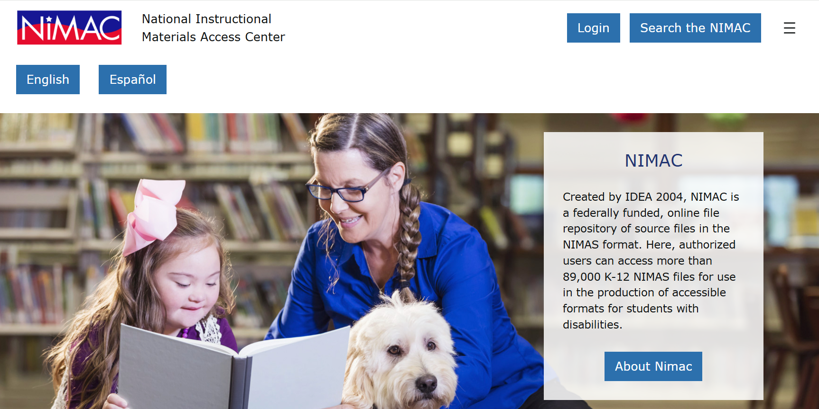
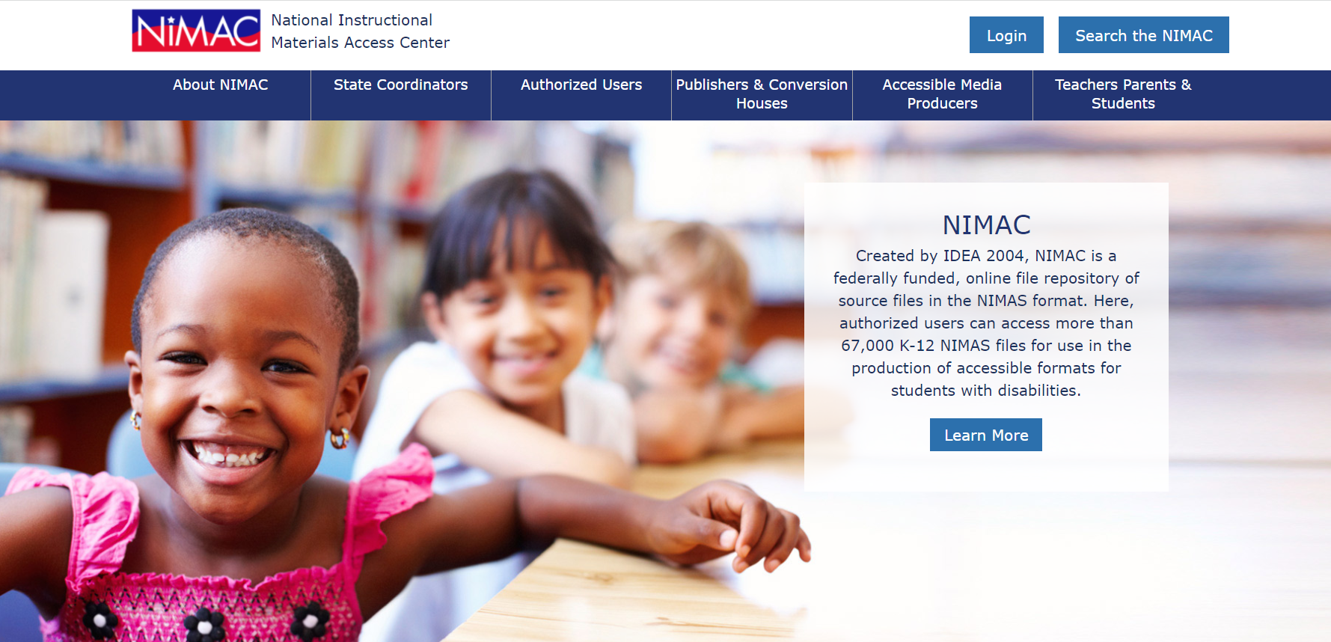
NIMAC Website

Slide 50
Live Demo: Your Account

Slide 51

Questions?
Don’t hesitate to get in touch with us for assistance:
nimac@aph.org
877-526-4622
The contents of this resource was developed under a grant from the US Department of Education, #H327E210001. However, these contents do not necessarily represent the policy of the US Department of Education, and the reader should not assume endorsement by the Federal Government. Project Officer: Rebecca Sheffield.

