Slide 1
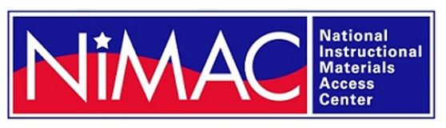
The NIMAC for AUs:
Basics, Updates, and a Demo
Liz Schaller, NIMAC Director
eschaller@aph.org
Alexa Miller, NIMAC Librarian
amiller@aph.org
April 2026

Slide 2
Today’s Webinar
Part 1: PowerPoint
  NIMAC Basics
  NIMAS and Procurement
  Services & System Features for AUs
  Working with NIMAS
Part 2: Live Demo!
  Searching and Downloading
  Assigning Files to an AMP
  Using the Watchlist
  Publisher & AMP Contact Information
  Adding temporary sub users
  Reports

Slide 3
Learning Objectives
Understand the requirements for NIMAS eligibility
Learn how to download NIMAS files
Learn how to assign NIMAS files
Understand how to utilize the Watchlist Service

Slide 4
NIMAC: The Basics

Slide 5
The NIMAC Project
  Created by IDEA 2004, the NIMAC is the national source file repository for K-12 textbooks and instructional materials.
  We make NIMAS files available for use in producing accessible formats for K-12 instructional materials.
  We have received over 90,000 file sets from over 200 publishers.
  All 50 States, the eligible territories, and the DoDEA work with the NIMAC.

Slide 6
What is NIMAS?
  “NIMAS” means the National Instructional Materials Accessibility Standard.
  Under IDEA, this is the only file format the NIMAC is allowed to receive.
  NIMAS is an XML-based source file format used to produce accessible formats such as braille, DAISY, EPUB, and large print.
  It is not distributed directly to students.
  Because NIMAS is not generated as a part of print or digital book production, it can take several weeks for it to be produced.

Slide 7
How we get files
  Under IDEA 2004, the only mechanism to require NIMAS from the publisher is the book adoption contract or purchase agreement.
  There is no blanket requirement for publishers to submit files to the NIMAC.
  States and districts have been able to require NIMAS when they purchase new textbooks since July of 2006.
  Ideally, when NIMAS is included in contracts, a file will already be available when a need is identified.

Slide 8
Types of materials we receive
  NIMAC receives a wide range of student-facing instructional materials.
  These include textbooks, workbooks, supplementary readers, and ancillary materials such as blackline masters.
  Exempt materials include teacher’s editions, pre-2006 titles, trade books, college textbooks, reference books.
  We can also now accept NIMAS files for some digital instructional materials.

Slide 9
What is an Authorized User?
An Authorized User is someone who has been designated by their State Coordinator to have an account that provides full access to the NIMAC repository.
These individuals are generally from within the educational structure of the State, such as from an IRC or State department of education.
In some States, the State Coordinator also functions as an Authorized User. We identify these individuals as “hybrid” State Coordinators.

Slide 10
Authorized Users & AMPs
  As an Authorized User, you can search and download files from the NIMAC.
  You can also assign files for download by registered Accessible Media Producers (AMPs).
  AMP accounts are freely available but provide more limited access to the repository.
  We’ll cover assigning files to AMPs in the demo.

Slide 11
NIMAS and Procurement

Slide 12
NIMAS in Procurement Contracts
  Under IDEA 2004, there was no blanket requirement for publishers to submit files to the NIMAC.
  The only mechanism to require NIMAS from the publisher is the book adoption contract or purchase agreement.
  Including NIMAS language in all SEA and LEA contracts is essential to ensuring that the NIMAC will receive the files students need.

Slide 13
Requiring NIMAS from publishers is a legal obligation
All states and all districts that coordinate with the NIMAC are obligated under IDEA to require publishers to submit files to the NIMAC as a part of any instructional materials adoption process or contract.
This is a requirement under the legislation and not optional.

Slide 14
Sample Contract Language from NCADEMI
“By agreeing to deliver the materials marked with “NIMAS” on this contract or purchase order, the publisher agrees to prepare and submit on or before [month/day/year] a NIMAS fileset to the NIMAC that complies with the terms and procedures set forth by the National Instructional Materials Access Center (NIMAC) (IDEA Title I, Part D, sec. 674(e)).
The publisher also agrees to mark up materials eligible for NIMAS submission that contain mathematical and scientific instructional content by using the MathML modular extension of the DAISY/NIMAS Structure Guidelines , as posted and maintained at the DAISY Consortium website [refer to the latest applicable version].
Should the vendor be a distributor of the materials and not the publisher, the distributor agrees to immediately notify the publisher of its obligation to submit NIMAS filesets of the purchased materials to the NIMAC. The files will be used for the production of accessible formats as permitted under the law for eligible students [IDEA Title I, Part B, sec. 612(a)].”

Slide 15
NIMAC Case Study on Timely Delivery of Accessible Materials

Slide 16
NIMAC Case Study
In 2025, the NIMAC worked with True North Evaluation on a case study on timely delivery of accessible formats.
Data collection focused primarily on three states–Ohio, Oregon, and Utah–while a few surveys and focus groups targeted a wider, national audience.
The case study sought to address two key questions:
  What are the positive benefits to timely delivery of newly created accessible instructional materials when NIMAS files for the materials are already in the NIMAC system?
  What practices, including procurement contracts, facilitate the timely delivery of accessible instructional materials?

Slide 17
Case Study Report
The full report, which you are welcome to share with colleagues, is now available on the NIMAC website: Case Study Report (PDF) and Case Study Report (Accessible Word)
The NIMAC will be developing a condensed report with key takeaways as well. We will share that out with you!
The NIMAC is using feedback and recommendations from the case study to improve our technical assistance efforts.
Please don’t hesitate to reach out if you have any questions about the case study, or suggestions for implementing recommendations.

Slide 18
Working with NIMAS

Slide 19
Duxbury and Braille 2000 Training Series
This summer, the NIMAC will be offering two free, 6-part webinar series on textbook transcription from start to finish.
One series will be focused on working with Braille 2000 and BrailleBlaster, and the other series will be focused on workflows for NIMAS in NimPro and Duxbury.
Both series will be archived on our website.
The Duxbury webinars will be offered May 28th-July 1st. Register here!
The Braille 2000 webinars will be offered June 16th–July 21st. Register here!

Slide 20
Large Print Templates and Macros for Word
In conjunction with OCALI’s AT&AEM Center, the NIMAC offered a training on large print templates and macros developed by the AT&AEM Center that will assist a user in converting NIMAS files to large print more easily.
The Large Print templates and macros are downloadable from the training link.
Please reach out to OCALI if you have any questions about getting started.

Slide 21
Free EPUB Conversion Tool
The DAISY Pipeline 2 is a free tool from the international DAISY Consortium that provides a way to quickly convert digital files from one format into another.
One valuable conversion available to NIMAC users is the conversion of “DTBook” (NIMAS files) into EPUB.
The EPUB files can then be provided to your student to access using their preferred EPUB reader.
Use this link to download the most recent App version (Windows or Mac)

Slide 22
NIMAS to EPUB Conversion
When you go in to convert a file, please select the following menu options:
  Script: DTBook to EPUB
  Select the NIMAS XML file you want to convert
  Select “No Validation”
  Check the NIMAS input box
  Then run the conversion!
We have a brief how-to video to demonstrate the conversion
If you have any issues with getting started, please reach out to nimac@aph.org and we can assist.

Slide 23
Braille 2000 and Duxbury User Groups
The NIMAC offers two braille software user groups for transcribers who work with NIMAS.
These quarterly virtual meetings are facilitated by experienced transcribers.
Please reach out to nimac@aph.org for more information!

Slide 24
System Features and
Services for AUs

Slide 25
The Watchlist Research &
Expedite Service
  If a file you need is not available in the NIMAC, you may not be certain if it “should” be in the NIMAC or not.
  AU accounts have a built-in system feature where you can add the ISBN of a needed title to your Watchlist.
  NIMAC will research the item for you and try to obtain NIMAS for the title, if the material is within scope for the repository.

Slide 26
Watchlist Research
  If the title is within scope for NIMAS (i.e., not in an exempt category), we will request the file from the publisher.
  If the file is already in production, we may be able to expedite it for you.
  When the requested item becomes available in the NIMAC, you will receive an automated system email to let you know.
  If the file is outside of scope, we will research other accessibility alternatives and provide that information to you.

Slide 27
Side Note: Email Notifications
  The NIMAC system generates emails:
    when a Watchlist item becomes available
    when a sub user account is expiring
    when a download request has been processed and is ready (if you’ve selected this option)
  These emails show as sent by: noreply-NIMAC@overdrive.com
  Adding this address to your email contacts may prevent them from being filtered as spam.
  Contact us if you need further help.

Slide 28
MathML and NIMAS
MathML is optional XML markup for math and scientific notation.
The benefit of MathML is that, when software supports it, it can be used to automatically generate braille or other formats.
In the past, math was most often provided in NIMAS as images, which cannot automatically be converted into braille.

Slide 29
No MathML Download
Many publishers now provide MathML in their NIMAS files--however, not all software supports MathML.
If a NIMAS file includes MathML but your software does not support it, you can choose to download the file without MathML.
We will show you this download option during the demo.

Slide 30
Does the file include MathML?
The NIMAC system will only show a “No MathML” download option if MathML is present in the file.
This is one easy way to know whether a file contains MathML.
There are also two other ways: looking at the system record or the XML file.

Slide 31
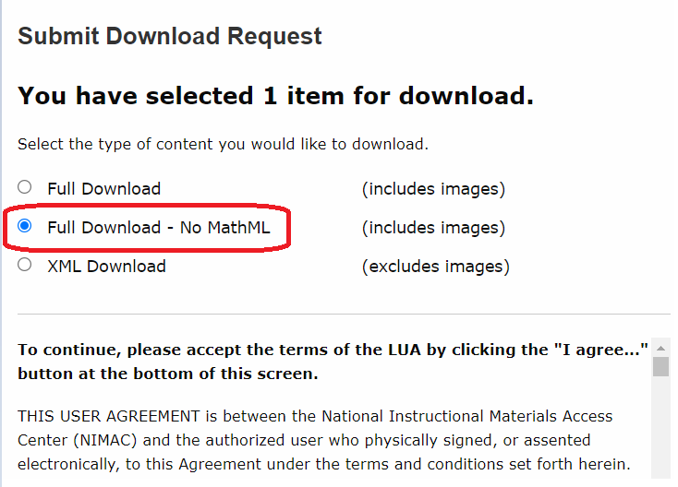
1. No MathML Download Option

Slide 32
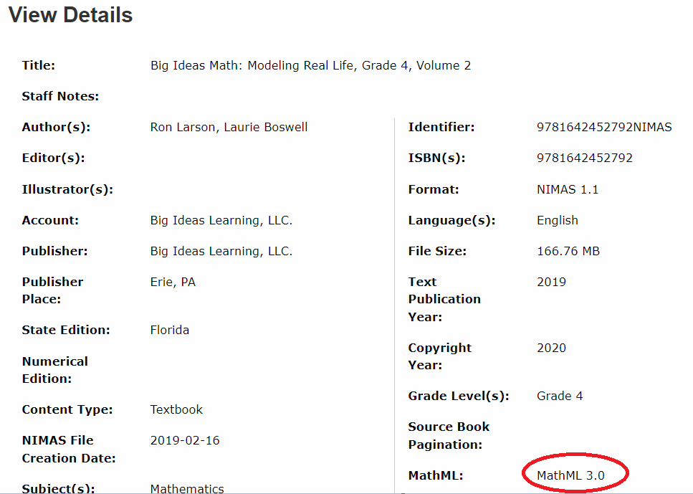
2. MathML in the system record

Slide 33
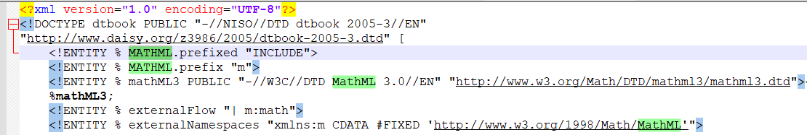
3. MathML is mentioned at the top of the XML file

Slide 34
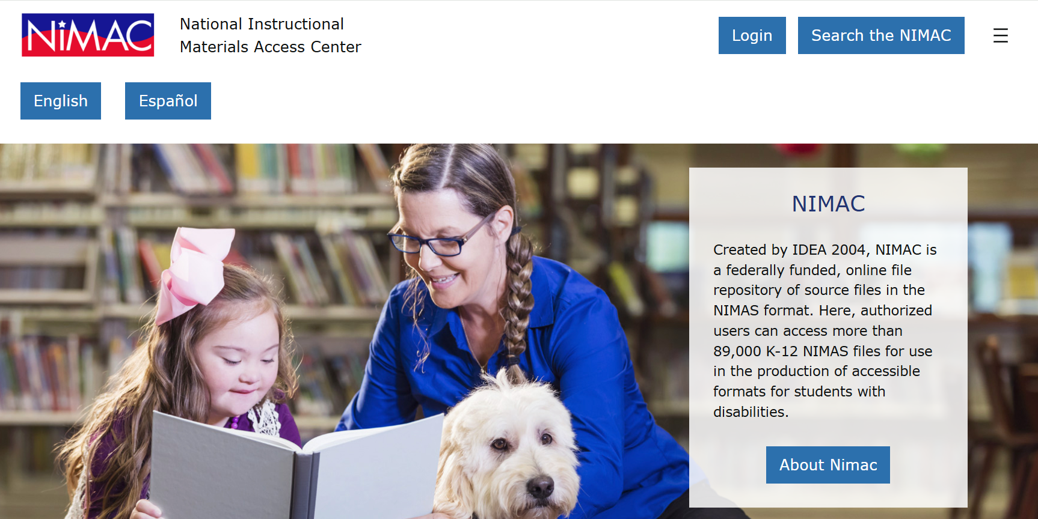
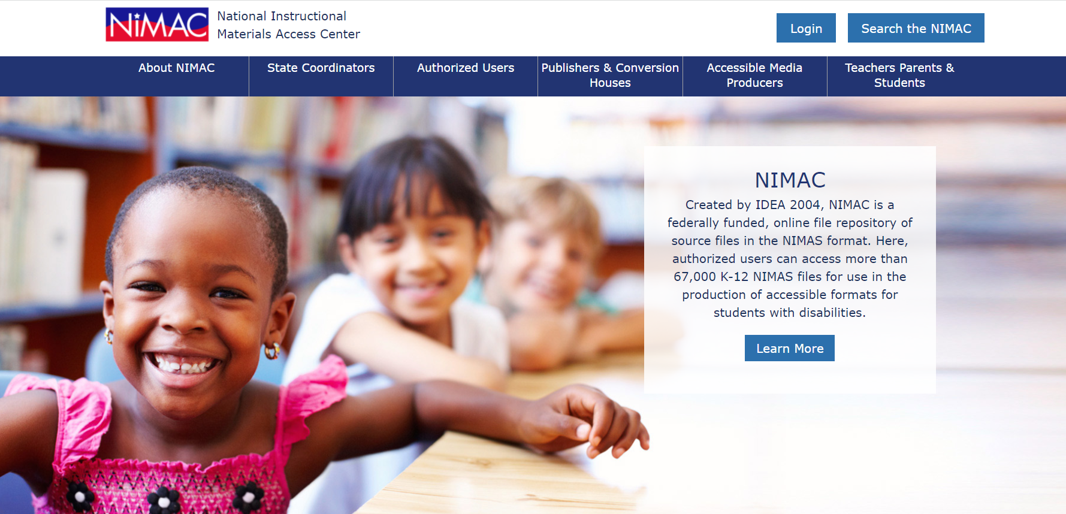
NIMAC Website

Slide 35
Live Demo: Your AU Account

Slide 36
What we’ll cover!
Basics
  Searching
  Downloading
  Assigning Files to an AMP
Additional System Features
  The Watchlist
  Publisher & AMP Contact Information
  Adding sub users
  Reports

Slide 37

Questions?
Don’t hesitate to get in touch with us for assistance:
nimac@aph.org
877-526-4622
The contents of this resource was developed under a grant from the US Department of Education, #H327E210001. However, these contents do not necessarily represent the policy of the US Department of Education, and the reader should not assume endorsement by the Federal Government. Project Officer: Rebecca Sheffield.

