Slide 1

The NIMAC for AMPs:
Basics, Updates, and a Demo
Liz Schaller, NIMAC Director
eschaller@aph.org
Alexa Miller, NIMAC Librarian
amiller@aph.org
April 2026

Slide 2
Today’s Webinar
Part 1: PowerPoint
  NIMAC Basics and File Assignments
  NIMAC Case Study
  Services & System Features for AMPs
Part 2: Live Demo!
  Your Account Information & Sub Users
  Publisher Contact Information
  Reports
  Using the Watchlist
  Downloading & Managing File Assignments
  Searching

Slide 3
Learning Objectives
Understand how to download NIMAS files
Learn how to use the NIMAC Watchlist Service

Slide 4
NIMAC: The Basics

Slide 5
The NIMAC Project
  Created by IDEA 2004, the NIMAC is the national source file repository for K-12 textbooks and instructional materials.
  We make NIMAS files available for use in producing accessible formats for K-12 instructional materials.
  We have over 90,000 file sets from over 200 publishers.
  All 50 states plus 6 outlying areas and the DoDEA work with the NIMAC.

Slide 6
What is NIMAS?
  NIMAS is the National Instructional Materials Accessibility Standard.
  An XML-based source file format.
  Designed for use in producing formats such as braille, DAISY, EPUB, large print.
  It is not intended for distribution directly to students.
  NIMAS is the only format we receive.
  NIMAS is not a “by-product” of print or digital book production—it can take up to six weeks or more for NIMAS to be produced.

Slide 7
How we get files
  Under IDEA 2004, the only mechanism to require NIMAS from the publisher is the book adoption contract or purchase agreement.
  There is no blanket requirement for publishers to submit files to the NIMAC.
  States and districts have been able to require NIMAS when they purchase new textbooks since 2006.
  Ideally, when NIMAS is included in contracts, a file will already be available when a need is identified.

Slide 8
Types of materials we receive
  NIMAC receives a wide range of student-facing instructional materials.
  These include textbooks, workbooks, supplementary readers, and ancillary materials such as blackline masters.
  Exempt materials include teacher’s editions, pre-2006 titles, trade books, college textbooks, reference books.
  We can also accept NIMAS files for some digital instructional materials.

Slide 9
What is an Authorized User?
An Authorized User is someone who has been designated by their State Coordinator to have an account that provides full access to the NIMAC repository.
They can search and download files or assign files to registered Accessible Media Producers (AMPs).
These individuals are generally from within the educational structure of the state, such as from an IRC or State department of education.

Slide 10
What is an AMP account?
An Accessible Media Producer (AMP) account allows the user to download any file assigned to them by an Authorized User.
These accounts are freely available to any organization or individual who can work with NIMAS to produce accessible formats for K-12 students with print disabilities.
These users do not have to be designated by a State Coordinator, but they have more limited access to download files.

Slide 11
Should I be an AU?
If you need direct access to download files from the system, it may be appropriate for you to be designated as an Authorized User for a given State.
To become an AU, you need to be a part of the educational structure of the state, or a non-profit that qualifies as an “authorized entity” under Chafee.
Feel free to contact the NIMAC if you have questions or would like more information.

Slide 12
Side Note: the APH AMP Directory
AMP information in the NIMAC is not public.
Only AUs that are logged into the NIMAC system can view information about AMPs.
If you are interested in sharing information publicly about the services you offer, we invite you to participate in the Accessible Media Producers Directory.
This searchable online directory is a free service of APH (separate from the NIMAC).
Contact resource@aph.org for more information!

Slide 13
NIMAS File Assignment

Slide 14
File Assignment
Once you have an active AMP account, any Authorized User in any State can assign you files for download.
If you are working on a project for a State or district and need help locating an AU in that state to assign you the NIMAS file, just let us know.

Slide 15
Email Notification
Whenever you are assigned a file by an Authorized User, the system will send an automated email to let you know that the file is available for download in your queue.
The notification will let you know what item has been assigned, what accessible format is being requested, and what user made the assignment.

Slide 16
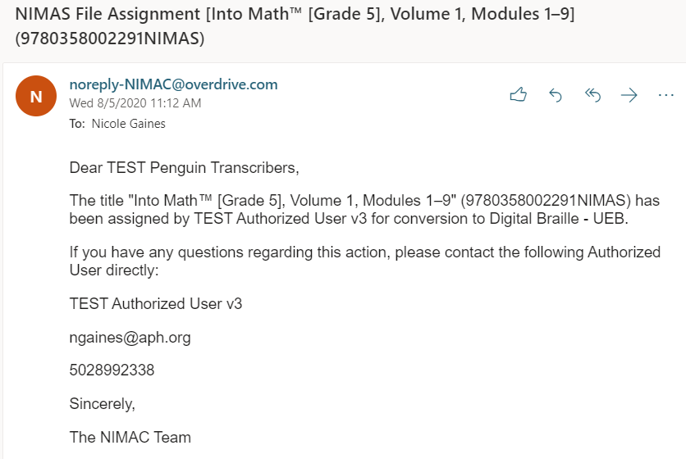
Example of File Assignment Email

Slide 17
Spam Filter Heads Up
All automated emails from the NIMAC will show as the sender noreply-NIMAC@overdrive.com.
Some email systems will filter out automated emails unless you “whitelist” the sender.
If you encounter any issues receiving emails, please add this address to your contacts.
You may need to get help from your IT administrator if network restrictions prevent system emails from getting through.
Contact the NIMAC for further assistance.

Slide 18
Choosing Format Capabilities
Format capabilities are selected when a new AMP completes the online registration for a NIMAC account.
This information is provided as a convenience for AMPs and the Authorized Users who are assigning them files.
If a file assignment is not expected or does not seem correct, reach out to the AU for more information.
If the format selected by the AU is not correct, but the file assignment was intentional, you can still download the file and produce the needed format(s).
However, if you receive a file assignment by mistake, the AU should log in and remove the file assignment.

Slide 19
Updating Format Capabilities
Format capabilities can be viewed and updated at any time by going to User Information → My Account.
We recommend that you review your format capabilities at least once a year.
Formats should be updated whenever needed to reflect changes in what you produce.

Slide 20
Current Format Capability Options
Audio
DAISY Audio
DAISY Text
Digital Braille - UEB
Digital Braille - UEB with Nemeth
Embossed Braille - UEB
Embossed Braille - UEB with Nemeth
Large Print
PDF
EPUB
Other

Slide 21
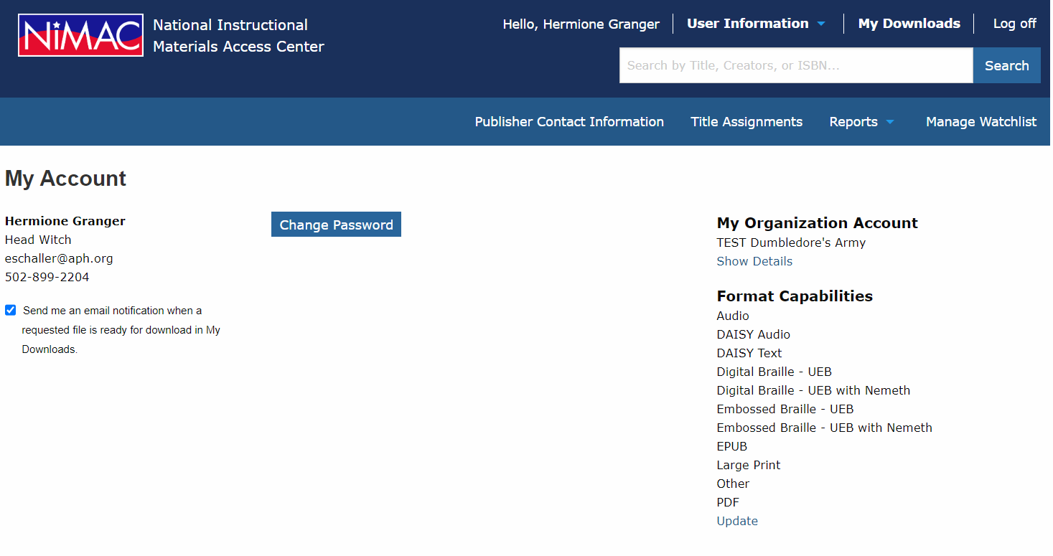
AMP Format Capabilities

Slide 22
NIMAC Case Study on Timely Delivery of Accessible Materials

Slide 23
NIMAC Case Study
In 2025, the NIMAC worked with True North Evaluation on a case study on timely delivery of accessible formats.
Data collection focused primarily on three States–Ohio, Oregon, and Utah–while a few surveys and focus groups targeted a wider, national audience.
The case study sought to address two key questions:
  What are the positive benefits to timely delivery of newly created accessible instructional materials when NIMAS files for the materials are already in the NIMAC system?
  What practices, including procurement contracts, facilitate the timely delivery of accessible instructional materials?

Slide 24
Case Study Report
The full report, which you are welcome to share with colleagues, is now available on the NIMAC website: Case Study Report (PDF) and Case Study Report (Accessible Word)
The NIMAC will be developing a condensed report with key takeaways as well. We will share that out with you!
The NIMAC is using feedback and recommendations from the case study to improve our technical assistance efforts.
Please don’t hesitate to reach out if you have any questions about the case study, or suggestions for implementing recommendations.

Slide 25
Working with NIMAS Files

Slide 26
Duxbury and Braille 2000 Training Series
This summer, the NIMAC will be offering two free, 6-part webinar series on textbook transcription from start to finish.
One series will be focused on working with Braille 2000 and BrailleBlaster, and the other series will be focused on workflows for NIMAS in NimPro and Duxbury.
Both series will be archived on our website.
The Duxbury webinars will be offered May 28th-July 1st. Register here!
The Braille 2000 webinars will be offered June 16th–July 21st. Register here!

Slide 27
Large Print Templates and Macros for Word
In conjunction with OCALI’s AT&AEM Center, the NIMAC offered a training on large print templates and macros developed by the AT&AEM Center that will assist a user in converting NIMAS files to large print more easily.
The Large Print templates and macros are downloadable from the training link
Please reach out to OCALI if you have any questions about getting started

Slide 28
Free EPUB Conversion Tool
The DAISY Consortium NIMAS to EPUB conversion tool is a free tool for quickly converting NIMAS files to EPUB, which can be provided to your student using their preferred EPUB reader.
Use this link to download the most recent App version (Windows or Mac)

Slide 29
NIMAS to EPUB Conversion
When you go in to convert a file, please select the following menu options:
  Script: DTBook to EPUB
  Select the NIMAS XML file you want to convert
  Select “No Validation”
  Check the NIMAS input box
  Then run the conversion!
We have a brief how-to video to demonstrate the conversion
If you have any issues with getting started, please reach out to nimac@aph.org and we can assist.

Slide 30
Braille 2000 and Duxbury User Groups
The NIMAC offers two braille software user groups for transcribers who work with NIMAS.
These quarterly virtual meetings are facilitated by experienced transcribers.
Please reach out to nimac@aph.org for more information!

Slide 31
System Features and
Services for AMPs

Slide 32
The Watchlist Research &
Expedite Service
  If a file you need is not available in the NIMAC, you probably will not have a way to know if it “should” be in the NIMAC or not.
  AMP accounts now have a built-in system feature where you can add the ISBN to your Watchlist.
  NIMAC will research the item for you and try to obtain NIMAS for the title.

Slide 33
Watchlist Research
  If the title is within scope for NIMAS (i.e., not in an exempt category), we will request the file from the publisher.
  If the file is already in production, we may be able to expedite it for you.
  If the file is outside of scope, we will research other accessibility alternatives and provide that information to you.
  When the Watchlist file is available in the NIMAC, you will receive an automated email to let you know.

Slide 34
MathML and NIMAS
MathML is optional XML markup for math and scientific notation.
The benefit of MathML is that, when software supports it, it can be used to automatically generate braille or other formats.
In the past, math was most often provided in NIMAS as images, which cannot automatically be converted into braille.

Slide 35
No MathML Download
Many publishers now provide MathML in their NIMAS files--however, not all software supports MathML.
If a NIMAS file includes MathML, but your software does not support MathML, you can choose to download the file without MathML.
We will show you this download option during the demo.

Slide 36
Does the file include MathML?
The NIMAC system will only show a “No MathML” download option if MathML is present in the file.
This is one easy way to know whether a file contains MathML.
There are also two other ways: looking at the system record or the XML file.

Slide 37
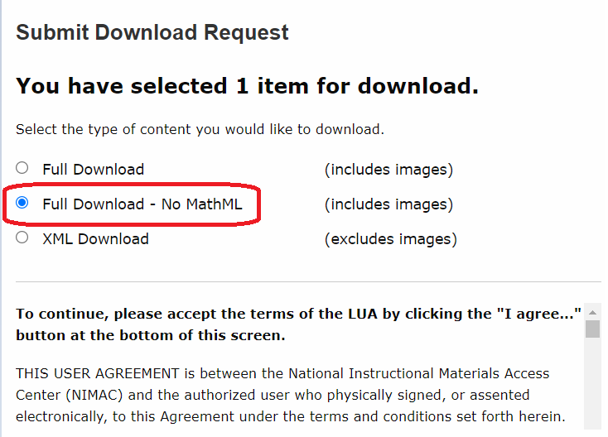
1. “No MathML” shows as a download option

Slide 38
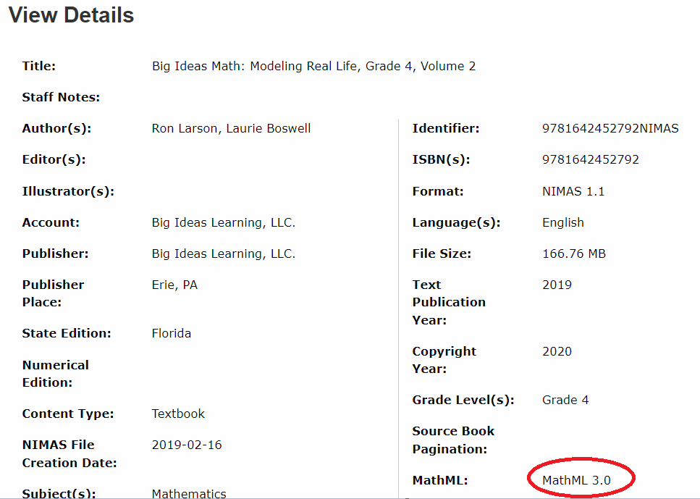
2. MathML in the system record

Slide 39
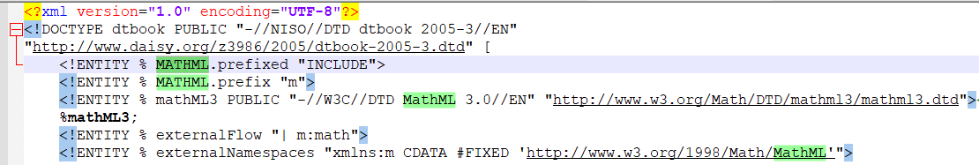
3. MathML is mentioned at the very top of the XML file

Slide 40
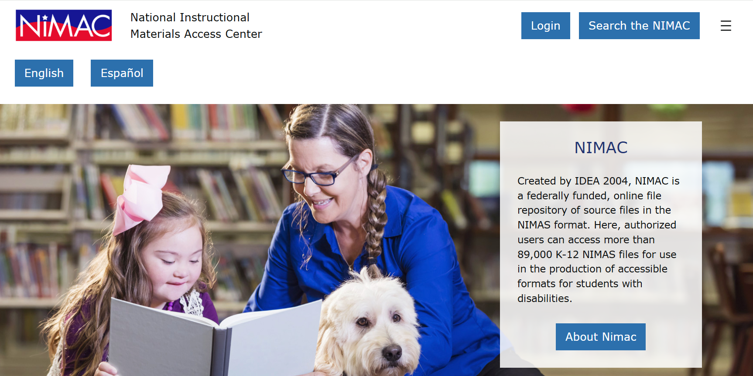
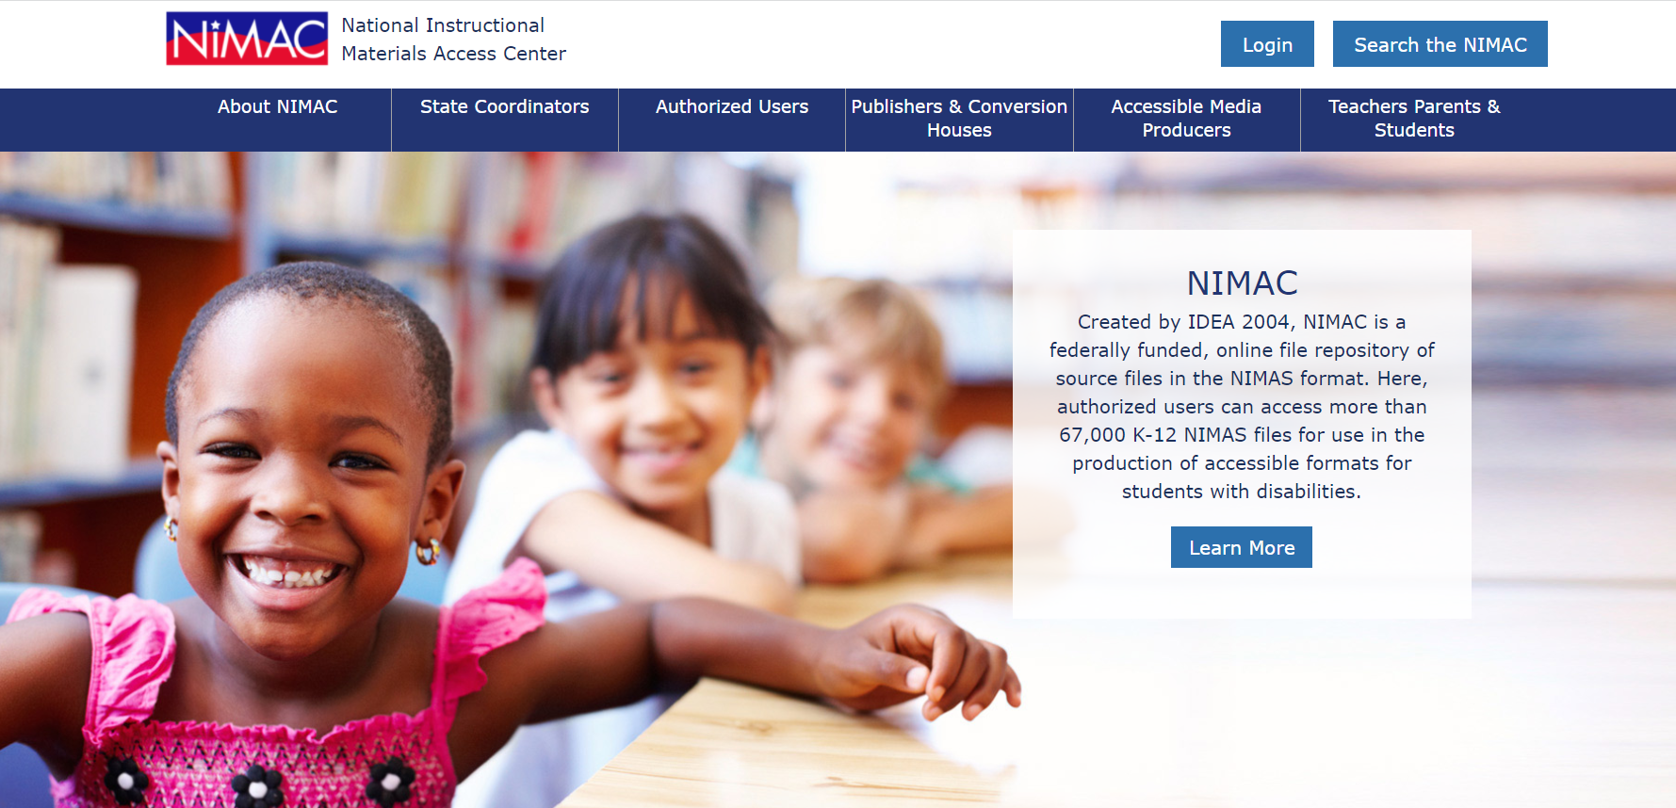
NIMAC Website

Slide 41
Live Demo: Your AMP Account

Slide 42
Demo!
  Your Account Information & Sub Users
  Publisher Contact Information
  Reports
  Using the Watchlist
  Downloading & Managing File Assignments
  Searching

Slide 43

Questions?
Don’t hesitate to get in touch with us for assistance:
nimac@aph.org
877-526-4622
The contents of this resource was developed under a grant from the US Department of Education, #H327E210001. However, these contents do not necessarily represent the policy of the US Department of Education, and the reader should not assume endorsement by the Federal Government. Project Officer: Rebecca Sheffield.

