Slide 1

NIMAC for Publishers and Vendors:
Basics & File Submission
Nicole Gaines, NIMAC Project Director
ngaines@aph.org
Liz Schaller, NIMAC Manager
eschaller@aph.org
June 2025

Slide 2
Today’s Webinar
Part 1: PowerPoint
  NIMAC basics
  Publisher accounts overview
  File validation & submission
  NIMAC file certification process
Part 2: Live Demo
  Manually adding/replacing NIMAS files
  Creating additional user accounts
  Generating reports (optional feature)

Slide 3
Mark your calendar!
For a more in-depth look at the technical side of creating NIMAS files, please join us for Part 2 of this series, NIMAS File Creation: Resources & Best Practices. Part 2 will be offered twice: Tuesday, July 8, 2pm ET and Wednesday, July 9, 9am ET.
For guidance on how to assist customers looking for accessible formats, please join us for the third webinar in our series, NIMAC/NIMAS and How to Assist Your Customers Looking for Accessible Formats. This will be held Tuesday, July 22 at 2pm ET.

Slide 4
NIMAC: The Basics

Slide 5
The NIMAC Project
  Created by IDEA 2004, the National Instructional Materials Access Center is the national source file repository for K-12 textbooks and core instructional materials.
  We make NIMAS files available to states for use in producing accessible formats (such as braille) for qualifying students in K-12.
  Files in the NIMAC are not distributed directly to students.

Slide 6
The NIMAC: Key Dates & Numbers
  The NIMAC has been in continuous operation since opening in December of 2006.
  States and districts have been able to require NIMAS in their instructional materials contracts since July of 2006.
  To date, we have received over 83,000 file sets from over 200 publishers.
  Over 57,000 files have been downloaded for use in producing accessible formats for students with disabilities.

Slide 7
States and the NIMAC
IDEA does not require that states work with the NIMAC, but all 50 states, the six eligible territories, and DoDEA have chosen to do so.
States and districts that coordinate are legally obligated to:
  require NIMAS from publishers in their textbook adoption contracts; and
  abide by the eligibility requirements of IDEA and copyright law in the use of NIMAS files.
States are also required to designate and manage a small number of Authorized Users for their state.

Slide 8
States & Authorized Users
Each State Education Agency (SEA) that coordinates names a NIMAC State Coordinator.
This individual is responsible for designating and managing the state’s Authorized Users (AUs).
These individuals receive login credentials to access the repository and download files.
AUs may also assign files for download to registered Accessible Media Producers working on behalf of the state.

Slide 9
Student Eligibility
IDEA 2004 defines the eligibility requirements for receiving materials produced from NIMAS.
To qualify, students must be in elementary or secondary education and have:
  a qualifying disability per the eligibility guidelines of the National Library Service for the Blind and Print Disabled (NLS) and
  an Individualized Education Program (IEP).
NIMAC is not involved in determining eligibility for individual students.

Slide 10
The NIMAS Specification
  NIMAS is the National Instructional Materials Accessibility Standard.
  It is an XML-based source file format based on the DAISY standard.
  It is designed for use in producing formats such as braille, DAISY, EPUB, and large print.
  It is not intended for distribution directly to students.
  NIMAS is the only format the NIMAC can receive.

Slide 11
Materials within Scope for NIMAS
Under IDEA, the materials within scope for the NIMAC include:
  “printed textbooks and related printed core materials that are
  written and published primarily for use in elementary school and secondary school instruction and
  required by a state education agency (SEA) or local education agency (LEA)
  for use by students in the classroom.”

Slide 12
Range of Materials Received
Neither the U.S. Department of Education nor the NIMAC imposes a definition of “core.”
The NIMAC accepts a range of student-facing materials, including:
  Textbooks
  Workbooks
  Supplementary readers
  Ancillary materials (e.g., blackline masters).

Slide 13
Materials not within Scope for NIMAS
Materials that the NIMAC does not generally receive include:
    Trade books (such as novels)
    College textbooks
    Reference books
    Materials published before 2006
    Teacher’s editions of textbooks and ancillaries for the exclusive use of the teacher

Slide 14
The “Notice of Interpretation” (NOI) on Digital Materials & NIMAS
In May of 2020, the Department published a Notice of Interpretation (NOI) clarifying that IDEA permits the NIMAC to accept NIMAS files for digital instructional materials—when these materials can be supplied in valid NIMAS format.

Slide 15
Digital Materials & NIMAS
The subset of digital instructional materials that are appropriate to submit to the NIMAC includes those that:
  are composed primarily of static text and static images;
  have a linear reading order;
  have minimal or no interactivity; and
  have little or no audiovisual content.
Digital products that are highly interactive or contain significant audiovisual content (e.g., games, software, videos) cannot be converted into NIMAS format.

Slide 16
NIMAS Exemption for WCAG-compliant Digital Materials
The Notice of Interpretation states that digital instructional materials that meet the WCAG 2.0 AA accessibility criteria are exempt from NIMAS.
For more information, please see our FAQ on NIMAS & Digital Materials.

Slide 17
NIMAC Requests to Publishers
States and districts that coordinate with the NIMAC are legally obligated to require NIMAS in their instructional materials contracts.
However, with over 13,000 school districts in the U.S., this does not always happen.
The NIMAC will reach out to publishers to request a file when there is a need to produce braille or another accessible format for an eligible student.
We greatly appreciate publishers’ assistance and support of students in response to these requests.

Slide 18
Side Note: Helping Teachers & Schools Locate Accessible Formats
NIMAS files are only used in the first production of an accessible format.
Once produced, braille and other formats can be reproduced, as needed, to serve additional qualifying students.
If you are helping your customers locate accessible formats for your materials, the best resource is the Louis Database of Accessible Materials.
We are also happy to help your customers locate materials or help them get connected to resources in their state.
If you’d like to learn more, please join us for Part 3 of this webinar series on July 22!

Slide 19
Publisher Accounts &
File Submission

Slide 20
Publisher Accounts: Managing Inventory
NIMAC publisher accounts allow companies to:
  Manually upload new inventory to the NIMAC system (files up to 250 MB each)
  Manually replace inventory
  Search, view, and download their own inventory
  Export inventory reports

Slide 21
Publisher Accounts: Other Functions
These accounts also provide the ability to:
  Create additional user accounts for others at your company or for your conversion vendors
  Download the NIMAC Validation Wizard and the Excel to OPF metadata template
  Generate correctly formatted OPF metadata using the Excel to OPF tool
  Export reports of user downloads for your materials

Slide 22
Submitting NIMAS Files
Part 1: Validation

Slide 23
NIMAC Validation Wizard
In fall 2024, the NIMAC released an update to the validation wizard for publishers and vendors.
As in the past, we ask that publishers/vendors validate all files before submitting or uploading to the NIMAC.
Files that fail automated validation will be rejected for upload by the system and in the batch delivery file processing.

Slide 24
NIMAS Validation
NIMAS validation ensures that the XML is well formed, that referenced images are present, and that the file validates to the NIMAS and MathML DTD (if MathML is present).
The tool also provides feedback related to missing or invalid OPF metadata, and it can also detect some XML tagging errors and provide Best Practices feedback for some issues.
The updated Wizard and the NIMAC portal will now alert you if a file contains MathML, but certain math symbols are detected outside of MathML. This will show up as a Warning in your validation feedback.

Slide 25
How to Use the Tool
The validation wizard is available in Windows and Mac versions.
Once you have installed the tool on your machine, just navigate to the location of the zipped file for the complete NIMAS file set.
Then click the Validate button.
When the validation is complete, the results will display on the screen.
These results can also be exported as a .csv file, if desired.

Slide 26
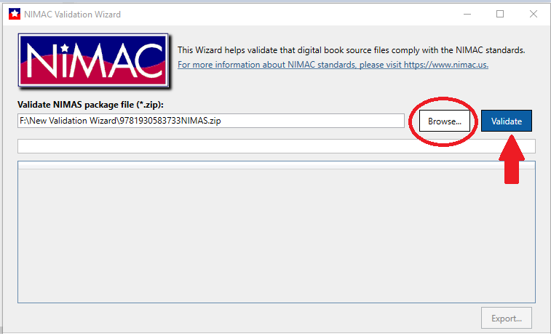
Navigation to the Zipped File

Slide 27
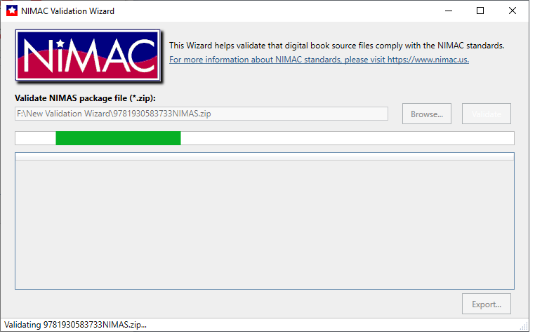
Validation in Progress . . .

Slide 28
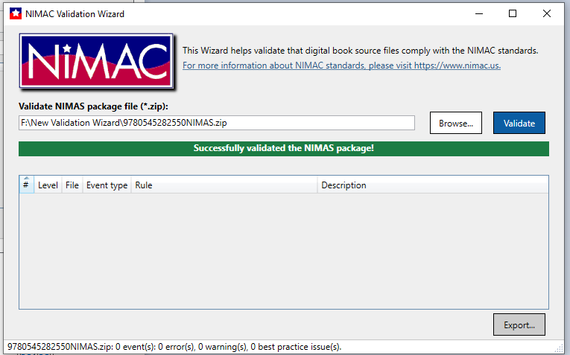
Successful Validation Output

Slide 29
Types of Validation Output
Errors: Must be corrected or file cannot be uploaded to NIMAC system.
Warnings: Correction is recommended but not required for upload. (Further review will be done by NIMAC after upload.)
Best Practice: Information to consider in preparing NIMAS files.

Slide 30
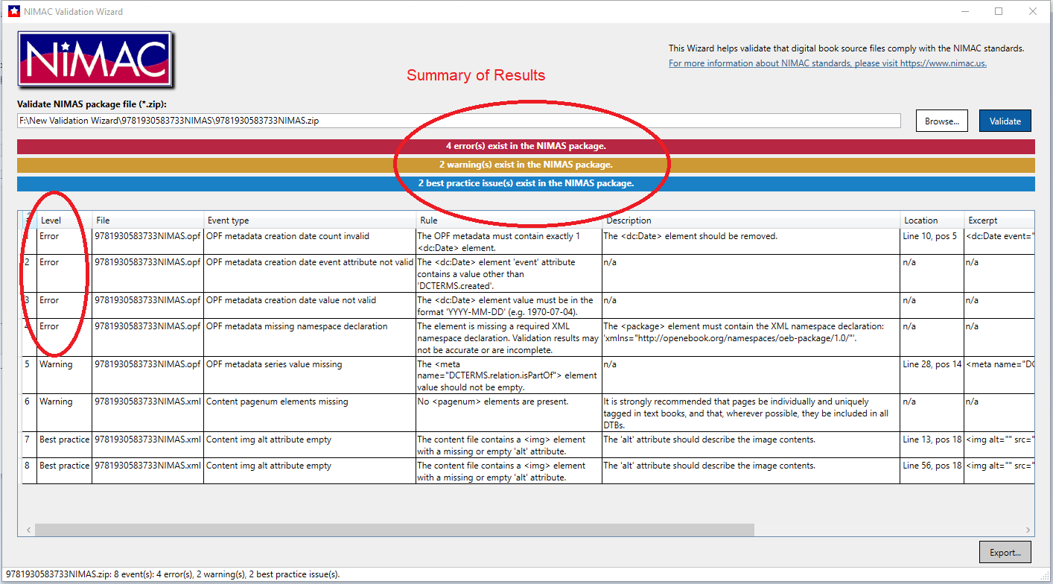
Validation Output Showing Errors

Slide 31
Corrupt Zip Files
Occasionally files will fail upload or batch processing due to the zip files being corrupt.
After zipping your NIMAS file sets, it’s a good idea to check to ensure that the files were not corrupted during the compression process.
Just click on the zip file. If it opens, the file is probably okay and not corrupt.

Slide 32
Submitting NIMAS Files
Part 2: File Delivery

Slide 33
Manual File Delivery

Slide 34
Manual File Upload
Files up to 250 MB each can be manually uploaded to the NIMAC system by logging into your publisher or vendor account.
When you log into your account, your inventory will always be your landing page.
Add Inventory is used to upload a file that has not been previously submitted. (The ISBN is not already in the system.)
Replace Zip File is used to replace the zip if the file has been previously submitted. (The ISBN is already in the NIMAC.)

Slide 35
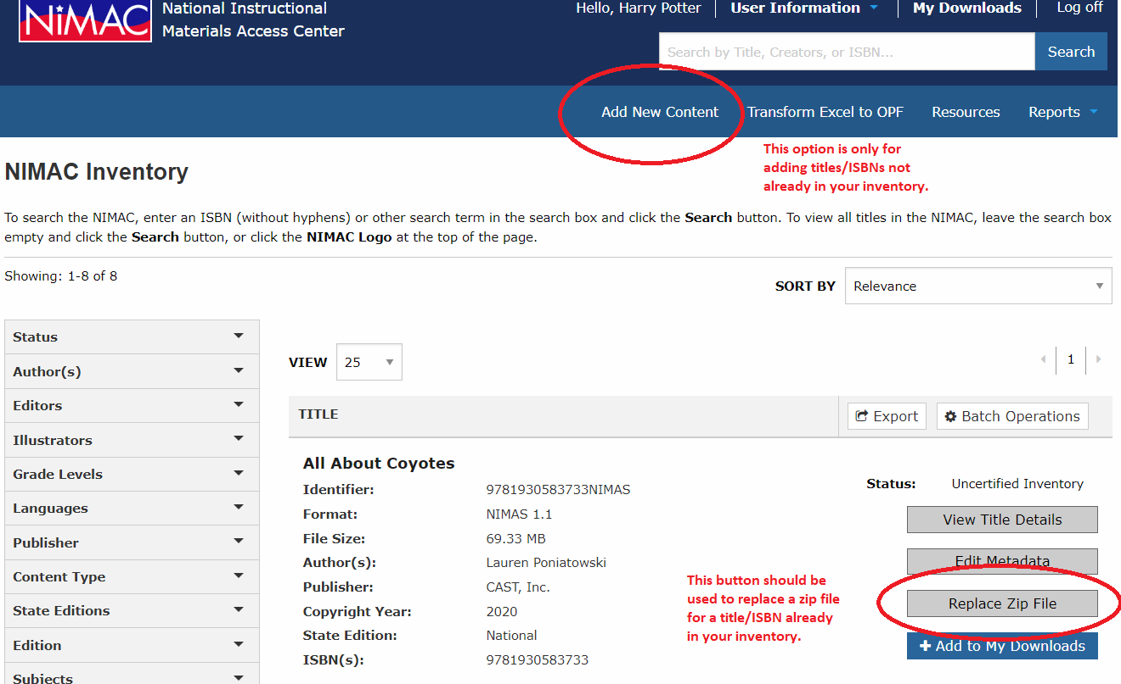
Add New Content vs. Replace Zip File

Slide 36
Manual Upload Process
When files are uploaded, the file first undergoes automated validation.
If the file fails validation, the system will display the errors.
If the file passes, the system will extract the OPF metadata to create a system record and open it up in edit mode.
The record can then be reviewed and edited, if needed. (Any changes made to the record will also be saved to the OPF.)
When the file is saved, it will appear in your Uncertified inventory.

Slide 37
Manual Upload vs. Batch Delivery
Files up to 300 MB each can be manually uploaded to the NIMAC system, but the upload time will be slower the larger the file is.
Due to upload times, you may want to consider delivering files over 250 MB each by FTP.
There is no minimum or maximum file size for submitting files by FTP.
There is also no minimum or maximum number of files that can be delivered at one time.

Slide 38
Batch Delivery (FTP)

Slide 39
Delivering files by FTP
Files that are over 300 MB must be delivered directly to our system vendor, OverDrive, by SFTP.
The host location of the FTP is:
transfer.overdrive.com
If you do not yet have an FTP login, you can request one by emailing OverDrive:
nimac-support@overdrive.com

Slide 40
Requesting FTP Access
In your request, include your NIMAC login ID for the publisher’s account.
If you are a publisher, you will need to create a NIMAC “sub user” account for each conversion vendor that needs to upload files on your behalf.
If you are vendor, you will need a separate NIMAC account and FTP login for each publisher account for whom you wish to submit files.

Slide 41
Important Note: Don’t use folders on the FTP
When placing files on the FTP, put them in the ROOT directory of the FTP only.
Do not move files over in folders. Transfer only the zip files themselves.
The batch process cannot detect files that are delivered inside folders and files inside folders will not be uploaded.
If you have questions or need any further assistance, just let us know.

Slide 42
The Daily Batch Delivery Report

Slide 43
Batch Delivery Report
FTP deliveries are processed overnight (U.S. Eastern time).
The next morning, you will receive an automated report that details the processing results.
This report will go to the email address associated with the FTP login.
If you are a vendor that supplies files for multiple publishers, you will receive a separate report for each publisher.

Slide 44
Side Note: Spam filters
If you are delivering files by FTP but are not seeing the automated email the following morning in your Inbox, please be sure to check your Spam or Junk folder.
You may need to whitelist noreply-NIMAC@overdrive.com or the domain “overdrive.com” to successfully receive the emails.

Slide 45
Reviewing the FTP Report
Please be sure to review all reports you receive.
The daily report is your only notification if an FTP delivery fails.
Important Note: If a vendor’s email address changes, or the vendor contact associated with the FTP account leaves their company, OverDrive will need to update the email address associated with the FTP login or create a new account.
Please contact the NIMAC if you have questions or need further assistance.

Slide 46
Reading the Report
At the top of the report, you will see a summary of the upload results:
If the report shows no failed uploads, you do not need to take any further action.
If the report does show failed uploads, please review the Details column information, correct the issue, and deliver the file again.

Slide 47
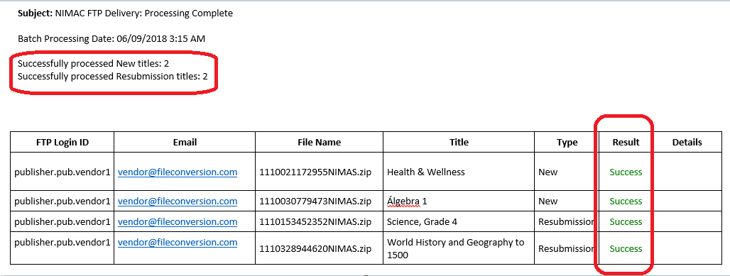
Report showing all uploads successful

Slide 48
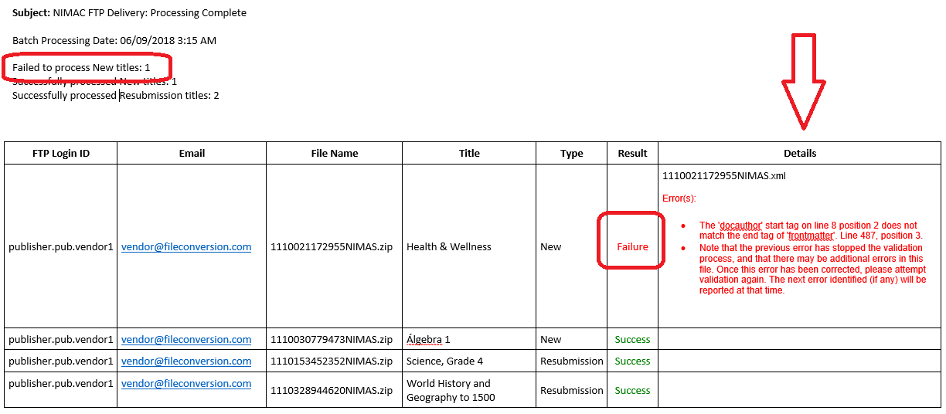
Report including failed upload

Slide 49
Failed uploads
If a delivery fails, the Details column in the daily report will provide the information related to the error that prevented upload.
The daily report is your official notification regarding failed uploads.
If you have any questions about an error on a report, contact the NIMAC.

Slide 50
Uploading Corrected Files
Once you have corrected and resubmitted a file, you do not need to provide any notification to OverDrive or NIMAC.
Just deliver the file(s) again by FTP.
The new delivery will show up on the daily report on the following day.
You will be able to verify at that point that the corrected file uploaded successfully.

Slide 51
Resubmission of Certified Inventory
If a file has already been certified, the system will prevent a user from overwriting the zip file.
If you need to replace a file that is in your Certified inventory, just contact us at nimac@aph.org and we can move the file into Stalled status.

Slide 52
File Review & Certification

Slide 53
NIMAC File Queue
Newly uploaded files appear in Uncertified inventory and are automatically placed in the file review queue.
Files are generally reviewed in the order received, but we are happy to expedite files when there is an immediate need.
If you have a deadline for certification, please let us know at the point of file submission (or in advance, if possible.)

Slide 54
Certificate Numbers
To be accepted into the NIMAC, files must pass automated validation (upon upload) and a manual review by NIMAC staff.
When files are certified, they move into your Certified inventory and the “super user” receives an automated email with the digital certificate number.
You can also add up to three additional email addresses to receive these emails.
The numbers can also be found in the individual system records and in inventory reports exported from your account.

Slide 55
File Review Checks
NIMAC staff review the metadata submitted with the file set to ensure it is correct and complete.
There are some additional checks to the XML to ensure that some required tags (such as page numbers) are present and that common content (e.g., TOC and glossary) are tagged correctly.
If present, alt text will also receive a spot check for quality.
NIMAC does not receive print books and does not do a page-by-page comparison to evaluate the tagging in the XML.

Slide 56
File Feedback
NIMAC staff can make minor metadata corrections in the system at the point of file review (without requiring that files be resubmitted).
However, most XML and other file issues will require vendor correction and resubmission of the file.
When files require correction, staff will send detailed feedback to the individual that uploaded the file.
Files awaiting correction are placed in “Stalled” inventory.

Slide 57
File Review Timeline
The time for a delivery to be reviewed and certified varies depending on the number of files received at a given time and the number of files in the review queue.
When submissions are relatively light, a file may be certified the day it is uploaded to the system.
However, if a delivery is large or many other files are in the queue, it may take 2 weeks or longer.

Slide 58
Certification Deadlines
Publishers: If you have an upcoming contract deadline with a customer, please notify us via email so that we know to expedite your file(s) for review.
The NIMAC is not looped into state or district procurement processes, and we will only know about a file submission deadline if the publisher relays this information to us.

Slide 59
Expediting Certification
We encourage publishers to submit files at least two weeks in advance of a deadline.
This helps ensure that if there are any issues with the files, your vendor will have time to make the needed corrections and resubmit the files, if this is needed.
Files are usually certified in the order received, but we are happy to prioritize files to help a publisher meet a deadline.

Slide 60
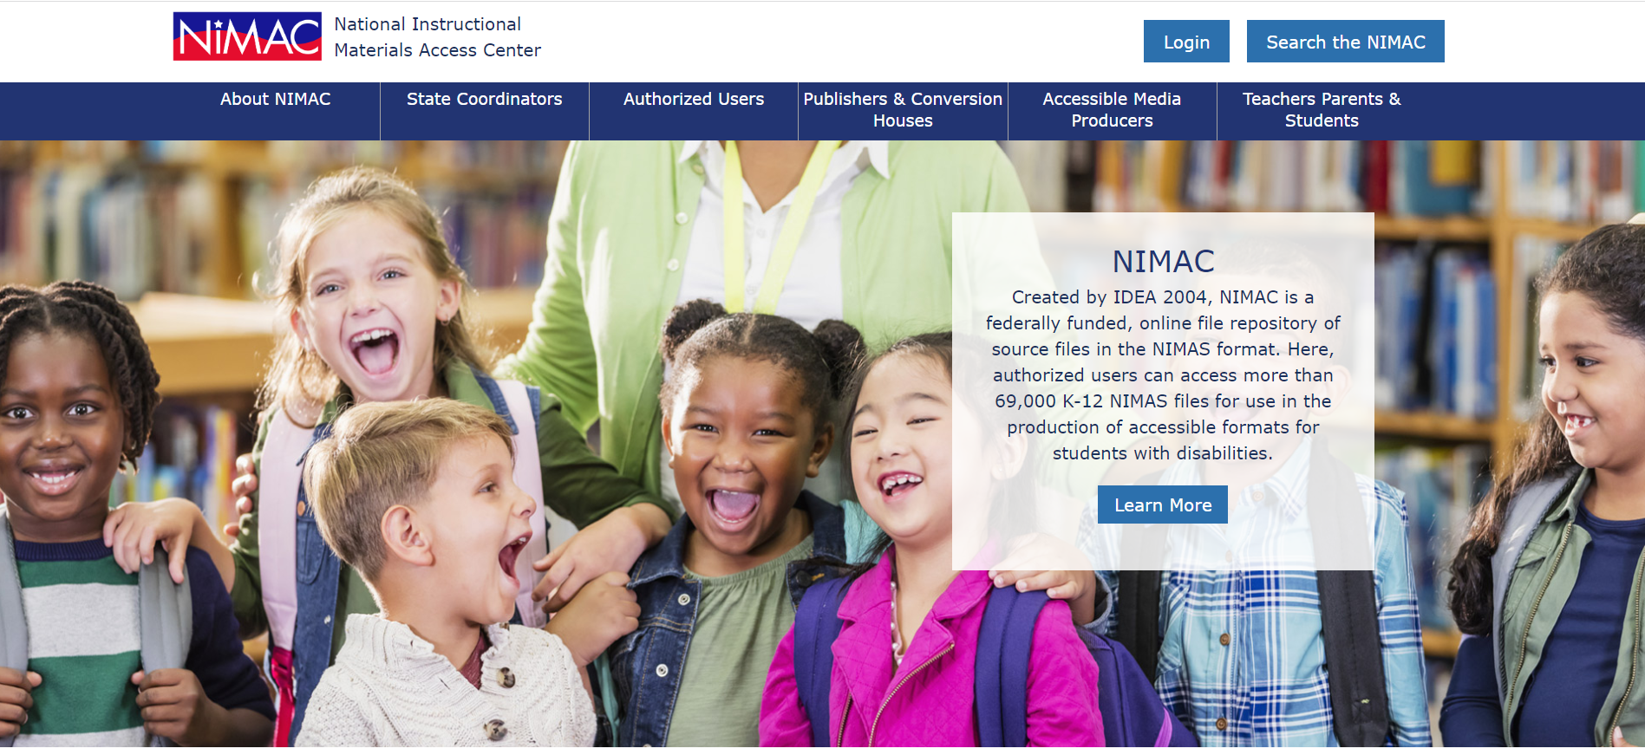
NIMAC Homepage

Slide 61
Live Demo

Slide 62

Questions?
For any questions about the status of files in the NIMAC system, feedback provided by our staff, or anything else, don’t hesitate to get in touch:
nimac@aph.org
877-526-4622
The content of this resource was developed under a grant from the US Department of Education, #H327E210001. However, these contents do not necessarily represent the policy of the US Department of Education, and the reader should not assume endorsement by the Federal Government. Project Officer: Rebecca Sheffield.

